Slide 1
So, you’re a Records Coordinator* . . .
You probably have lots of questions.
What you will be doing? How much time it will take from your real job? Where do you begin?
This PPT is designed to help you with those answers.

Slide 2
What is a Records Coordinator?
Per Administrative Policy 05.04, you were appointed a Records Coordinator by your program management, to assist the Agency Records Office with records management and retention duties of your administration, division, or office.
What does that really mean?
DSHS is too large for one person to manage retention responsibilities for the entire agency. As a part of the DSHS information network, you know your records better than the Agency Records Officer – me* – and I need your help.

Slide 3
* Who am I?
My name is Millie Brombacher and I am the Agency Records Officer appointed by the DSHS Secretary in 2003 to act as the DSHS liaison to the Division of Archives and Records Manager, Office of the Secretary of State, per RCW 40.14.040.
I do exactly what you do except on an agency level.
And, am available to you anytime you need assistance in the records retention world. My email is brombma@dshs.wa.gov and my phone number is 360.664.6048.
I will certainly call you if I need help and turn-about is fair play.

Slide 4
Before we begin. . .
Please complete the following trainings listed on the DSHS Records Retention web page at http://one.dshs.wa.lcl/FS/Loss/Records/Pages/Training.aspx.
Records Management for DSHS Employees, an LMS training required annually for every DSHS employee.
Using the State Records Center, including:
How to Assemble an Archives Box
How to Pack an Archives Box
How to Submit a Box Transmittal Request to the State Records Center
How to Submit a Reference Request to the State Records Center
About Essential Records
Email Retention: What Should I be Doing?

Slide 5
Specifically, our duties are:
Listed in Administrative Policy 05.04, under the policy section, and include, but are not limited to:
Acting as primary contact for DSHS and program records issues.
Reviewing our unique schedules and forwarding revisions.
Identifying essential records and establishing procedures for their protection.
Assisting with records disposition.
Establishing procedures for onsite records destruction.
Assisting with record inventories.
We will discuss and clarify each of the above in the following training.

Slide 6
Acting as primary program contact for program records issues.
I receive daily questions regarding DSHS records belonging to various DSHS administrations, divisions, or programs. Since I don’t know all of your program policies and procedures, I will send them to you for assistance.
You know your records better than I do.
If I route something to you, and you do not know the answer, you and I can discuss the issue; or I can contact State Records Management for a more definitive proposal. You are never alone in this. As I have you to help me, it is a good idea for you to develop a Records Custodian* network to help you.
Please contact me at any time you need assistance.

Slide 7
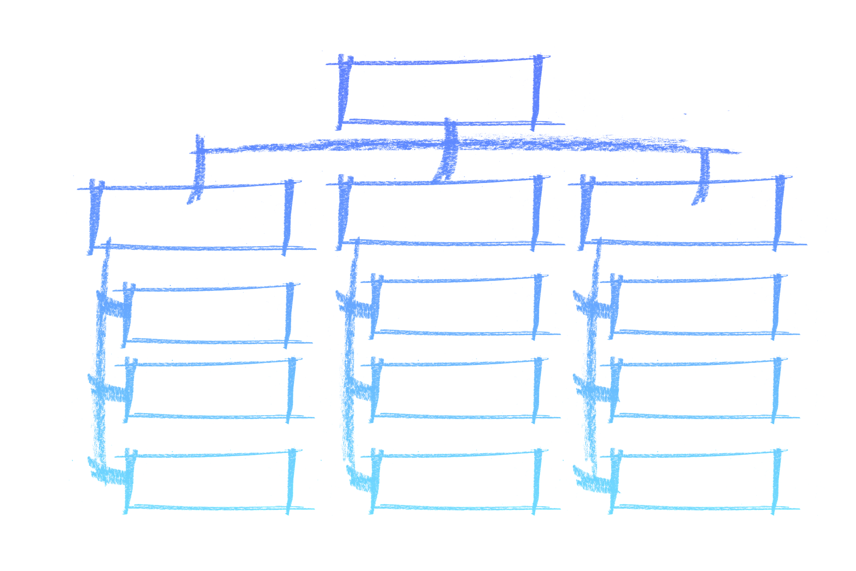
* What is a Records Custodian?
A Records Custodian is your contact within the units of your organization. Your contacts may be administrative secretaries, field staff, or others who manage records for their unit.
These staff are more familiar with the grass roots of your organizational records as they create and work with the records daily. Your network of custodians have more direct knowledge and control of the records being produced in the ordinary course of business. They will know the records they use and can help you.

Slide 8
Reviewing your unique schedules and forwarding revisions to me.
Every January, I send a reminder to Records Coordinators to review retention schedules for changes and corrections; however, you may send corrections to your schedule to me at any time. For example, if you have:
A new office which needs a new records series;
A series that needs to be discontinued because an office is abolished; or
An existing series requires updating.
It is important that you familiarize yourself with the records used in your office (i.e. who creates and uses them). Records retention schedules are found at http://one.dshs.wa.lcl/FS/Loss/Records/Pages/Schedules.aspx
All changes must be approved per RCW 40.14.050 by State Records Committee.*

Slide 9
* What is the State Records Committee?
The State Records Committee is charged by law to approve, modify, or disapprove the recommendations on retentions schedules for all state records.
The committee meets in a public meeting every other month to approve records retention changes. It is comprised of the state archivist, a state auditor appointee, an attorney general appointee, and an appointee of the director of financial management. Committee members discuss the historical, operational, legal, and financial impact of all records changes.
If you are interested in attending a meeting, please call me.

Slide 10
Identifying essential records and establishing procedures for their protection.
Essential records are identified on the records retention schedules* in the column titled “Designation.” Typically, less than 5% of all government records are essential.

Slide 11
* What are record retention schedules?
Records retention schedules help determine how long agency records must be kept and establishes a method of prompt and legal disposition of record series. They also help identify and preserve archival records.
There are two places in which you may find record series:
The State General Records Retention Schedules contain retention for records common to many state agencies and include administrative, fiscal, legal and personnel records.
The unique Department of Social and Health Services Retention Schedule contain agency-specific records retention schedules that are unique to DSHS.

Slide 12
More about essential records. . .
When developing a new series, I will help you identify whether a record is essential; however, per policy, you are responsible for helping your organization protect these records.
About Essential Records describes further what essential records are and options for protecting them.
Building an Essential Records Protection Plan offers guidelines in establishing a plan protecting DSHS records needed for the continuity of operations during and following a disaster.
I am also available if you need further information or help.

Slide 13
Assisting with records disposition.
“Disposition” means there is a change to the custody, location, or nature of DSHS records and includes transfer, duplication, or destruction.
There are two situations during which records disposition may require your attention. These are:
1. Disposition Report sent monthly from the State Records Center
CITRIX files sent monthly from DSHS Technical Services Division

Slide 14
1. Disposition Report sent monthly from the State Records Center (SRC)
Each month the SRC sends a list of records stored there which have met their retention, called a Disposition Report. Not every Records Coordinator will receive this report each month.
The department has 30 days in which to check the listed records for holds* or approve destruction of the identified records. These are program records so I send the report to you, via email, for processing.
Here’s where having a Records Custodian network is very important since most of these records originate from the field. You must develop a process and follow-up to learn the disposition of these identified records so you can notify me.

Slide 15
* What is a hold?
“Holds” result from events where records must not be destroyed and are kept longer than their minimum retention requirements. There are several types of holds: Legal, Program, and Audit.
The DSHS Discovery Officer notifies the agency of legal holds where records are involved in a existing, pending, or anticipated litigation. We must not destroy these records until directed by the Discovery Officer. Working with your Discovery Coordinators helps you identify these records.
You notify me when program or audit holds are necessary. Program holds occur when programs need to keep records longer than the minimal retention requirement for operational reasons; and audit holds are placed during program audits.

Slide 16
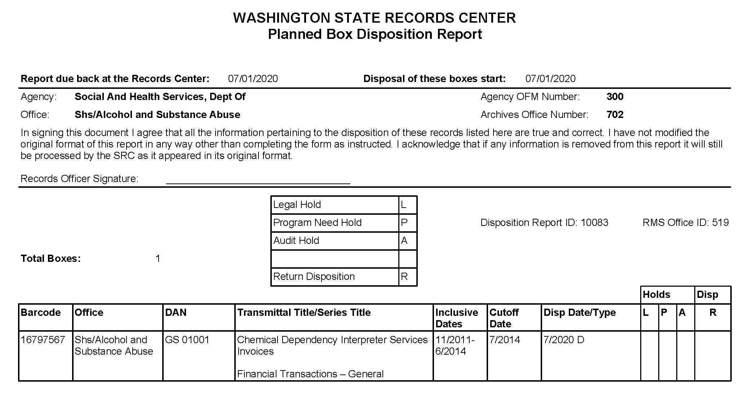
The below is an example of a Disposition Report for Office 702 of records scheduled for disposition 07/01/2020, due to me no later than 06/30/2020.
Check the appropriate box under the Holds and Disp (for disposition) columns:
L is legal hold;
P is program hold; and
A is audit hold.
If you check the R column, your boxes will be returned to you.
If you leave the form blank, that means the records may be destroyed.

Slide 17
2. CITRIX files sent monthly from DSHS Technical Services Division (TSD)
Some staff work remotely through CITRIX which is a remote connectivity application managed by TSD. Once they stop using CITRIX, files often remain on their computer which may still require retention.
TSD notifies me monthly of existing records. I contact you as the files are program records and organized into administration folders. You have access only to your administration folder (i.e. ALTSA, BHA, SCC). After review, you may delete those no longer requiring retention or download for storage those that have remaining retention or require hold.
Due by the end of the month, if there are files remaining in your folder, I will send the files to you via email.
Access to the staging area is required; and, once you become a Records Coordinator, you will be given access.

Slide 18
Establishing procedures for onsite records destruction.
As a Records Coordinator, you must help your administration, division, or program establish procedures for onsite records destruction per minimum requirements as stated in Administrative Policy 5.04, Attachment A: Onsite Destruction Log.
Onsite records is the destruction of DSHS records at the location where the records were created and used. A destruction log is required to document that staff were compliant with current retention requirements at the time that the records were destroyed.

Slide 19
Assisting with record inventories.
Every seven years DSHS is required per RCW 40.14.040 and State Records Management to conduct an agency records inventory.
The purpose of a records inventory is to identify and quantify all records created or maintained by your administration, division, or office. It is used to collect information about your records including type, date range, format, volume, storage location, and applicable records series information.
Copies of past records inventories have been imaged into MODIS; and all Records Coordinators have access to this program. If you do not, please contact me.

Slide 20
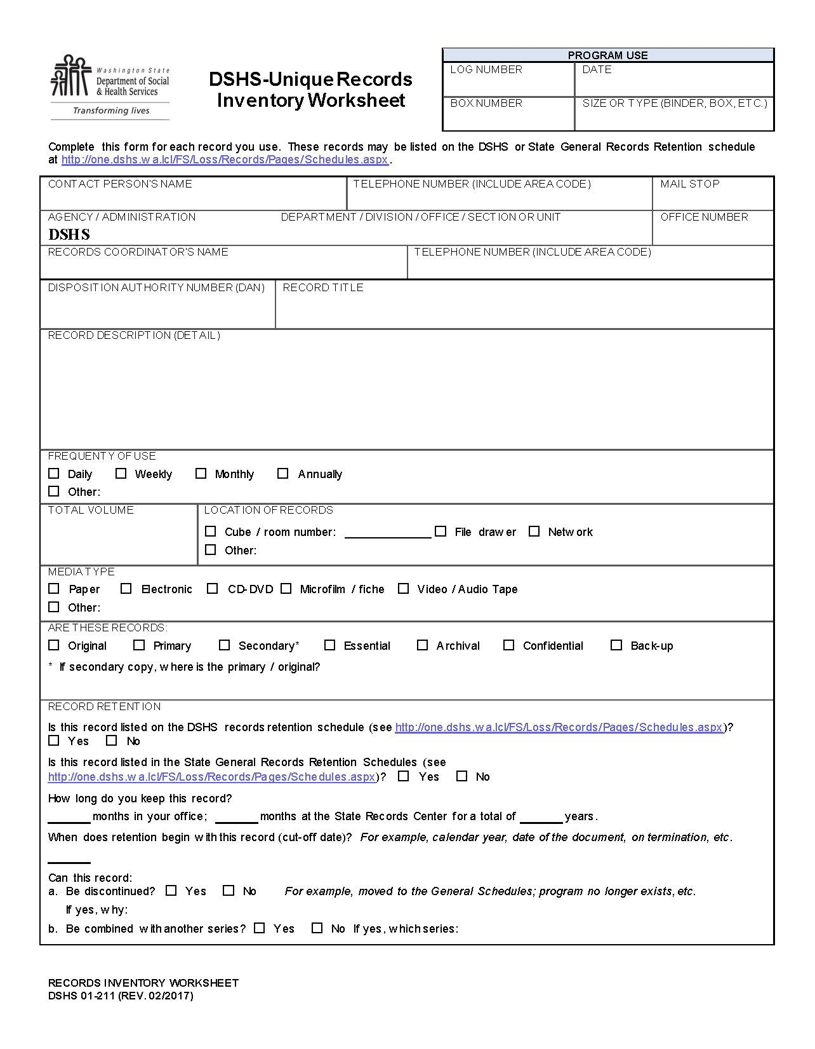
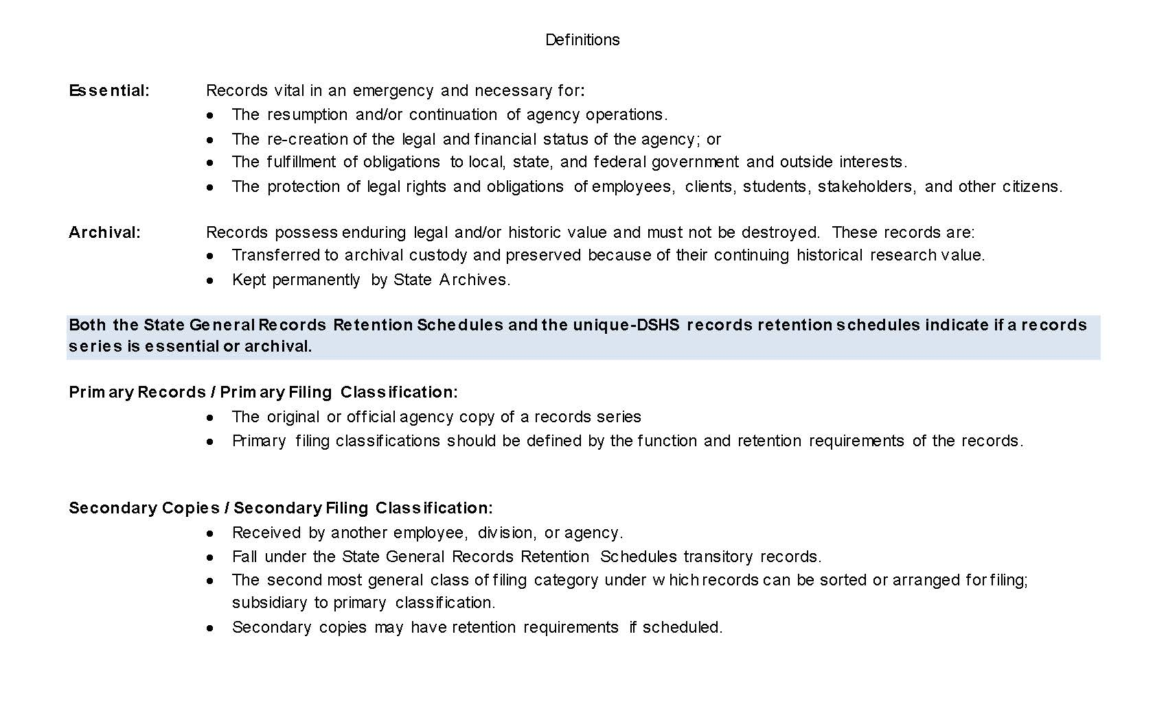
This is the form completed for each unique-DSHS record series used by your administration, division, or program during a records inventory.

Slide 21
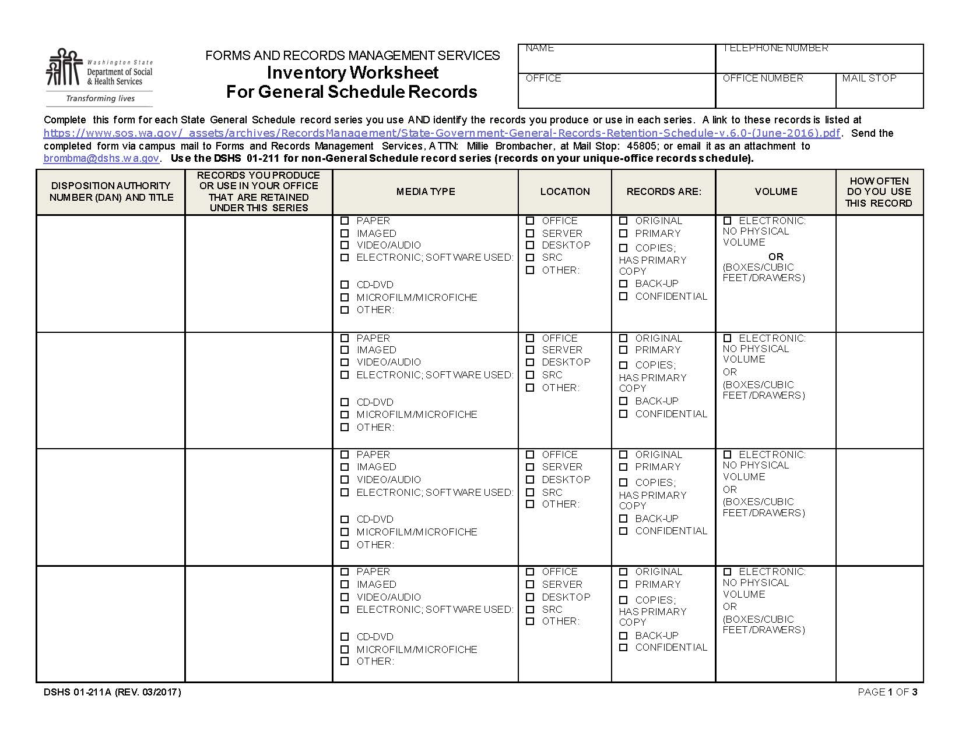
Complete this form for each record series found on the State General Records Retention Schedules and used by your administration, division, or program during a records inventory.

Slide 22
That’s about it. If you have any questions or need additional information regarding expectations and duties, please call to me or another Records Coordinator.
Here is a link to a list of current Records Coordinators: http://one.dshs.wa.lcl/FS/Loss/Records/Documents/RecordsCoordinator.pdf Please remember to let me know of any changes so I can keep the list updated.
Also, remember, you are not alone. We all had to start somewhere and knowing the records scene provides a great foundation wherever you find yourself in the department.
Thank you for joining us.

Slide 23

Great things in business are never done by one person, they’re done by a team of people.
Steve Jobs
Welcome to our team!

