Slide 1

Election Costs
State Elections Conference - June 10, 2015

Slide 2
What makes up Election Costs?
Costs incurred when you hold an election.
  Specific to the election.
    Salary/wage/benefits, supplies, envelopes, ballots, voter pamphlets, advertising.
  Shared costs across multiple elections in a year.
    Salary/wage/benefits, shared supplies, training, copiers.
Internal service fund charges.
  Entity-wide services, provided at a fixed charge or rate.
  IT, insurance, routing, fleet, mail, space.

Slide 3
What makes up Election Costs?
Indirect Costs – Overhead.
  Outlined in OMB Circular A-87, aka 2 CFR Part 225.
  Entity- wide support costs such as Finance and Accounting, Human Resources, Legal Counsel (civil).
  If you don’t have a plan in accordance with A-87 -
    Can charge a flat 15% of the adjusted general costs (direct and indirect costs). Does not include internal service fund charges.
    This 15% covers both the governmental support costs and the internal service fund charges.
  Terms:
  OMB: Office of Management and Budget
  CFR: Catalog of Federal Registry

Slide 4
What makes up Election Costs?
Equipment Costs.
  Capital outlay not allowed.
  Depreciation and uses charges are allowed.
    Based upon rates that result in a reasonable recovery of the original equipment over its useful life.
  No depreciation or use charge allowed if:
    15% overhead factor is used.
    Grant funded equipment.
Equipment replacement fees.
  Are not considered depreciation or use charges and may be included in the total cost for an election or voter registration.

Slide 5
How Costs are Allocated?
(Weighted v. Not Weighted)
State BARS allows for two allocation methods.
Method One -- Weighted
  Factors in the number of issues and offices for each jurisdiction.
    First issue or office has a weight factor of 1.
    Additional weighting added for each additional issue/office determined by the county.
Method Two – Not weighted
  Simply allocates costs based on number
  of registered voters participating in the
  election.
  No extra weighting for issues/offices on ballot.

Slide 6
Minimum Fee
BARS requires each jurisdiction to pay at least $50.00.
Built into the spreadsheet.
  Term:
  BARS: Budget Accounting and Reporting System

Slide 7
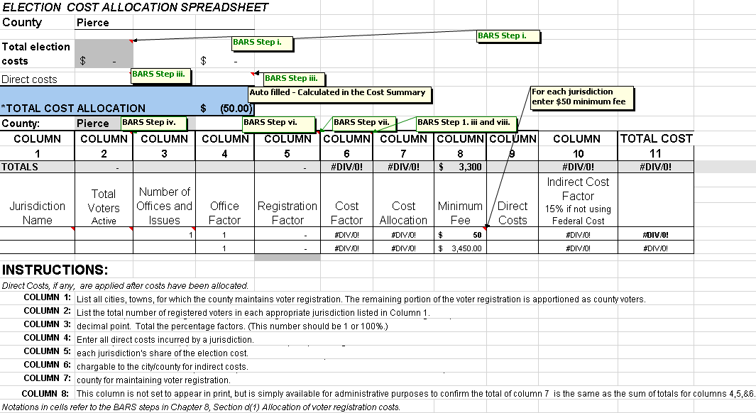
State Spreadsheet

Slide 8
Voter Maintenance Costs
Same cost rules apply.
No weighting.
Costs are shared by County, Cities and Towns only.
Allocated based on total of active and inactive voters.

Slide 9
Cost Estimates for Jurisdictions
Throughout the year jurisdictions ask “How much will my election cost if …”
We have built a table of historical election costs by jurisdiction to help answer this question.
For Pierce County – average per registered voter costs:
  Special Elections run between $2.00 and $4.00 per registered voter. But we’ve seen costs as high as $8.00.
  Even-year Primary and General elections run $1.25 to $1.50.
  Odd-year Primary elections average $1.50.
  Odd-year General elections average $0.75.

Slide 10
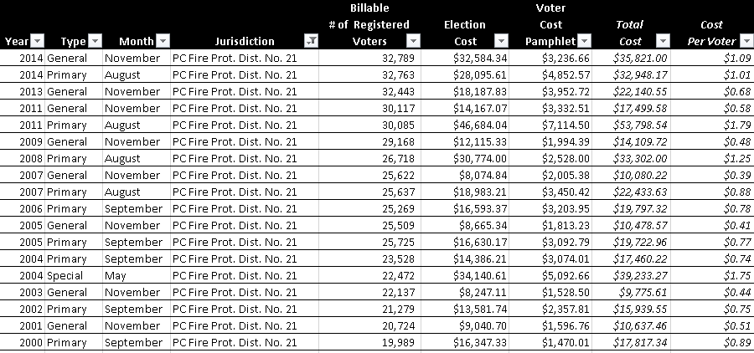
History Table Example

Slide 11
Election Replacement Fund
Began in 2011 as a 20 year plan at $.02 cents per registered voter per election.
Revised to a 10 year plan with increasing contribution rates up to $.10 cents. Currently at $.08 cents in 2015.
Historical contributions average $30,000 in odd years and $100,000 in even years. Collected $101,870 in 2014. Have made “catch up” contributions. Current balance $722,929.
Use - election equipment system replacement.

Slide 12
Voter Registration Replacement Fund
Began in 2011 as a 20 year plan at $.05 cents per registered voter (including active and inactive).
Revised to a 10 year plan with increasing contribution rates up to $.10 cents. Currently at $.10 cents in 2015.
Historical contributions average $35,000 per year. Collected $40,492 in 2014. Have made “catch up” contributions. Current balance $327,881.
Use - voter maintenance system replacement.

Slide 13
Questions and Answers

Slide 14
Where to Find More Information
SAO BARS Link: http://www.sao.wa.gov/local/BarsManual/Documents/GAAP_p3_VotrRegstrnElectnCost.pdf
  Includes hyperlinks to applicable RCWs:
  29A.04.410
  29A.04.420
  29A.08.150
  29A.32.270
  36.33.200 and 36.33.210
OSOS website

Slide 15
Thank you
Mary Schmidtke
Pierce County Fiscal Manager
mschmid@co.pierce.wa.us
253-798-2583
Mike Rooney
Pierce County Elections Manager
mrooney@co.pierce.wa.us
253-798-2148

