Slide 1
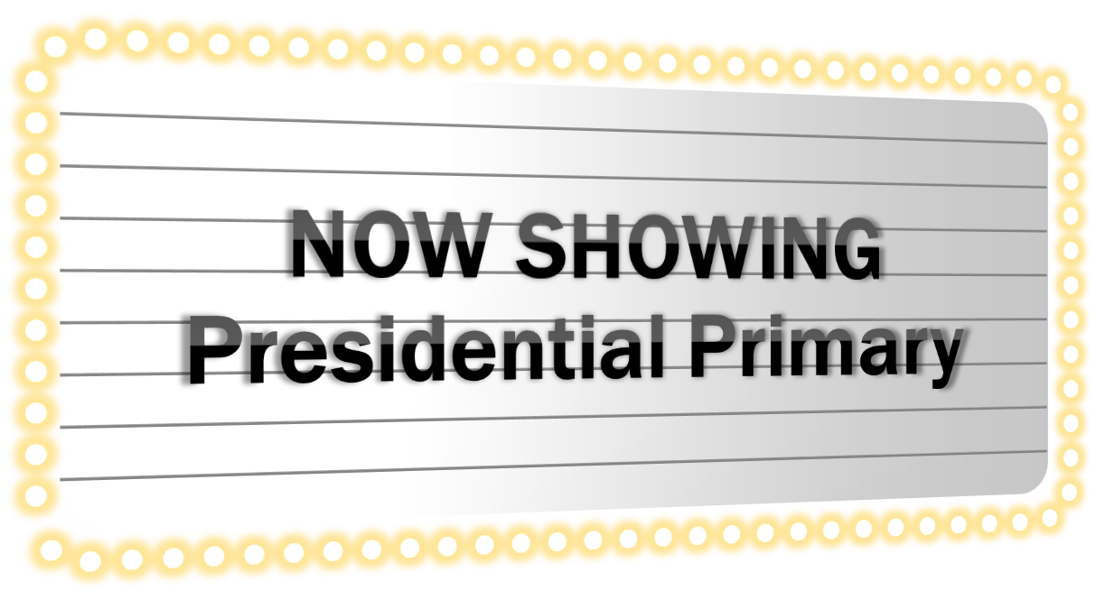
starring
The Elections Division
Production
Notes:
Welcome to the Premier of the Presidential Primary Show!
<click>

Slide 2
First time at the show?
Presidential Primary
Theater
Notes:
Is this the first time at the show for you?
Everyone who has not been part of a presidential primary stand up.
Because of you, this presentation starts with basics.
Thank you. Please be seated. <click>

Slide 3
Or is this a re-run?
This is NOT a horror flick
Notes:
For those of you who have done one before, your memories might be…. <click>
Today, we are not presenting a Horror flick rerun. <click>
This Primary for major political parties is
Challenging,
Adventurous, and slightly quirky,
But you shouldn’t be frightened.
The purpose of this show is to start preparing you for a primary.
We don’t have a lot of the details for you today. This session is to start you thinking about a 2016 Presidential Primary

Slide 4
In the Beginning
A long, long, time ago
Well, not so long ago really.
People gathered in a room to decide who to support for President.
The chosen traveled to another time and place to select the party nominee.
It will happen again next year.
This is a caucus.
Notes:
(Auto) no speaking—let slide say it for you
<click to next slide after caucus.>

Slide 5
Caucus – multi level
Precinct caucus
Select candidate and county convention delegates
County conventions
Elect delegates for the state convention
State convention
Delegates of 10 districts & alternates
Elect delegates for National Convention
Represent candidate chosen by the district
Notes:
LIBBY - A Caucus simply is a meeting or gathering of a common interest.
Talk as you Animate the process . <click to next slide>
Precinct caucuses. Rep – March 5, Dem – March 26

Slide 6
Rise of the Primary . . .
1989 Initiative to the Legislature
The intent?
Greater voter participation.
Notes:
L: So we get to the Rise of the Primary. Sheryl, would you explain how the primary came about?
S: An Initiative to the Legislature in 1989. The legislature passed into law, so it did not go to a vote of the people
L: Why do we have a Presidential Primary?
Sheryl: Read RCW. There were very good intentions with the creation of a Primary
<click to next slide>

Slide 7
Presidential Primary
vs Caucus
Primary
Party Caucus
40% participation
3 % participation
Notes:
SHERYL- Ralph Munro used to say “more people attend the Seattle Boat Show than go to their caucuses.”
But if participation rate is so low, why are the parties reluctant to adopt the primary?
L: No voter reg. by party – . Other states you register by party—same ballot. Parties are wary because of possible cross over voting – want only party affiliates. The Parties are more confident of the voter affiliation.
<click to next slide>

Slide 8
Not your typical primary!
Secretary of State selects candidates
Voters must affiliate with a major political party.
Each major party has a ballot
Primary
Notes:
L : SOS choosing candidates National media 90 days before the PP. Will send initial list to counties.
Final waits for petitioning period and the withdrawal from the ballots. Final will be sent to you 66 days before the primary. <click next bullet>
S: Party oath - why? Example of other state PP.—register by party/voters only receive ballot for that party
<click next bullet>
L: Voters can only vote one ballot—can be consolidated or on separate pieces of paper
<click to next slide>

Slide 9
Not your typical primary!
Primary
Primary has nothing to do with General
Results select delegates of a party, not the nominees.
Notes:
L: . Primary only assists parties to choose delegates to the national convention. <click to next bullet>
S:. Parties can use all the results, part, or none of the results. The Democratic Party has already decided not to use the results if a primary is held.
S: We are not selecting which candidates will appear on Washington’s ballot.
<click to next slide>

Slide 10
In 2016 - Coming to a county near you!
County & OSOS planning
Secretary’s legislation
Alternate date selection
Phase 1 – Research
Phase 2 – Problem solving
Phase 3 – Consensus and adoption
HB 2185 & SB 5978 still alive!
Committee meets to set a date other than May 24, 2016.
Notes:
Libby – Planning in process
Coordinated effort
3 phases – looked at ---
S: Why did you look at 2008? L: no pp in 2012 <click to next bullet>
Sheryl - The Secretary’s bill is still alive. <click to next slide>
4th Tuesday in May to 2nd Tuesday in March.
The option to change the date still exists. <click to next bullet>
Requires both political parties to use results
Date—Committee can still convene -March 8/Kim; other March dates possible

Slide 11
Special elections?
No change to spring special election dates.
BUT
Legislature could set the Presidential Primary on a special election.
Notes:
Sheryl, What about special elections? In 2008 there was a special . . . . .
- February not an option – Party Rules But why not in April?
Libby: Too late in the process.
Super Tuesday - March 1. Southern Conference and candidates would not make the trip to Washington.
S: Legislature could pass legislation to change it. It could also cancel the primary. Budget has not passed yet
Libby. We will let you know when we know. So, what can counties do now?
Sheryl: Try to anticipate public perceptions. . .<click to next slide>

Slide 12
Phone calls
Misunderstandings
Media intensity
“Love” notes
Comments on cost
Prepare messaging
Notes:
Libby – Let’s visit the Critics’ Choice. Ask for experienced war stories. What can you expect?
Phone calls—Many; sending to OSOS is not always right
Sheryl: Misunderstandings—why sign oath, purpose of primary
Libby: Define “love” notes
Sheryl: Cost—who is paying for the election
Libby: Purpose is not to frighten but to prepare! <click to next bullet> You can get ready by preparing messages and phone scripts.
<click to next slide>

Slide 13
Rehearsal Schedule
September
Managing voters expectations
Ballot & envelope design
Ballot processing
Canvassing
Cost recovery
Notes:
Sheryl
If we have a Primary, expect online training in September.
<click to next slide>

Slide 14
Rehearsal Schedule
October – November
Advisories
WAC changes
Procedure suggestions
October 1
Date set
Oaths
Notes:
Sheryl - These are the statutory dates. Other dates are relative to the date of the PP which is why we can’t tell you at this time.
Advisories will actually occur through the Primary, but expect the bulk to occur October-November
<click to next slide>

Slide 15
Sound Bites
What about minor parties and independent candidates?
Who pays for the Presidential Primary?
What about voters that don’t want to affiliate?
When will WACs be adopted?
Let’s talk!
Notes:
Libby: Minor parties use state conventions
Sheryl: Bill state within 60 days of certification. Talk to vendors ahead of time.
Libby: Voter must affiliate or vote does not count. An unaffiliated choice misleads voter that vote will count.
Sheryl: WAC changes begin after Legislature makes a decision. Changes firmed up by September training.
State lacks funds for voter outreach. Phase 1 identified the benefit of simplification. Unified message. Kim?
Remember, we have successfully conducted Presidential Primaries before. <click to next bullet>

Slide 16
This is not The END!
WE
COME
Notes:
We overcome the impossible by doing the unthinkable—
Libby & Sheryl: WE ARE ELECTION ADMINISTRATORS!!!
<click to next slide>

Slide 17
Bigger! Bolder! Coming next year! PRESIDENTIAL PRIMARY 5
Maybe.
Notes:
Read slide and click

Slide 18
Presidential Primary
C&T Manager Sheryl Moss
Program Specialist Libby Nieland
Audio support Joe MacLean, Adam Rech
Visual support Google.com
1st Grip Kay Ramsay
2nd Grip Kerri Kroll
Research State Election Administrators
production
This has been a
Notes:
Don’t click now – you will mess up the credits.

