Slide 1
The Voting Rights Act of 1965 Past, Present, and Future
By Bruce L. Adelson, Esq.
© Federal Compliance Consulting LLC and Bruce L. Adelson, 2015 All Rights Reserved

Slide 2
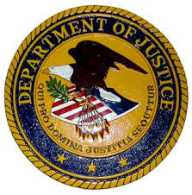
The Voting Rights Act of 1965 Past, Present, and Future
Bruce L. Adelson, Esq, CEO of Federal Compliance Consulting LLC, is nationally recognized for his compliance expertise concerning many federal laws, including the Voting Rights Act and federal election laws. Mr. Adelson is a former U.S Department of Justice Senior Trial Attorney. During his Justice career, Mr. Adelson had national law enforcement and policy responsibility.
In 2014, the Chief Judge of the U.S. District Court for the Middle District of Louisiana qualified Bruce as an expert in several areas, including civil rights and allegations of discrimination.
Bruce is the testifying expert in two federal cases alleging Voting Rights Act violations and in three federal ADA litigations against health care providers and a large airport authority

Slide 3
The Voting Rights Act of 1965 Past, Present, and Future
Today’s Material is the Property of Federal Compliance Consulting LLC & Bruce L. Adelson. All Intellectual Property Rights Retained.
Today’s Material is Informational and Educational Only
©Federal Compliance Consulting LLC and Bruce L. Adelson 2015. All Rights Reserved

Slide 4
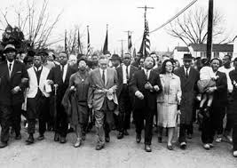
The Voting Rights Act of 1965 Past, Present, and Future
The Voting Rights Act of 1965, is considered to be the most effective civil rights statute ever enacted by Congress.
"So long as I do not firmly and irrevocably possess the right to vote I do not possess myself. I cannot make up my mind — it is made up for me. I cannot live as a democratic citizen, observing the laws I have helped to enact — I can only submit to the edict of others."
Dr. Martin Luther King, Jr.

Slide 5
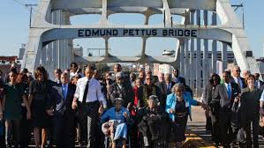
The Voting Rights Act of 1965 Past, Present, and Future
“In observing the law’s 50th anniversary Wednesday, President Barack Obama said “few pieces of legislation have defined our national identity as distinctly, or as powerfully.”
“It transformed the concepts of justice, equality, and democracy for generations to come,” Obama said.”
NY Daily News

Slide 6
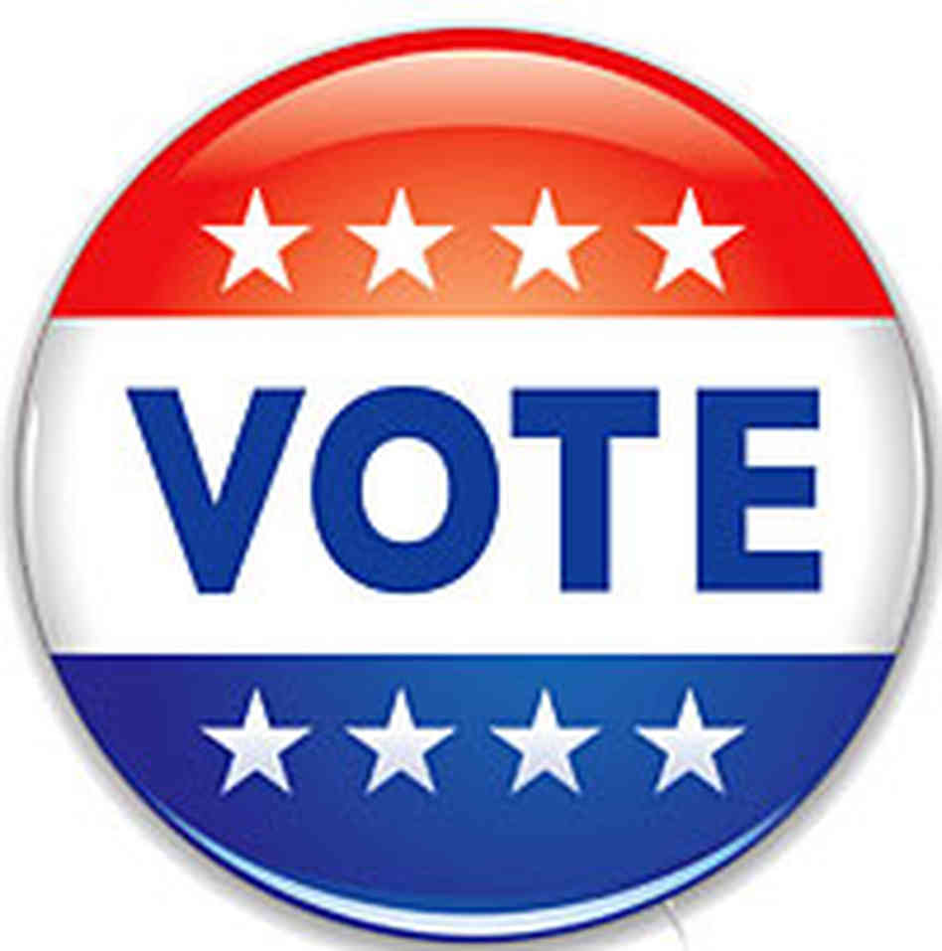
The Voting Rights Act of 1965 Past, Present, and Future
“One of those who fled, Cager Lee, was struck on the head, fell to the ground, and was kicked. Lee was eighty-two; … But he escaped, and ran into a café, where he saw his daughter Viola and two grandchildren, Emma Jean and Jimmie Lee Jackson. When troopers stormed the café and began beating people, Jackson tried to protect his mother. He was shoved up against a cigarette machine and shot twice in the stomach by a trooper named James Fowler. “
Gary May – Bending Toward Justice

Slide 7
The Voting Rights Act of 1965 Past, Present, and Future
“In cases of voting, Southern states made things even more difficult by having registrars in suspect counties resign, so that, when the Justice Department came calling, there were no officials around to charge. Also, in some Southern counties, almost no African-Americans in the twentieth century had ever even attempted to register, so there were few cases to litigate.”
Louis Menand – The New Yorker 7/8/13

Slide 8
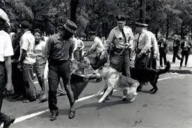
The Voting Rights Act of 1965 Past, Present, and Future
“But in Birmingham, when the Commissioner of Public Safety, Eugene (Bull) Connor, brought out the police dogs and fire hoses, and in Selma, when Sheriff Jim Clark socked a black minister, C. T. Vivian, in the face, reporters and cameramen were right there. Many white Americans who saw or read about the violence blamed the demonstrators, but the world blamed the American government. That got the attention of the White House.”
Menand – The New Yorker 7/8/13

Slide 9
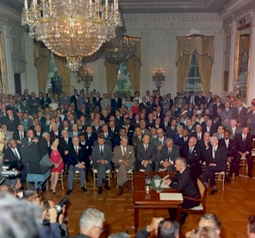
The Voting Rights Act of 1965 Past, Present, and Future
Civil Rights Act of 1964 – Historic Law

Slide 10
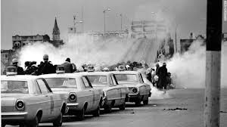
The Voting Rights Act of 1965 Past, Present, and Future
“[Governor] Wallace had ordered [Sheriff] Lingo to take “whatever steps necessary” to stop the march. The troopers wore gas masks and carried nightsticks; Clark’s men were armed with clubs, whips, and cattle prods. One carried a rubber hose wrapped in barbed wire. A number of white Alabamans had come out to watch the sport. … So had the press. It’s all on film….
Forty tear-gas canisters were fired that day. The marchers were chased for a mile back to Selma.”
Menand

Slide 11
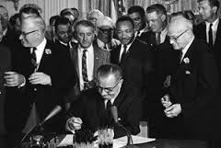
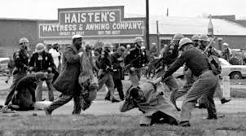
The Voting Rights Act of 1965 Past, Present, and Future
“President Johnson signed the resulting legislation into law on August 6, 1965. Section 2 of the Act, which closely followed the language of the 15th amendment, applied a nationwide prohibition against the denial or abridgment of the right to vote on the literacy tests on a nationwide basis.”
Source: U.S. Department of Justice

Slide 12
The Voting Rights Act of 1965 Past, Present, and Future
“Among its other provisions, the Act contained special enforcement provisions targeted at those areas of the country where Congress believed the potential for discrimination to be the greatest.”
USDOJ
Section 5
“Attorney General could designate county covered by VRA special provisions for the appointment of a federal examiner to review the qualifications of persons who wanted to register to vote. Further, in those counties where a federal examiner was serving, the Attorney General could request that federal observers monitor activities within the county's polling place.”
© Federal Compliance Consulting LLC and Bruce L. Adelson, 2015 All Rights Reserved

Slide 13
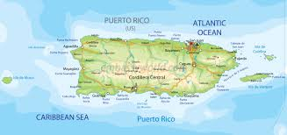
The Voting Rights Act of 1965 Past, Present, and Future
VRA Moves Forward
1970, 1975 - Section 5 Extensions
1975 – Congress hears testimony about voting discrimination based on language & national origin
Minority language provisions added – Section 203
Also See: Section 4 – Puerto Rico
© Federal Compliance Consulting LLC and Bruce L. Adelson, 2015 All Rights Reserved

Slide 14
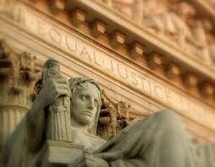
The Voting Rights Act of 1965 Past, Present, and Future
1982
Congress renews VRA for twenty-five years.
Congress adds "bail out" from coverage
Congress amends Section 2 to provide that a plaintiff could establish a violation of the Section without having to prove discriminatory purpose.
© Federal Compliance Consulting LLC and Bruce L. Adelson, 2015 All Rights Reserved

Slide 15
The Voting Rights Act of 1965 Past, Present, and Future
2006
Congress renewed VRA special provisions in Fannie Lou Hamer, Rosa Parks, Coretta Scott King, Cesar E. Chavez, Barbara Jordan, William Velazquez and Dr. Hector Garcia Voting Rights Act Reauthorization and Amendments Act.
“I gave blood,” [Congressman John] Lewis said, his voice rising, as he stood alongside photographs of the clash. “Some of my colleagues gave their very lives. Yes, we’ve made some progress; we have come a distance,” he added. “The sad truth is, discrimination still exists. That’s why we still need the Voting Rights Act, and we must not go back to the dark past.”
NY Times – 7/14/06
© Federal Compliance Consulting LLC and Bruce L. Adelson, 2015 All Rights Reserved

Slide 16
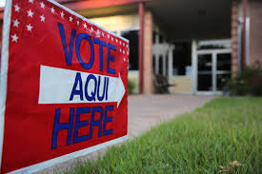
The Voting Rights Act of 1965 Past, Present, and Future
2006
VRA Section 203 Changes:
Use of ACS data
New Determinations Every 5 Years
© Federal Compliance Consulting LLC and Bruce L. Adelson, 2015 All Rights Reserved

Slide 17
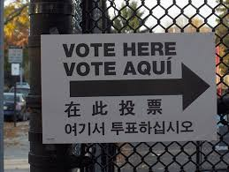
The Voting Rights Act of 1965 Past, Present, and Future
Sections 203 and 4(e)
Require certain covered jurisdictions to provide bilingual written materials and other assistance.
US v. Berks County (E.D. Pa 2003)
Court decided County had violated Sections 2, 4(e) and 208.
© Federal Compliance Consulting LLC and Bruce L. Adelson, 2015 All Rights Reserved

Slide 18
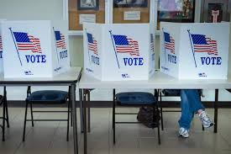
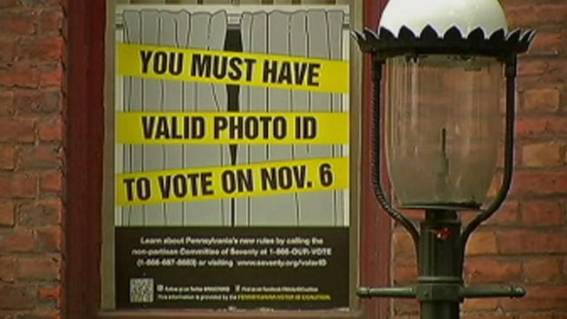
The Voting Rights Act of 1965 Past, Present, and Future
2013
“On June 25, 2013, the United States Supreme Court held that the coverage formula in Section 4(b) of the Voting Rights Act, 42 U.S.C. 1973b(b), as reauthorized by the Voting Rights Act Reauthorization and Amendments Act of 2006, is unconstitutional and can no longer be used as a basis for subjecting jurisdictions to preclearance under Section 5 of the Voting Rights Act, 42 U.S.C. 1973c. Shelby County v. Holder, 570 U.S. ___, 2013 WL 3184629 (U.S. June 25, 2013) (No. 12-96). Accordingly, no determination will be made under Section 5 by the Attorney General on the specified change.”
Source: USDOJ

Slide 19
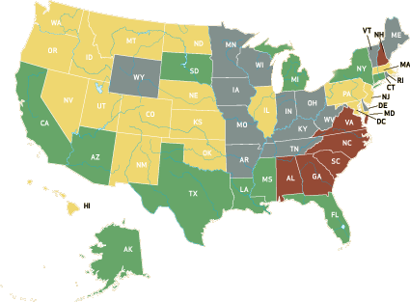
Covered Jurisdictions (Pre-Shelby)
 | 203
 | 5
 | 5/203

Slide 20
The Voting Rights Act of 1965 Past, Present, and Future
Life After Shelby County
Section 3c preclearance - “Bail-In”
Shelby County does not affect Section 3(c) of the Voting Rights Act, 42 U.S.C. 1973a(c). Jurisdictions covered by a preclearance requirement pursuant to court orders under Section 3(c), remain subject to the terms of those court orders.
Source: USDOJ
© Federal Compliance Consulting LLC and Bruce L. Adelson, 2015 All Rights Reserved

Slide 21
The Voting Rights Act of 1965 Past, Present, and Future
Supreme Court’s constitutional concerns in Shelby County about VRA Section 4b not being based on “current conditions.”
Section 3c requires proof of contemporary intentional discrimination
Not based on 1960s/1970s voting behavior.
Section 3c has nationwide coverage. Not limited to any states or regions of the country, as was VRA Section 4b’s coverage formula.
© Federal Compliance Consulting LLC and Bruce L. Adelson, 2015 All Rights Reserved

Slide 22
The Voting Rights Act of 1965 Past, Present, and Future
Preclearance “Limited in scope”
Court or the United States Attorney General to review two distinct types of voting changes adopted by the Evergreen City Council during the period from the date of entry of this order until December 31, 2020: (1) any change in the redistricting plan or method of election for City Council elections, and (2) any change in the standards for determining which voters are eligible to participate in the City of Evergreen’s municipal elections.
Allen v. City of Evergreen, Alabama (S.D. Ala., 2014)
© Federal Compliance Consulting LLC and Bruce L. Adelson, 2015 All Rights Reserved

Slide 23
The Voting Rights Act of 1965 Past, Present, and Future
“We hold that the State of Arkansas has committed a number of constitutional violations of the voting rights of black citizens.”
Jeffers v. Clinton, 740 F.Supp. 585
(E.D. Ark, 1990)
© Federal Compliance Consulting LLC and Bruce L. Adelson, 2015 All Rights Reserved

Slide 24
The Voting Rights Act of 1965 Past, Present, and Future
“… a limited preclearance remedy is still required by this record. The State has systematically and deliberately enacted new majority-vote requirements for municipal offices, in an effort to frustrate black political success in elections traditionally requiring only a plurality to win. We therefore direct that any future laws, standards, or practices designed to enforce or enhance a majority-vote requirement not take effect until the preclearance process has run its course.”
Jeffers v. Clinton, 740 F.Supp. 585
(E.D. Ark, 1990)
© Federal Compliance Consulting LLC and Bruce L. Adelson, 2015 All Rights Reserved

Slide 25
The Voting Rights Act of 1965 Past, Present, and Future
“This does not mean that racial discrimination must be the sole motive behind the action challenged. It need only be one of the motivating factors but for which the action would not have been taken. In addition, there will rarely be direct proof of the forbidden motive. Courts must be sensitive to circumstantial evidence from which a reasonable inference of discriminatory intent may be drawn.”
Jeffers

Slide 26
The Voting Rights Act of 1965 Past, Present, and Future
Life After Shelby County
Objective Analysis to justify Bail-In
VRA Section 2 – At-Large Elections
VRA Section 203 – Effective Language Assistance
Voting Discrimination Complaints
Court Decisions/Consent Decrees
Section 5 Objections
Federal Observers – Recent Observer Certification by Court or Attorney General
© Federal Compliance Consulting LLC and Bruce L. Adelson, 2015 All Rights Reserved

Slide 27
The Voting Rights Act of 1965 Past, Present, and Future
Bail-In Cases
Hall v. State of Louisiana
Terrebonne Parish NAACP v. State of Louisiana
State of Alaska
“Issuing an order Pursuant to Section 3 (c) of The Voting Rights Act…retaining jurisdiction over this action and requiring Terrebonne to obtain preclearance…”
© Federal Compliance Consulting LLC and Bruce L. Adelson, 2015 All Rights Reserved

Slide 28
The Voting Rights Act of 1965 Past, Present, and Future
“The City of Yakima is permanently enjoined from administering, implementing, or conducting any future elections for the Yakima City Council in which members of the City Council are elected on an at-large basis, whether in a primary, general, or special election.”
Montes v. City of Yakima
UNITED STATES DISTRICT COURT
EASTERN DISTRICT OF WASHINGTON

Slide 29
The Voting Rights Act of 1965 Past, Present, and Future
“A federal judge in Anchorage ruled that the state Elections Division violated the U.S. Voting Rights Act by failing to provide ballot and candidate information in Native languages to Yup’ik and Gwich’in speakers in three rural regions of Alaska. In a big victory for Native rights advocates, U.S. District Judge Sharon Gleason rejected the state’s assertions that it had done enough in Southwest Alaska and the Interior by providing bilingual poll workers and “outreach” personnel. Gleason said the state’s effort failed to provide “substantially similar” information in Native languages as it does in English, a requirement of the Voting Rights Act since 1975.”
Alaska Dispatch News – 9/3/14

Slide 30
The Voting Rights Act of 1965 Past, Present, and Future

Slide 31
The Voting Rights Act of 1965 Past, Present, and Future
“The Department of Justice has expanded the scope of the Election Day monitoring conducted by Civil Rights Division staff to include assessments of the physical accessibility of polling places. For the 2012 general election, the Department’s Election Day monitors conducted accessibility surveys of approximately 240 polling places in 28 jurisdictions throughout the country.
In some circumstances, when a public entity is unable to identify or create an accessible polling place for a particular voting precinct or ward, election administrators may instead use an alternative method of voting at the polling place. While absentee balloting can be offered to voters with disabilities, it cannot take the place of in-person voting for those who prefer to vote at the polls on Election Day. “
THE AMERICANS WITH DISABILITIES ACT AND OTHER FEDERAL LAWS
PROTECTING THE RIGHTS OF VOTERS WITH DISABILITIES – USDOJ – 2014

Slide 32
The Voting Rights Act of 1965 Past, Present, and Future
“…[D]istrict court correctly entered summary judgment in favor of United Spinal based on undisputed evidence of the BOE’s failure to address barriers to access at New York City polling places. These barriers to access included steep ramps, missing handrails or guardrails on ramps, locked or heavy interior doors, blocked interior pathways, and missing signs identifying accessible entrances.
Disabled in Action et al v. NY Board of Elections
U.S. Second Circuit Court of Appeals
August 14, 2013

Slide 33
The Voting Rights Act of 1965 Past, Present, and Future
“In February 2014, the Department of Justice and Blair County, Pennsylvania, entered into a Settlement Agreement under the ADA concerning the accessibility of the County’s polling places. The County agreed that by the 2014 general election, all of its polling places would be accessible on Election Day to voters with mobility and vision impairments. The County agreed to relocate some polling places that were not accessible and to provide temporary measures at others such as portable ramps and doorbells to make sure that they are accessible on Election Day.”
USDOJ

Slide 34
The Voting Rights Act of 1965 Past, Present, and Future
“Prior to Election Day or the beginning of early voting, election staff and volunteers should receive training so they can appropriately interact with people with disabilities. Staff and volunteers should understand the specific auxiliary aids and services that are available. They should be aware that service animals must be allowed to accompany voters inside the polling place, that accessibility features at the polling place need to be operational, that people with disabilities are allowed assistance from a person of their choice, and that other modifications may be needed to accommodate voters with disabilities.”
USDOJ 2014
© Federal Compliance Consulting LLC and Bruce L. Adelson, 2015 All Rights Reserved

Slide 35
The Voting Rights Act of 1965 Past, Present, and Future
“A public entity shall take appropriate steps to ensure that communications with applicants, participants, members of the public, and companions with disabilities are as effective as communications with others.
In determining what types of auxiliary aids and services are necessary, a public entity shall give primary consideration to the requests of individuals with disabilities.”
28 Code of Federal Regulations §35.160 (a)(b)(2) Part 35 Nondiscrimination on the Basis of Disability in State and Local Government Services
© Federal Compliance Consulting LLC and Bruce L. Adelson, 2015 All Rights Reserved. Unauthorized Use Prohibited

Slide 36
The Voting Rights Act of 1965 Past, Present, and Future
“Primary consideration” means that the public entity must honor the choice of the individual with a disability, with certain exceptions. The individual with a disability is in the best position to determine what type of aid or service will be effective.
The requirement for consultation and primary consideration of the individual’s choice applies to aurally communicated information (i.e., information intended to be heard) as well as information provided in visual formats.
Source – USDOJ
© Federal Compliance Consulting LLC and Bruce L. Adelson, 2015 All Rights Reserved. Unauthorized Use Prohibited

Slide 37
The Voting Rights Act of 1965 Past, Present, and Future
“The Department of Justice has expanded the scope of the Election Day monitoring conducted by Civil Rights Division staff to include assessments of the physical accessibility of polling places. For the 2012 general election, the Department’s Election Day monitors conducted accessibility surveys of approximately 240 polling places in 28 jurisdictions throughout the country. “
USDOJ
© Federal Compliance Consulting LLC and Bruce L. Adelson, 2015 All Rights Reserved

Slide 38
The Voting Rights Act of 1965 Past, Present, and Future
What Does It All Mean?
© Federal Compliance Consulting LLC and Bruce L. Adelson, 2015 All Rights Reserved

Slide 39
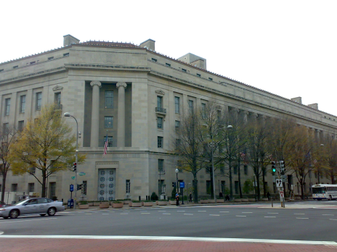
The Voting Rights Act of 1965 Past, Present, and Future
New DOJ Leadership
New Attorney General
New Assistant AG for Civil Rights
Deputy Assistant Attorney General Pam Karlan
Stanford University Law School
Voting Rights Act Expert
© Federal Compliance Consulting LLC and Bruce L. Adelson, 2015 All Rights Reserved

Slide 40
The Voting Rights Act of 1965 Past, Present, and Future
“The new legal landscape will require the department and civil rights groups to fight more battles to enforce the election laws in more places than they had done previously, if the Obama administration wants to fulfill its commitment to aggressive enforcement. Presumably, Karlan will oversee that new campaign. The appointment, which does not require Senate confirmation, will also raise her profile in Washington.”
Politico 12/20/13
© Federal Compliance Consulting LLC and Bruce L. Adelson, 2015 All Rights Reserved

Slide 41
US probes possible California voting violations for disabled
LOS ANGELES (AP) - The U.S. Justice Department is investigating whether California illegally denied voting rights to people with autism spectrum disorder, cerebral palsy and other intellectual or developmental disabilities, officials confirmed Wednesday.
The agency disclosed the probe in a May 15 letter to Secretary of State Alex Padilla and the California Supreme Court, in which investigators sought detailed records on how certain voters with disabilities are disqualified, an explanation of the rationale behind it and an account of how frequently it is happening.
The probe follows a federal complaint filed last year by advocates for the disabled who said thousands of people with intellectual and developmental disabilities, including conditions such as Down syndrome, are being systematically denied the right to vote. The department is investigating whether state voting practices and procedures have violated the Americans with Disabilities Act.
Washington Times – May 20, 2015
© Federal Compliance Consulting LLC and Bruce L. Adelson, 2015 All Rights Reserved

Slide 42
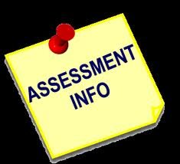
The Voting Rights Act of 1965 Past, Present, and Future
2015 - Assessment
New Enforcement Directions
New Minority language Requirements
Bail-In
Election Monitoring to Set-Up Cases
Coordination with Advocacy Groups
Rebooted Voting Section
Voter Id Activity
ADA!!!!!!
© Federal Compliance Consulting LLC and Bruce L. Adelson, 2015 All Rights Reserved

Slide 43
The Voting Rights Act of 1965 Past, Present, and Future
Our Prescription for 2016
Proactive, Preventive Exam - Analyze Your Risks
Work With Your Jurisdictions - Training
At-Large Election Vulnerability – Tied to Bail-In Potential
Historical Issues
When Did DOJ Last Visit You or Ask You For Information?
Don’t Wait for The Call From DC, The Suit, The Complaint
ADA Assessment & Training – Increase Awareness!
© Federal Compliance Consulting LLC and Bruce L. Adelson, 2015 All Rights Reserved

Slide 44
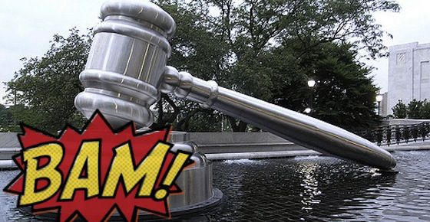
The Voting Rights Act of 1965 Past, Present, and Future
Courtesy: Michael Adelson

Slide 45
The Voting Rights Act of 1965 Past, Present, and Future
Bruce L. Adelson, Esq.
Federal Compliance Consulting, LLC
1301-762-5272 (direct line)
badelson1@comcast.net
badelsonfcc@verizon.net

