Slide 1
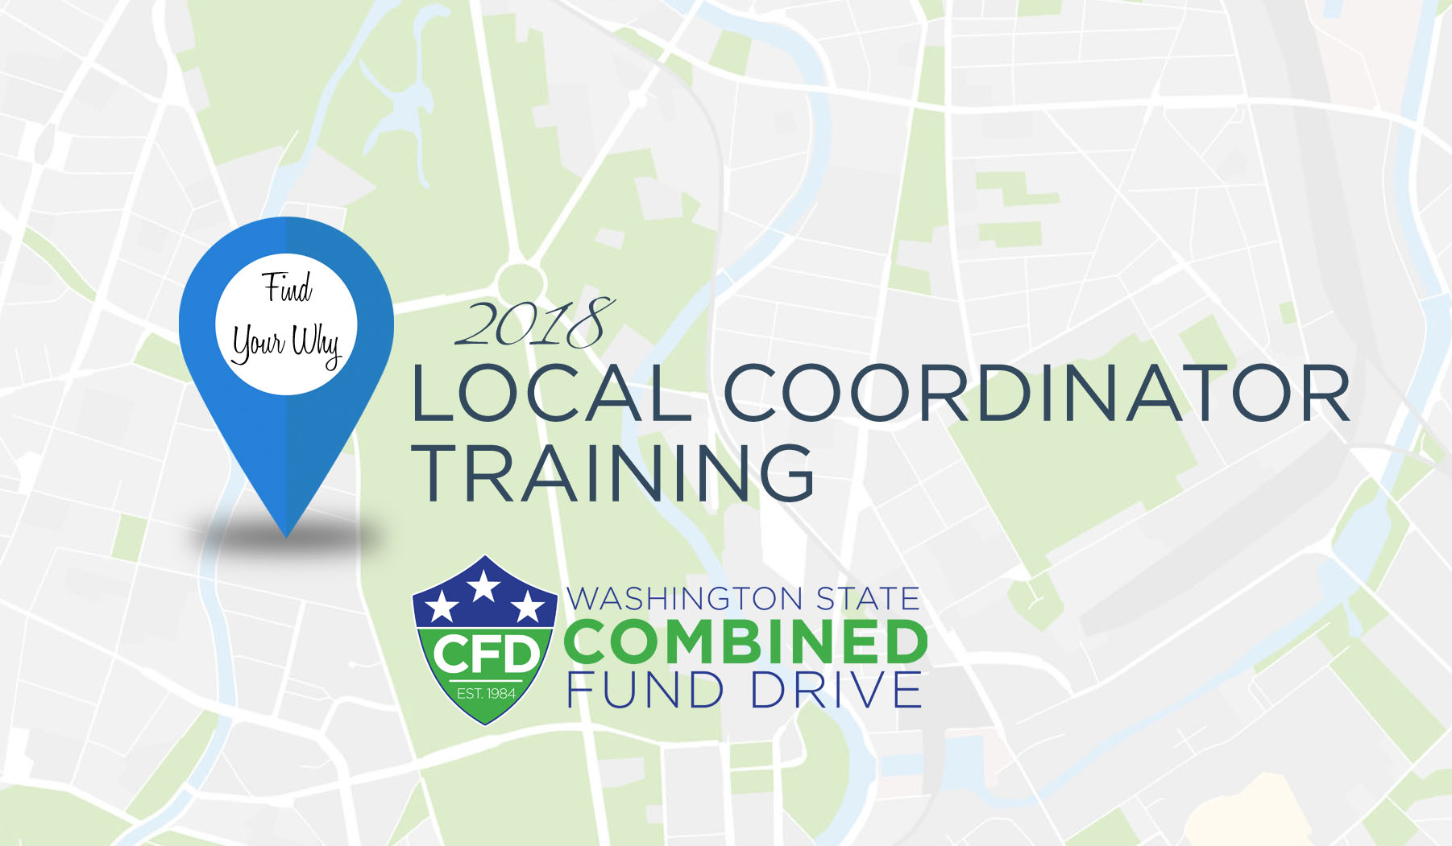

Slide 2

FISCAL
DURING YOUR FUNDRAISER
Check with your agency fiscal office regarding any internal cash handling policies
Protect all donations at your event
Protect yourself! Count all funds in the presence of another volunteer and document funds
Keep track of donations raised by type per charity

Slide 3
FISCAL
AFTER YOUR FUNDRAISER
Get the fiscal transfer number and dollar amount from your fiscal office: enter these details onto the Fundraiser Transfer Form
Enter your fundraiser online
Save all your fundraiser documents
Send your fundraiser documents to the CFD and OSOS Fiscal office
Share the results of your fundraisers with your agency

Slide 4
FISCAL
REIMBURSEMENT
Do not spend more money on your fundraiser than you anticipate raising
Complete the A-19 form, make copies of the A-19 and your receipts
Save all your reimbursement documents
Send your reimbursement documents to your financial office
Your financial office will reimburse you and CFD reimburses them

Slide 5
FISCAL
RAFFLES AND GAMBLING
RCW Title 9, Chapter 46
Raffles are permitted, but RCWs must be adhered to and the CFD cannot raise more than $5,000 in raffle fundraisers per year
Raffle tickets cannot be sold as part of a “deal,” like “3 tickets for $5”
Raffle tickets have value: protect them like cash
Gambling is prohibited and defined as a contest where the elements of prize, chance and consideration are present
  Remove one element and this is no longer gambling

