Slide 1
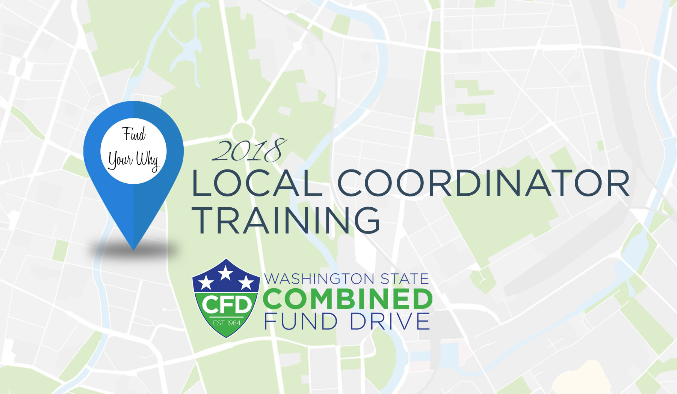

Slide 2


Slide 3

ETHICS AND THE CFD
CONDUCTING CFD ACTIVITIES ON STATE TIME
CFD is a legal part of state business: Advisory Opinion 00-09
CFD volunteers can conduct CFD activities using state resources like employee time, equipment and supplies
The amount of state resources devoted to CFD is left to the discretion of your agency
Contact the CFD if you’re having issues conducting your campaign

Slide 4
ETHICS AND THE CFD
SOLICITING BUSINESSES FOR IN-KIND DONATIONS
CFD volunteers are allowed to solicit for in-kind donations
  Employees at regulatory agencies may not be allowed to solicit
Solicitation letters are available by request only: contact cfd@sos.wa.gov for a letter
If you’re unable to solicit for in-kind donations, contact the CFD at (360) 902-4162 or cfd@sos.wa.gov for assistance

Slide 5
ETHICS AND THE CFD
TIPS FOR SOLICITATION
Obtain permission to solicit businesses for in-kind donations during work hours
Identify yourself as a CFD volunteer, NOT an employee at your agency
If you’re unable to use work time for in-kind solicitations, print solicitation letters and deliver them on your personal time or mail them

