Slide 1


Slide 2



Slide 3


Slide 4









The CFD is created through an Executive Order from Governor John Spellman with the assistance of Thurston County Auditor Sam Reed.
The Executive Ethics Board deems CFD a part of state business, allowing its volunteers to use state time and resources to run their campaigns.
The CFD becomes official state law through the passage of RCW 41.04.033
The CFD creates one of the first online giving station for public employees in the country.
The CFD moves from the Department of Personnel to the Office of the Secretary of State.

Slide 5
Raised $140 million since 1984
$5.4 million in 2017
One of only four states that give more than $5 million annually
Over 4,500 member charities
More than 1,100 volunteers statewide
Average monthly pledge is $10 per month

Slide 6


Slide 7


LIMITED TIME
MONTHLY
ONE-TIME
Employee selects a charity, start date and amount
Donation runs until employee cancels or separates from state government
Employee selects a charity, pay date and amount
Donation is taken out on specified date
Employee selects a charity, start and end date, amount
Donation is taken from each paycheck at specified time

Slide 8


Slide 9

CREDIT CARD
CASH
CHECKS
Follow all cash handling procedures
Deposit your funds into agency CFD account within 24 hours
Check must be made out to the CFD
Donor can fill out an individual paper contribution form or volunteers can send check to CFD office
Register your event with the CFD office
Must be treated as a standard fundraiser transfer in CFD system

Slide 10


Slide 11

GET HONORED
SEARCH
LOG
The CFD has multiple ways
for a donor
to search for volunteer opportunities
in their area
Donors can log volunteer hours with any CFD member charity through the search engine or their donation account
Agencies will be rewarded for logging the most volunteer hours at CFD recognition events

Slide 12

FOR CHARITIES
It’s FREE to join!!!
Reduces administrative cost
Helps charities plan their budgets for the year to come
Access to thousands of potential donors

Slide 13

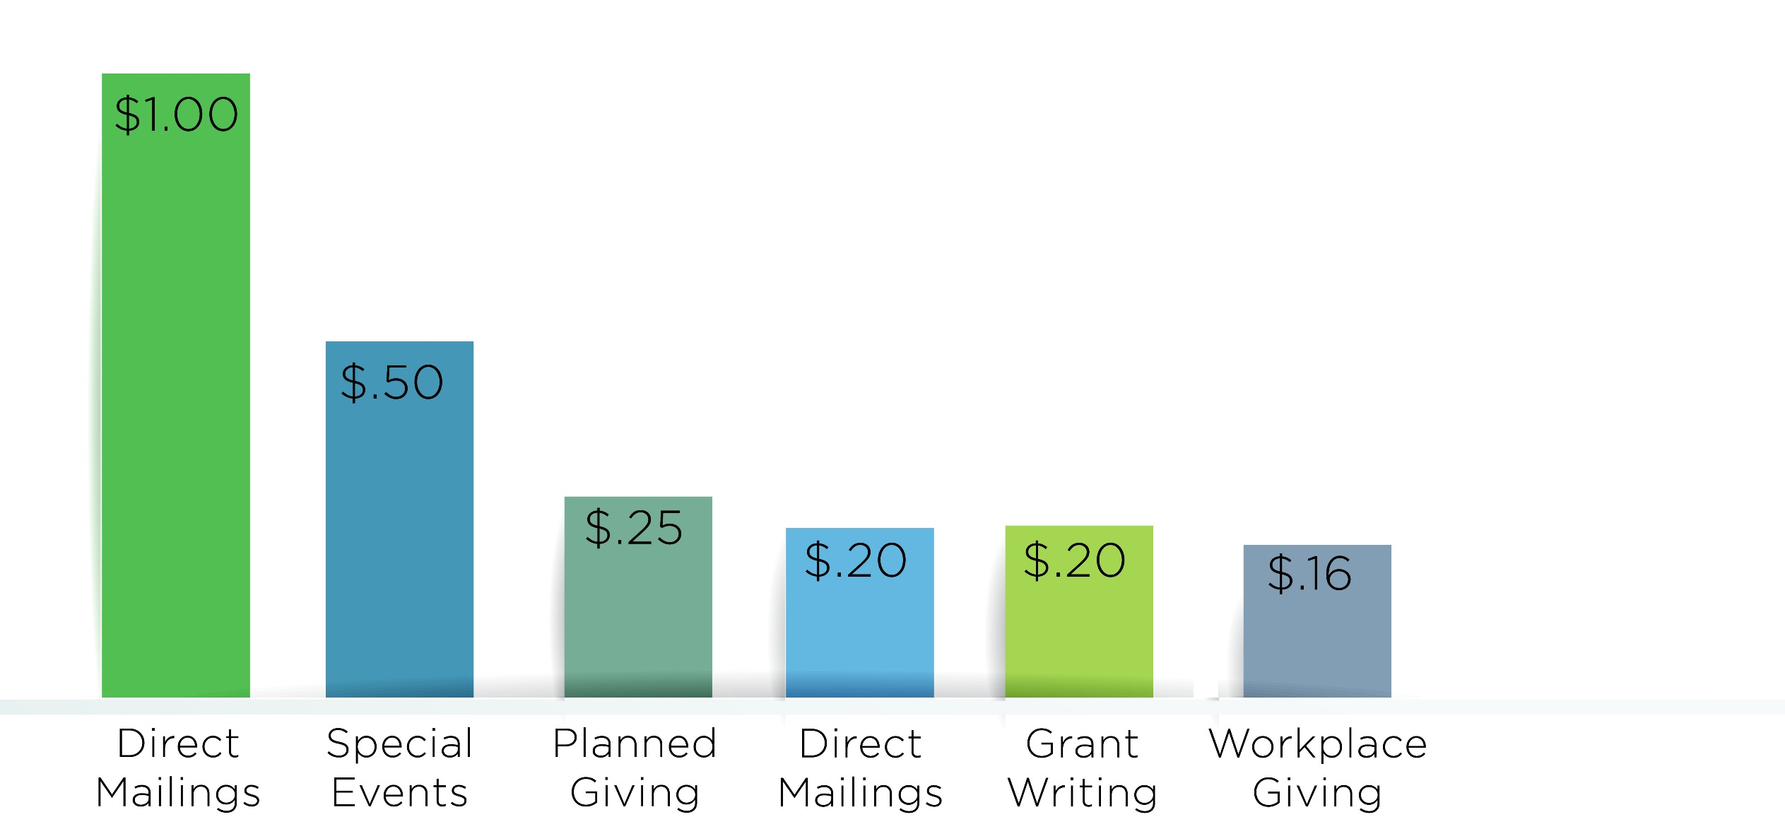
What it takes to make a buck
The average cost per service it takes to make $1.00 for charity

Slide 14
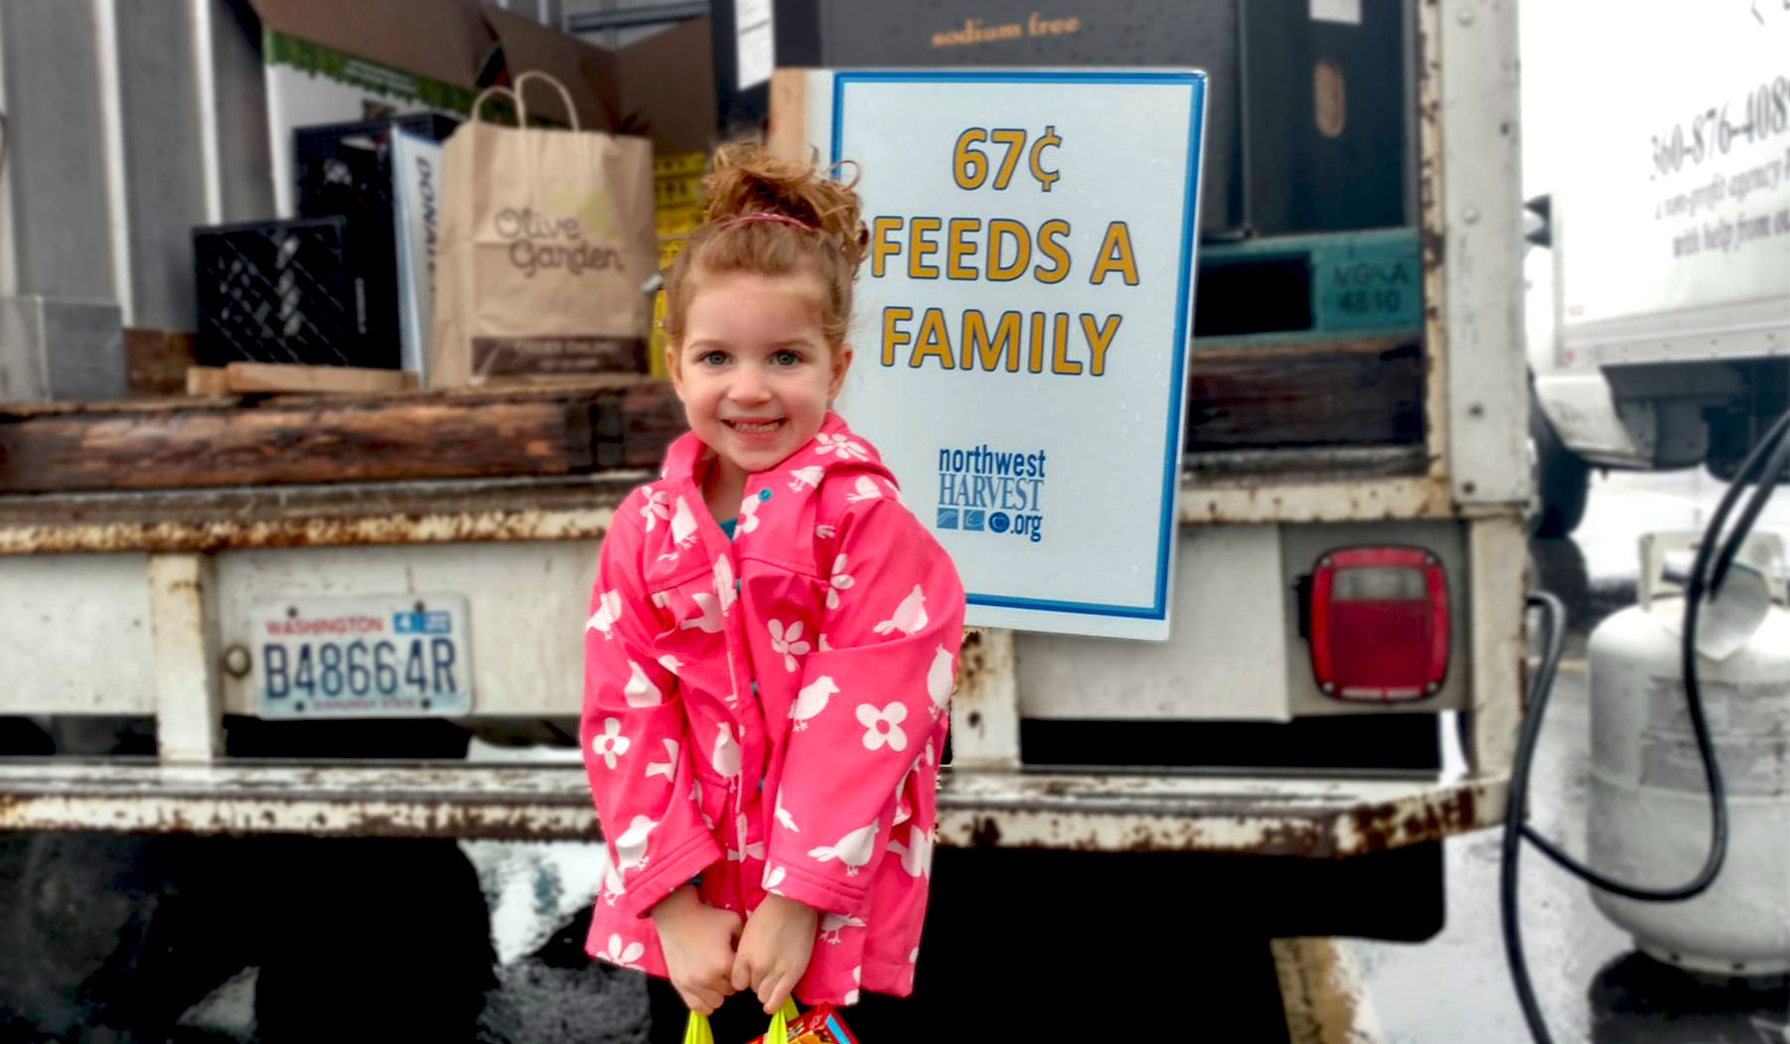

Slide 15
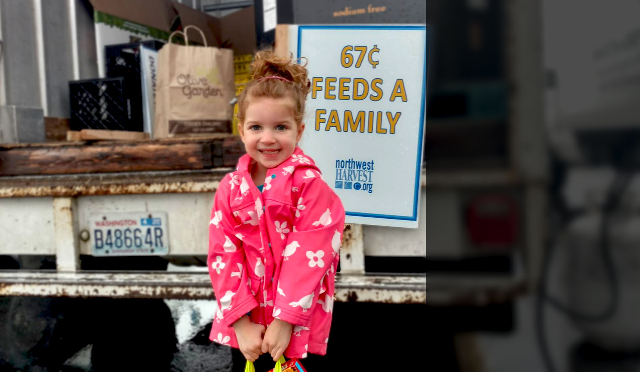
$.67
WHAT IT TAKES FOR NORTHWEST HARVEST TO FEED A FAMILY OF THREE
$1,627,000
THE AMOUNT OF MONEY DONATED TO NORTHWEST HARVEST FROM CFD SINCE 2008
1,000,000
THE AMOUNT OF FAMILIES THAT HAVE BEEN FED BY CFD DONORS SINCE 2008

Slide 16
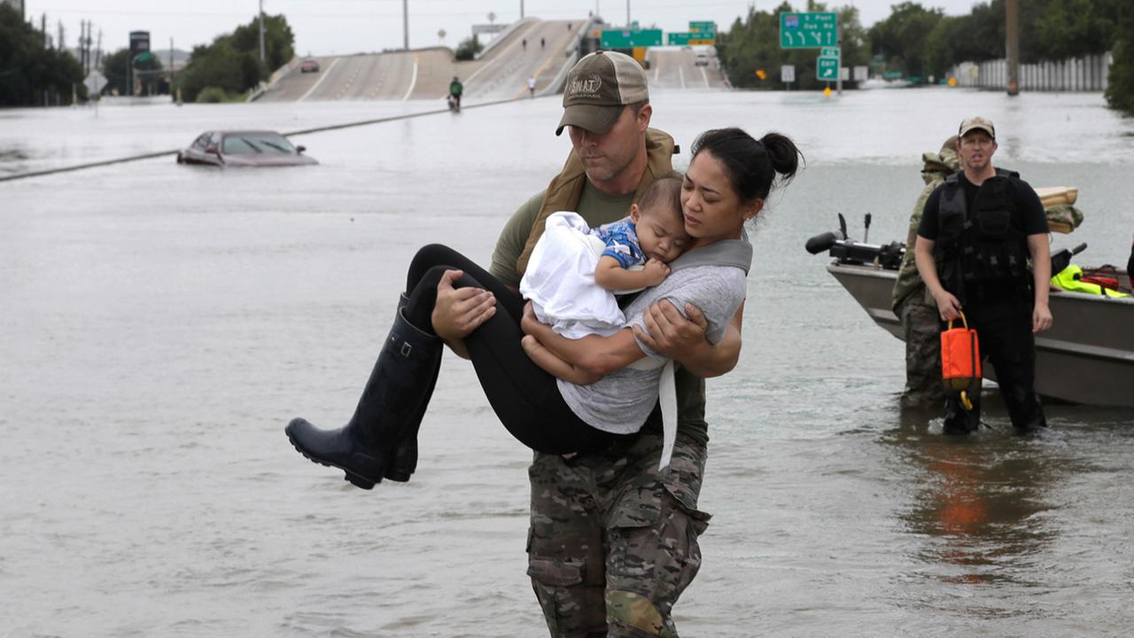

Slide 17
$250
FEEDS 25 DISASTER SURVIVORS A WARM MEAL FROM THE AMERICAN RED CROSS
$46,879
WHAT CFD DONORS GAVE TO THE AMERICAN RED CROSS DISASTER RELIEF FUND IN 2017
4,687
DISASTER SURVIVORS FED AS A RESULT OF CFD DONATIONS

Slide 18






Slide 19
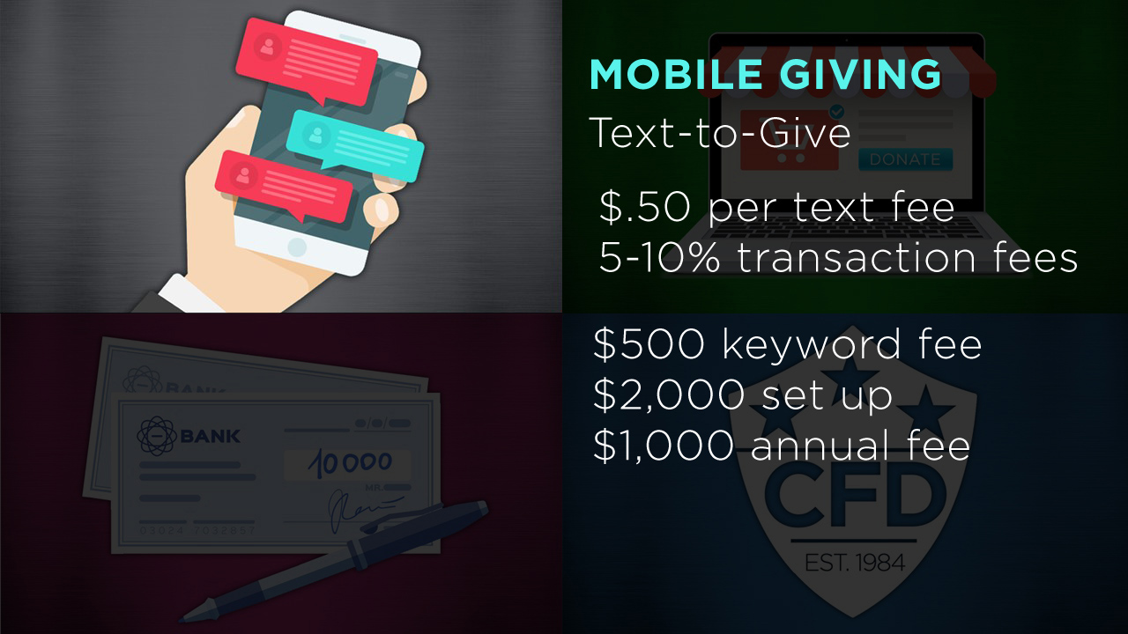

Slide 20
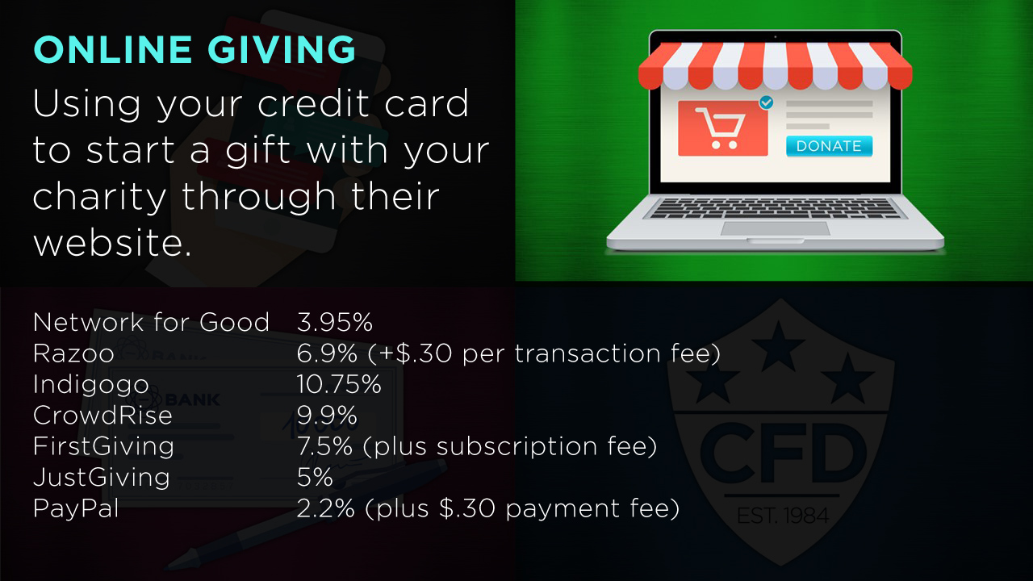

Slide 21
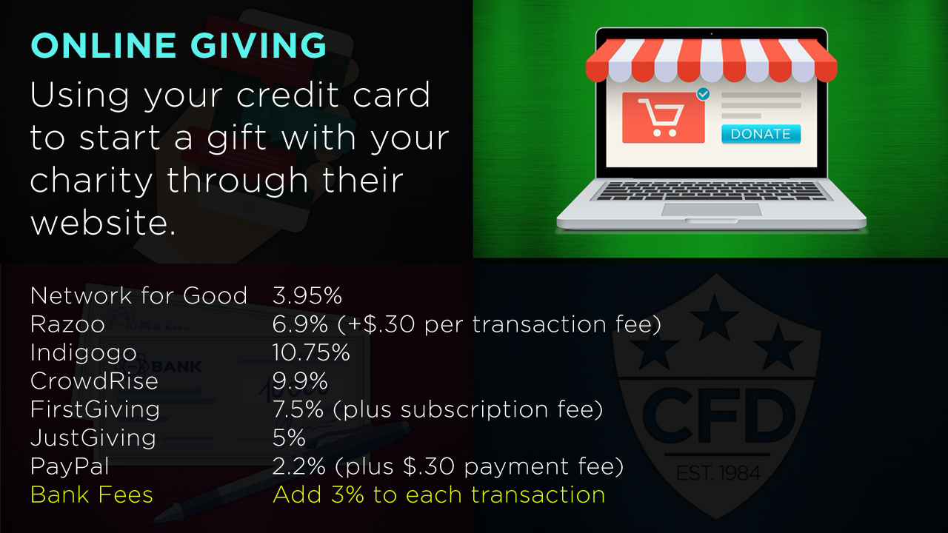

Slide 22
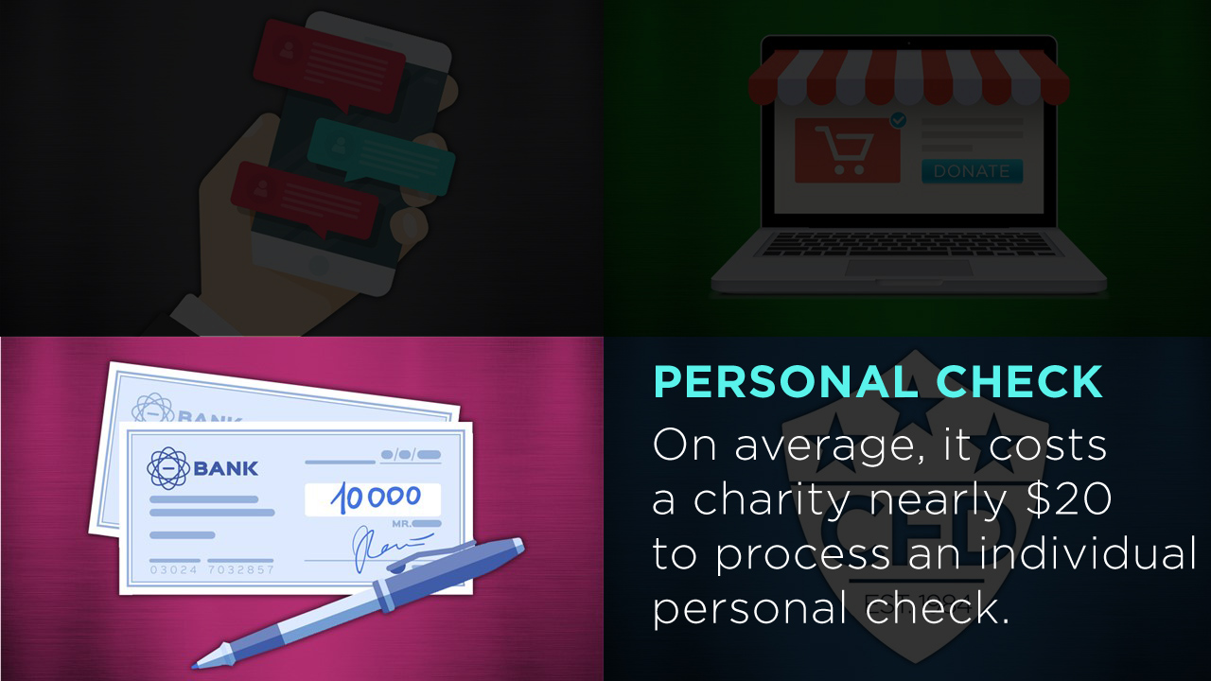

Slide 23
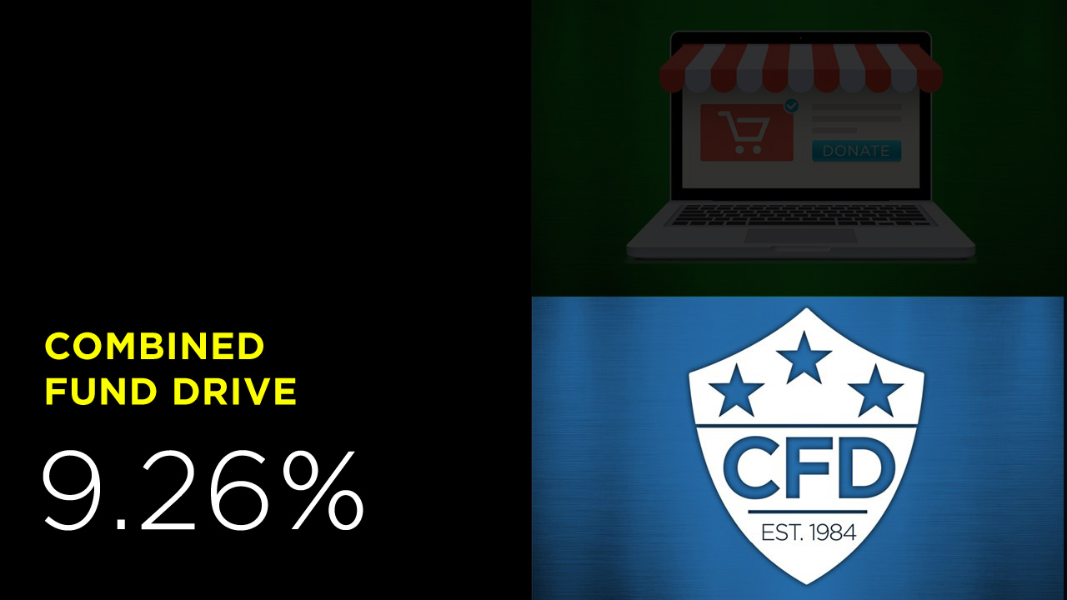

Slide 24
GETTING TO 9.26%
Payroll
Contribution
Agency
Fundraisers
Corporate
Donations
Interest
Earned
CFD
NON-SPECIFIED FUND
OPERATIONAL
EXPENSES
If there is money left, the remaining funds are disbursed to member charities
If costs remain, administrative fee is charged to member charities

Slide 25
FOR DONORS
It’s easy
It’s safe
It’s your choice
It’s tax deductible
Anonymity

Slide 26


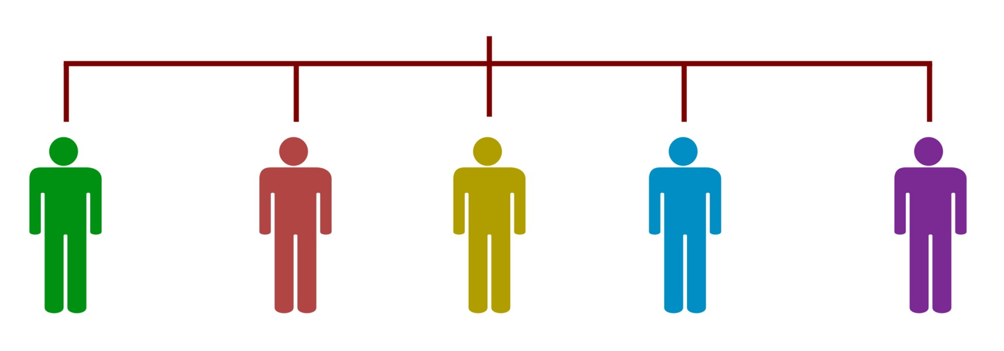
OUR STRUCTURE
Each agency has a Campaign Leader to lead and facilitate CFD activities
Local Coordinators are chosen to promote events, ask employees to give, and market the campaign in their offices.

Slide 27
YOUR ROLE
Recruit
Communicate
Set goals and theme
Log fundraisers
Make the ask

Slide 28

July Recruitment of Local Coordinators
August Local Coordinator Training
Supply ordering
October 1 Campaign begins (First Week to Give)
November 30 Campaign event deadline
December 3-7 Last Week to Give
December 7 Fundraising money transferred to CFD office by Campaign Leaders
December 31, 2018 Official end date of campaign
December 31, 2018 Nominate volunteers for recognition awards
February/March, 2019 Recognition events

Slide 29


