Slide 1
Basics of Managing Records
Washington State Archives
recordsmanagement@sos.wa.gov
(360) 586-4901

Slide 2
Benefits of Managing Records
Enables the agency to fulfill its mission
Promotes cost-effective use of agency resources
Promotes open and accountable government
Notes:
Time – Agency staff can work most productively when the right people are able to locate the right records at the right time. In addition, retaining records that document the agency’s actions and experiences helps prevent the wasting of time and resources during staff turnover.
Storage costs – Through timely destruction of non-archival records (which have met their minimum retention period) and transfer of archival records to Washington State Archives, agencies are able to make optimal use of the physical space within their facilities and the storage space on their servers.
IT costs – In addition to reducing IT storage costs, the appropriate disposal/transfer of public records also reduces other IT costs associated with the time it takes to backup/restore data and to migrate records.
Litigation costs – By being able to locate all necessary records in a timely manner during litigation,

Slide 3
What Is a Public Record?
For the purposes of retention and destruction, two criteria
(RCW 40.14.010):
Made or received in connection with the transaction of public business
Regardless of format
For public disclosure, refer to chapter 42.56 RCW.
Notes:
As part of your duties to this agency

Slide 4
Chapter 40.14 RCW
All public records shall be and remain the property of the state of Washington. (RCW 40.14.020)
They shall be delivered by outgoing officials and employees to their successors and shall be preserved, stored, transferred, destroyed or disposed of, and otherwise managed, only in accordance with the provisions of this chapter.
Notes:
This applies to you regardless of whether you work for or volunteer for the agency.
You can’t take records home or give them away.

Slide 5
My device/account = my records?
It may be your personal device or account, but if it’s being used for agency business, keep in mind that you are accessing (and sometimes creating) public records

Slide 6
RCW 40.16.020 – Injury to and Misappropriation of Record
Every officer who shall mutilate, destroy, conceal, erase, obliterate, or falsify any record or paper appertaining to the officer's office…is guilty of a class B felony and shall be punished by imprisonment in a state correctional facility for not more than ten years, or by a fine of not more than five thousand dollars, or by both.
Notes:
Intentional desctruction
Skamania: There was an investigation into questionable business practices, and the County Auditor ordered staff to destroy records.
Selah: Stole gov records and deleted public docs after he was fired.
Former Skamania County Auditor (2012)
Pleaded guilty to attempted injury to public record
168 hours community service; $62,000 in restitution
Former Selah City Supervisor (2014)
Entered Alford plea on one charge of injury to public record
1 day in prison; $65,474 in restitution

Slide 7
How Do I Know What to Keep?
Agencies are granted ongoing legal authority to disposition (get rid of records) through legal documents called
records retention schedules
Records retention schedules for local or state government are approved by the Local or State Records Committee (RCW 40.14.060 and 40.14.070; chapters 434-624 and 434-630 WAC)

Slide 8
Which Schedule Do I Use?
State Agencies
Local Agencies
sos.wa.gov/Archives
“State Agencies” Tab
“Records Retention Schedules”
Find your agency’s schedule
State General vs. Agency Specific
sos.wa.gov/Archives
“Local Governments” Tab
Find your type of local government agency
Find the appropriate retention schedule
CORE vs. Sector
Notes:
Live Demo: https://www.sos.wa.gov/archives/

Slide 9
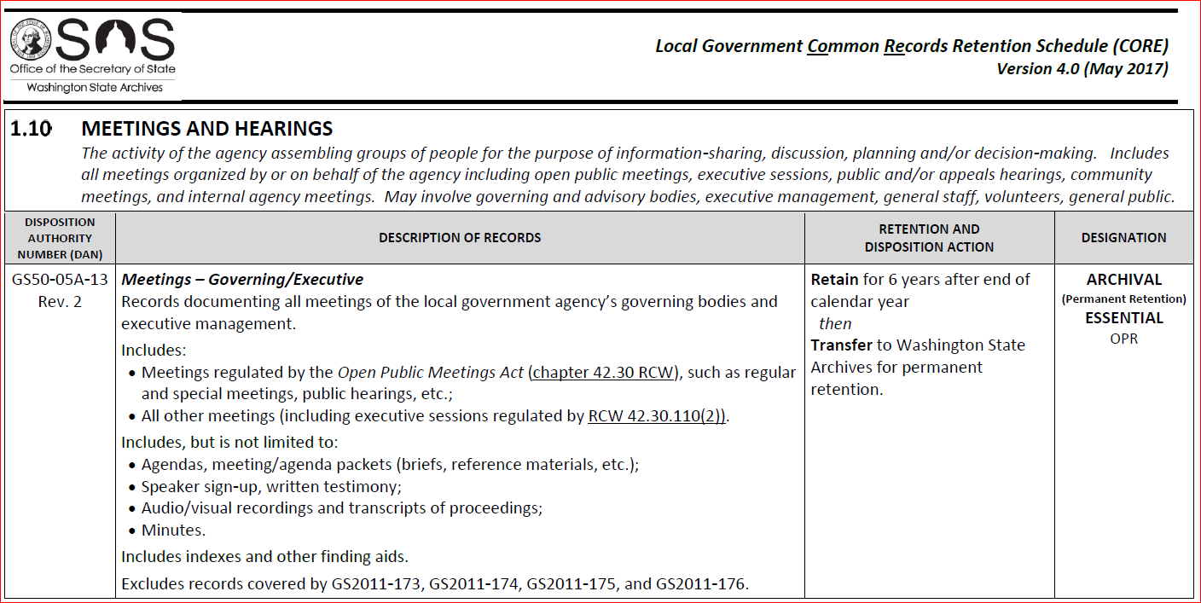
Records Retention Schedule
Rule of Thumb: Never destroy a record unless you can point to a
“DAN” authorizing you to do so.
Notes:
Explain “until no longer needed for agency business” retentions
This is a screenshot of a records retention schedule. It is a list of the types of records that an agency might create or receive.
READING THE SCHEDULES – PARTS OF A DAN
Each type of record has a Disposition Authority Number (DAN) which is the unique identifier that authorizes the destruction/transfer of that record at a certain time.
Each DAN has a title, description, retention and disposition action, and a designation.
Title and Description
The title and description will describe the type of record that falls under that DAN. It may also contain some examples of records that fall under that DAN and examples of records that DO NOT fall under that DAN. Your record may still fall under that DAN if it matches the description, even if it is not in the “included” list.
Retention and Disposition Action
This tells you how long you must retain that type of record, when that countdown starts, and what you must do with the record once it has met its required retention period. There are two options for dispositioning a record: destroy or transfer. If your record must be transferred, then you should call your Regional Branch Archivist when you are ready to get rid of the records. They will appraise (evaluate the historical value of) the records and decide whether all, some, or none should be transferred to the State Archives for permanent retention. If they find no historical value in the records, they will provide you with authorization to destroy the records. If they do find historical value in the records, they will walk you through the process of transferring the records to the State Archives.
Designation
There are two designation categories:
ARCHIVAL/NON-ARCHIVAL – Indicates what you need to do with a record at the end of the retention period.
Historical Research
If a record may have lasting historical value, it is designated as ARCHIVAL (Appraisal Required).
ESSENTIAL/NON-ESSENTIAL – Indicates that the records needs additional protection during its retention period.
Disaster Planning
An ESSENTIAL record is a record that your agency MUST have in order to resume normal operations after some kind of disaster.

Slide 10
KEEP PUBLIC RECORDS for
MINIMUM RETENTION
then
DESTROY
TRANSFER
Notes:
About 95% of records are not archival. Small percentage of records that have enduring historical value. That’s what goes to the Archives.

Slide 11
HOLD IT!
There are times when you must hang on to records even if their retention requirements have been met:
Litigation holds (must keep until hold lifted)
Open public records requests (must keep related responsive documents until request fulfilled/closed)
Notes:
Two acceptations to this rule

Slide 12
“Born Digital” Records
Electronic records must be retained in electronic format…for the length of the designated retention period.
Printing and retaining a hard copy is not a substitute for the electronic version.
(WAC 434-662-040)
Notes:
Don’t print out email
metadata

Slide 13
Records Management Resources
Website: sos.wa.gov/archives
Training – online and in-person
How-to videos
Retention schedules
Advice sheets
Notes:
Take folks on an online tour to show where stuff is.

Slide 14
Free Consultation, Training, and Advice
Washington State Archives
recordsmanagement@sos.wa.gov
www.sos.wa.gov/archives
Phone: (360) 586-4901
Notes:
If you don’t find what you’re looking for on our website, we’re happy to provide advice and consultation by phone, e-mail, and in person – at no charge!
We’re happy to provide the following services: small questions about DANs to large projects you need help with.
This is how to contact us.

