Slide 1
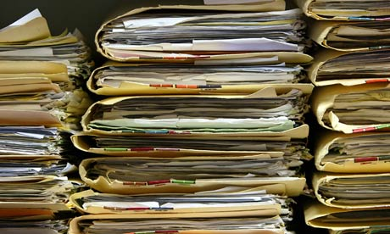
Reducing Stored
Paper Records
Steve Excell
State Archivist
Steve.Excell@sos.wa.gov
360-586-2664
Kim Wyman
Secretary of State
Russell Wood
State Records Manager
Russell.Wood@sos.wa.gov
360-586-4900
Notes:
Finally, we like so many others in the Heritage Caucus work to preserve the heritage of this State.
For three years a grant from the National Endowment of the Humanities has allowed us to participate in the National Digital Newspaper Project contributing digital images of early Washington newspaper to Chronicling America , a project of the Library of Congress.
Though our Washington Rural Heritage project we teach local library and museum staff how to digitize their historical treasures, describe them with metadata, and then we host the images for them.
We are the Corporate Library for the State maintaining a comprehensive collection of print and digital publications from State Agencies for the people of this state.
We also serve as a regional depository for federal publications.
So this is the Washington State Library, not a dusty quiet place in Tumwater where people in sensible shoes silently move about, but a vibrant organization with a mission to serve everyone in Washington.

Slide 2
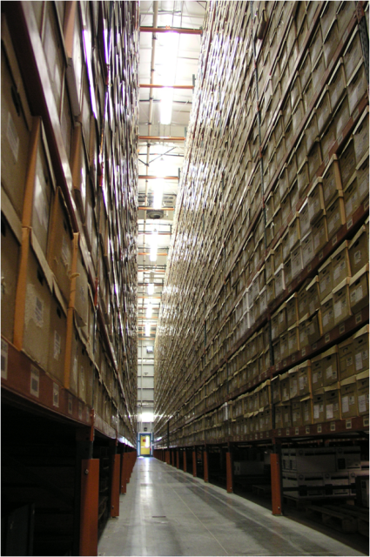
Isabella Bush Records Center
99%

Slide 3
Isabella Bush Records Center
99%

Slide 4
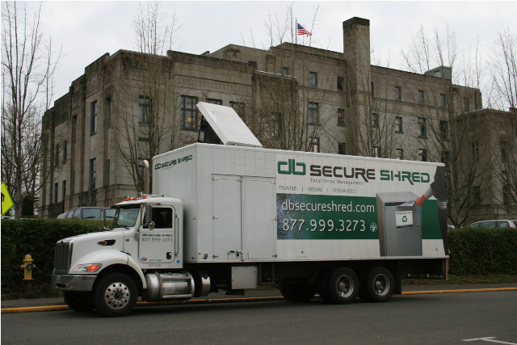
99%

Slide 5
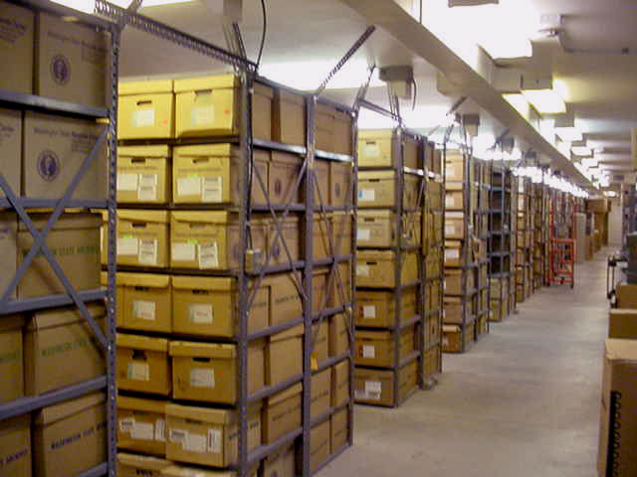
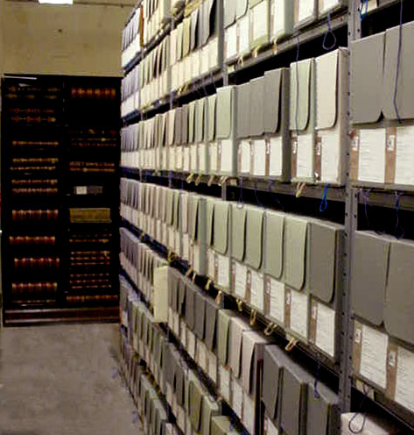
1%
In the stacks, underground
Washington State Archives

Slide 6
The State Archives is Full
The State Archives Building was built in 1962
The building is full and now technically obsolete.
2nd Engrossed House Bill 1115 (Chapter 3, Laws of 2015) authorized the predesign study for a new State Library – State Archives Building.
Implements RCW 43.82.10(5): “It is the policy of the state to encourage the collocation and consolidation of state services into single or adjacent facilities.”

Slide 7
State Records Committee
RCW 40.14.050
Committee Members:
State Auditor's Representative (Chair)
Attorney General's Representative (Vice-Chair)
Office of Financial Management Director's Representative
State Archivist (Secretary)

Slide 8
State Records Committee
Chapter 40.14 RCW
Committee’s Powers & Duties:
Review and adopt retention schedules for all state records held by all state agencies
Set the ultimate disposition for each record series:
Destroy
Archive
Archival Appraisal Required

Slide 9
Supplemental Operating Budget Proviso
(2014 ESSB 6002, Section 119)
The Office of the Secretary of State
convened a work group to:
“…study methods for retaining records in electronic formats and for shorter periods of time, with the goal of reducing the volume of stored paper records by ten percent by the end of 2016, and an additional ten percent by the end of 2018.”

Slide 10
Supplemental Operating Budget Proviso
(2014 ESSB 6002, Section 119)
Goals:
10% Reduction by the end of 2016
Added 10% Reduction by the end of 2018
Reports to Legislative Committees:
1st Report – December 31, 2014
2nd Report – December 31, 2015

Slide 11
Paper Records Reduction
Work Group
Eight state agencies met to brainstorm “how” to reduce the amount of paper records stored at the Records Center:
Office of the Attorney General (ATG)
Department of Corrections (DOC)
Department of Social & Health Services (DSHS)
Office of the Chief Information Officer (OCIO)
Office of Financial Management (OFM)
Office of the State Auditor (SAO)
Office of the Secretary of State (SOS)
Washington State Department of Transportation (WSDOT)

Slide 12
Paper Records Reduction
Work Group
Dozens and dozens of brainstorming ideas for reducing paper records…
…Resulted in six strategies to reduce the volume of paper records stored at the Records Center.

Slide 13
Strategy No. 1
Increasing Scrutiny of Retention Periods
& Archival Designations
Ask agencies for justifications for retention periods longer than 6 years. Extra scrutiny for extraordinarily long retention periods (50 years, 75 years, etc.).
Re-evaluate archival designations. Appraise potentially archival records when the retention period is set and prior to arriving at the Archives.
Accept electronic versions of archival records over paper if the record is informational and not historic in nature.

Slide 14
Strategy No. 2
Aligning Records Center Holdings
to Current Retention Schedules
Ask agencies to review 17,515 boxes of really old paper records in light on newer and shorter retention schedules.

Slide 15
Strategy No. 3
Increasing Agency Timeliness
in Authorizing Destruction of Records
State agencies used to delay many months, or even many years, before approving the destruction of records no longer required.
All agency are now within 2-3 months of being current on their destruct notice.

Slide 16
Strategy No. 4
More Focus on Coordinating Reviews
of Retention Schedules Across Government
Work with multiple state agencies with over-lapping jurisdictions to consolidate numerous record retention schedules into one.
Case Study: Department of Revenue, County Assessors, and Board of Tax Appeals (and each of the their legal advisers).

Slide 17
Strategy No. 5
Encouraging Use of Scan and Toss
“Non-Archival” paper records that have been scanned for electronic workflows can be tossed.
Scanning paper to just to eliminate storing paper is not cost-effective:
Scanning 1 cu. feet of records = $ 800.00
Storing 1 cu. foot box of records = $ 4.18 / Year
Break-Even Point $≈$ 190 Years

Slide 18
Strategy No. 6
Continuing to Work on Information Governance
Enterprise Content Management (ECM) Initiative is working to manage agencies’ information security, disclosure/access, retention and destruction in a coordinated and coherent way.
Convert manual paper processing to electronic workflows, and then manage retention and public disclosure with ECM tools.
Both require new IT investments by state agencies.

Slide 19
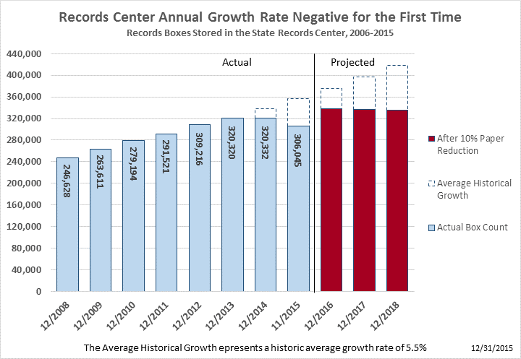
The Result:
The Mandated 10% Paper Record Reduction
Was Achieved One Year Early

Slide 20
Questions

