Slide 1
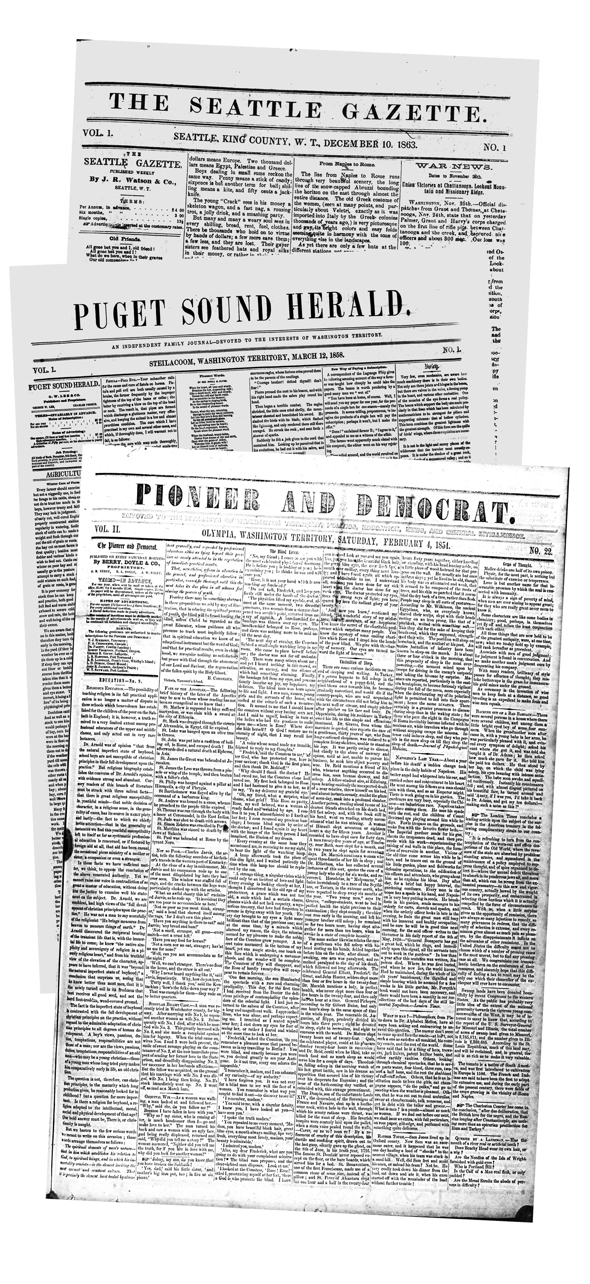
Civil War Newspapers
In Washington
Washington State Library
Office of the Secretary of State
October 19 2012

Slide 2
Pre-war Period
Olympia
The Columbian Sept. 1852-Nov. 1853
Washington Pioneer Dec. 1853-Jan. 1854
Pioneer & Democrat Feb. 1854-1860
Steilacoom
Puget Sound Courier May 1855-Apr. 1856
Puget Sound Herald Mar. 1858-1860
Truth Teller 1858

Slide 3
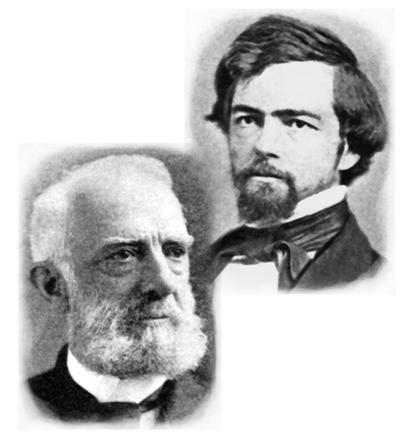
The Martial Law Controversy
In May 1856, Gov. Isaac Stevens arrests the chief
justice of the territorial Supreme Court, Edward Lander,
and proclaims a state of martial law in Pierce, and then
Thurston, counties.

Slide 4
Pioneer & Democrat
July 7, 1856
Puget Sound Courier
Apr. 25, 1856

Slide 5
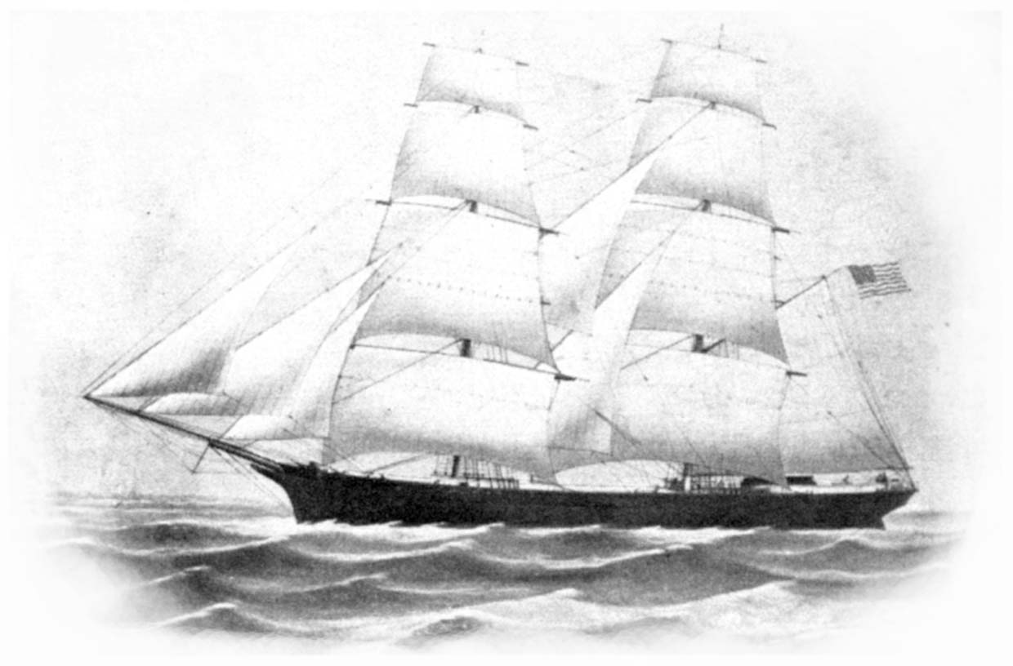
The Pig War
On June 15, 1859, Lyman Cutler, an American
settler on San Juan Island, shot and killed a pig
belonging to the British Hudson’s Bay Company,
triggering an international confrontation.
Pioneer & Democrat
Aug. 5, 1859

Slide 6
Puget Sound Herald
Aug. 5, 1859

Slide 7
The War Years
Olympia
Pioneer & Democrat Jan.-May 1861
Seattle
Washington Gazette Aug. 15, 1863
Seattle Gazette Dec. 1863-June 1864
Seattle Weekly Gazette Aug. 1864-1865
Steilacoom
Puget Sound Herald 1861-Nov. 1864
Walla Walla
Washington Statesman Dec. 1861-Aug. 1864
Walla Walla Statesman Sept. 1864-1865

Slide 8
Pioneer & Democrat, Olympia
May 10, 1861

Slide 9
Puget Sound Herald
Steilacoom
July 9, 1863
Republican

Slide 10
Washington Statesman
Walla Walla
July 25, 1863
Democrat

Slide 11
Latest News from
The East
Washington Statesman
Walla Walla
July 11, 1863

Slide 12
Secessionist Newspaper from Oregon
Table Rock Sentinel, Jacksonville
Oregon Sentinel, Jacksonville
In Historic Oregon Newspapers
http://oregonnews.uoregon.edu/newspapers/

Slide 13
Seattle Weekly Gazette
Apr. 20, 1865
Walla Walla Statesman
Apr. 21, 1865

Slide 14
Reconstruction
Seattle
Seattle Weekly Gazette Jan. 1866-Mar. 1866
Puget Sound Semi-weekly Apr. 1866
Puget Sound Weekly Apr. 1866-Mar. 1867
Puget Sound Weekly Gazette Mar.-June 1867
Puget Sound Dispatch Dec. 1871-Oct. 1880
Port Townsend
Weekly Argus Dec. 1870-Dec. 1875
Puget Sound Weekly Argus Jan. 1876-May 1882
Vancouver
Vancouver Register Oct. 1865-Oct. 1869
Walla Walla
Walla Walla Statesman 1866-Dec. 1869

Slide 15
Vancouver Register
Vancouver
Nov. 18, 1865
Republican

Slide 16
Puget Sound Dispatch
Feb. 22, 1872

Slide 17
Walla Walla Statesman
Apr. 17, 1868
Democrat

Slide 18
Vancouver Register
June 27, 1868
Republican

Slide 19
Chronicling America
http://chroniclingamerica.loc.gov/newspapers/
Historical Newspapers in Washington
http://www.sos.wa.gov/history/newspapers.aspx
Classics in Washington History
http://www.sos.wa.gov/history/publications.aspx
Washington State Library
www.sos.wa.gov/library

