Slide 1
2015 State Elections Conference Testing your COOP
June 10, 2015
Notes:
Pick a logo for the main page of your presentation. Delete the other logo.

Slide 2
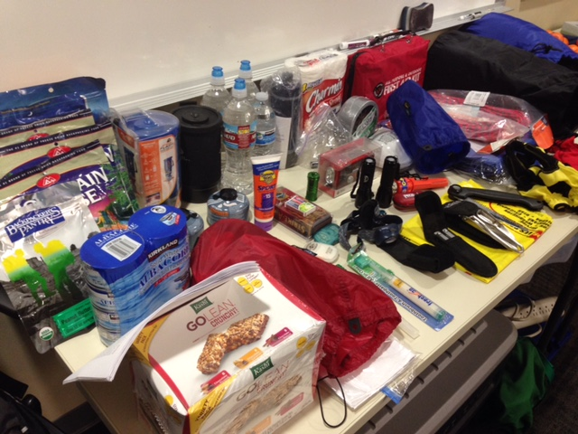
Emergency Go-Kit

Slide 3
Emergency Go-Kit Checklist

Slide 4
Emergency Go-Kit for Kids

Slide 5
Why Test Your COOP?
Evaluate if your COOP plans are adequate and can be implemented
Reveal weaknesses and gaps
The more you prepare and test the more individual performance and organizational coordination and communications will improve
Train new and existing personnel and clarify roles and responsibilities
Establish relationships with other partners
Update your COOP

Slide 6
Training Options
Orientation- This is just a paperwork exercise where you brainstorm/discuss rolls and responsibilities. If you find an error, you discuss how it will be fixed or who will handle the situation.
Tabletop Exercises-This is where you are given a scenario and you start to put your COOP into action.
Functional Exercises-Where you start to deploy and utilize your resources on a limited scale.
Full Scale Drill-Full scale, bring out all the equipment, everyone suits up exercise.

Slide 7
Orientation Exercises
Informal with little preparation
No simulation
Discussion and assignment of roles & responsibilities
Introduction to policies, procedures, plans & responsibilities
Solves problems as a group
Involve developing scenarios that describe potential problems and information necessary to address problem

Slide 8
Tabletop Exercises
Discussion guided by a facilitator(s)
Utilizes previously developed scenarios with information necessary to address problem
Effective tool to simulate emergency event and practice COOP procedures
No simulators and no attempt to arrange elaborate facilities or communications
One or two evaluators to observe proceedings and progress

Slide 9
Tabletop Exercises (Cont’d)
Murphy’s Law can come into play in this type of exercise
Exercise does not take place in real-time
Success is determined by feedback from participants and the impact this feedback has on the evaluation and revision of policies, plans, and procedures

Slide 10
Functional Exercise
Policy & coordination personnel practice emergency response
Stressful & realistic simulation
Takes place in real time
Emphasizes emergency functions
Command center is activated

Slide 11
Full Scale Exercise
Takes place in real time
Employs real people & equipment
Coordinates many agencies
Tests several emergency functions
Activates command center
Purpose is to provide a place where local government officials can work together. Three main groups: Policy, Coordination, & Operations
Produces high stress
Cost is a factor
Agencies may need to respond to a real event during exercise

Slide 12
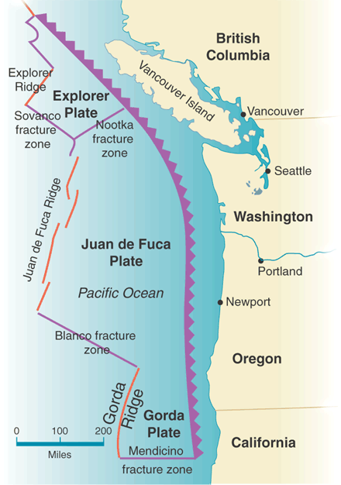
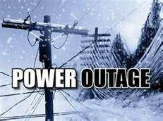
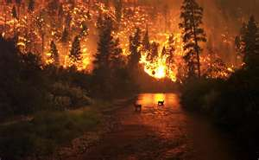
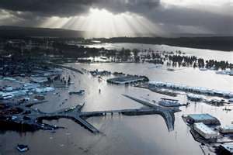
Tabletop Scenario Examples
Earthquake
Power Outage
Flood
Wildland Fire

Slide 13
Questions

Slide 14
Contact Information
Bob Bippert
Emergency Response Manager
Department of Enterprise Services
robert.bippert@des.wa.gov
(360) 407-9210

