Slide 1
Building an ECM Franchise:
Successes, lessons learned and observations from 10 years of enterprise content management
Kyle Stannert
Assistant Director / Public Records Manager
City of Bellevue

Slide 2
What we remember
16 - 3

Slide 3
What we try to forget…

Slide 4
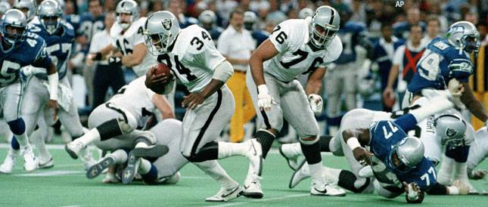

Slide 5
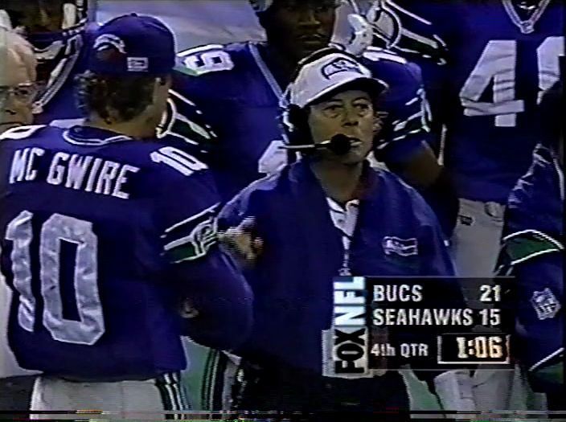

Slide 6
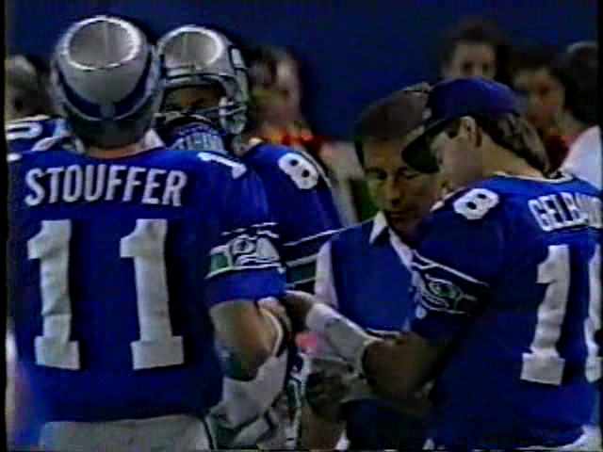

Slide 8
The Bellevue Story
The pilot
The purchase
The cut and run*
The Foundation
The Shift
Recommendations
Build your team
Set goals
Establish rules
Determine Resources
Adapt and move forward (fail faster!)
Don’t compromise
Take the time to explain everything
Explain again
Train all the time
Overview
* The cut and run is more of Kyle’s story and does not reflect a recommendation or the official viewpoint of the City of Bellevue.

Slide 9
Hosted solution (ASP)- The Cloud before we knew of “the cloud”
Scanning (document management) focused
200 users, 50 document types
Centralized enterprise-wide repository for COB electronic documents.
Addressed business need to provide frequently-requested public information in electronic form.
Provided operational efficiencies and reduces need to dedicate space to records storage.
Implemented OCR full text search capability.
The Pilot
(2004)

Slide 10
Bring Pilot Solution Onsite, and expand capabilities.
Foundational layer for Enterprise Application Architecture
Provides necessary solution for managing non-structured (non-database) information.
Consistent with organizational values to manage information from the point of creation, not a tailing process.
Allows move to electronic submittal of information (no user caps)
Reduces legal risk.
Enhances disaster recovery/response.
Conforms with State record keeping requirements and ICMA best practices/goals.
The Purchase
(2006)

Slide 11
IT Enterprise Architecture

Slide 12
The cut and run
(2008)

Slide 13
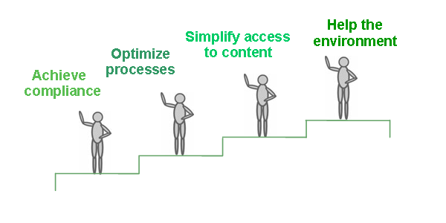
The Foundation
(2009)

Slide 14
1 + 1 = 1
The Migration
(2012 ->)

Slide 15
Methodology for Analysis
Review of ECM Functional Requirements
Technology and Organizational Fit
Review of Costs
Notes:
In place vs. Features
Gaps Identified Included: Records Retention, Imaging, Storage of Large Files (2 GB+)
Requires strategy to improve end user search experience (tools and governance)
Technology and Organizational Fit

Slide 16
ECM System Direction
Oracle ECM Approach | SharePoint ECM Approach
Multiple components implemented between 2007 – 2012 2012 budgeted components include: Records Retention Module Integration with SharePoint Vendor approach will require investment in new Oracle hardware and contracted support of $50k+ / year by 2015 | Originally released as a collaborative tool with no ECM capability Now emerging as an ECM solution with some remaining functionality gaps Better fits within existing IT Infrastructure (Microsoft Office and associated systems and hardware)
Proposed Plan Proposed agreement with Gimmal, LLC moves the City’s management of electronic public records forward by: Beginning shift to using SharePoint as the official ECM Repository Implementing Gimmal Compliance Suite to fill known gaps in the SharePoint solution and provide records retention functionality to enable compliance with state law Providing consultant assistance to ensure baseline system is set up correctly
Prior Solution
Current Solution
Information
Information
I/PM
UCM
SP2010
Estimated to achieve savings of $2M over 10 years
Notes:
Distinction between System Direction and Program Direction
Gross over simplification: There will be a number of pieces required to work along side SharePoint, much as there is with our current goal (integrations, etc). One difference is the need for additional 3rd party tools, primarily for records retention, which we will discuss in further detail.

Slide 17
Recommendation
Full support of current SharePoint 2010 implementation, with the view that it is an ECM platform.
Continued use of Oracle ECM for in-state functionality until SP2010 is in place and meets ECM needs (2014 – 2015 timeframe).
Move forward with electronic records retention project using SP2010 3rd Party tool (was Oracle URM).

Slide 18
Implementation Steps
Next Step: Develop a Work Plan Reflecting Recommended Approach
Dependencies
SP2010 Planning
SP2010 Phase I Implementation
Additional SP2010 Phases
RM Tool Selection
RM Tool Phase I
Additional SP2010 Phases
Required Steps for ECM Migration
Ongoing Program Work Plan
Imaging
Migration of Content
Support Existing Program Needs
(system maintenance, enhancements, end user support)
Re-Configure System Integrations
Document Centric Workflow Solution(s)

Slide 19
Owner
Who has the final say?
General Manager
Project sponsor
Coach
Guides the team day to day Players
Get the right people on the field
Build Your Team

Slide 21
Site Provisioning
Create
Use
Declare
Disposition
Policy / Procedure on Site Provisioning
Audit process to ensure new sites and libraries comply with requirements
Decide who can create sites and what do they have to do before they are allowed to
Direct Upload
Define time period for “use” (period of time between Create and Declare)
Define what / when records are declared per content type
(event vs. time)
Review Disposition Approval Process: Case Based Records
Create from Site
Approve Process to Create Gimmal Containers
Review Disposition Approval Process: Time Based Records
Adopt strategy for handling non-records (reference and transitory records).
Workflow
Establish Benchmark
% of Existing SP Content that is a record
Email
Who approves disposition?
Adopt strategy for handling non-declared records.
Minimum Metadata Standards
Establish Benchmark
% of Declared Records classified accurately
When to Transfer Archival Records
Get SP Development Environment up
Gimmal Compliance Suite installed
Outline Site Owner Training
Outline End User Training
Develop policy on how “Non-Records” are treated.
Conduct a sample / study to determine the current “Qualification Rate”
Set targets for
1) Qualification Rate
2) Declaration Rate
3) Classification Accuracy Rate
Review current disposition approval process
Send list of ‘potentially archival’ records series to the Washington State Archives
Develop litigation hold procedure for Gimmal Cs
Decisions (to do)
Decisions (complete)
RM Program
Post Go-Live

Slide 22
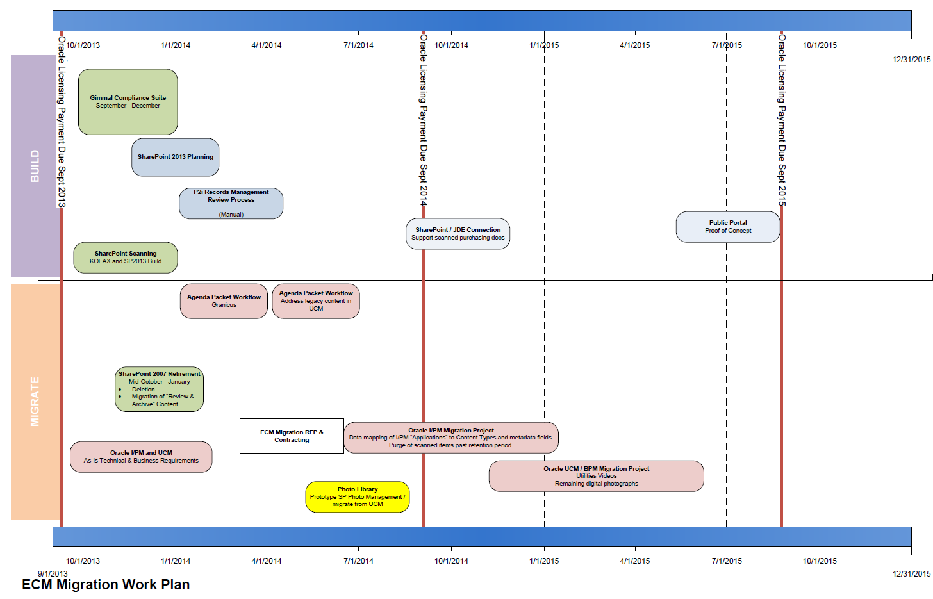

Slide 23
The Bellevue Story
The pilot
The purchase
The cut and run*
The Foundation
The Shift
Recommendations
Build your team
Set goals
Establish rules
Determine Resources
Adapt and move forward (fail faster!)
Don’t compromise
Take the time to explain everything
Explain again
Train all the time
Overview
* The cut and run is more of Kyle’s story and does not reflect a recommendation or the official viewpoint of the City of Bellevue.

Slide 24
Thank You!
KYLE STANNERT
Assistant Director
City Clerk’s Office
kstannert@bellevuewa.gov
425-452-6021

