Slide 1
The Basics of
Historical Research
Washington State Archives, Southwest Regional Branch
Washington State Library
Washington State Historical Records Advisory Board
October 22, 2016

Slide 2
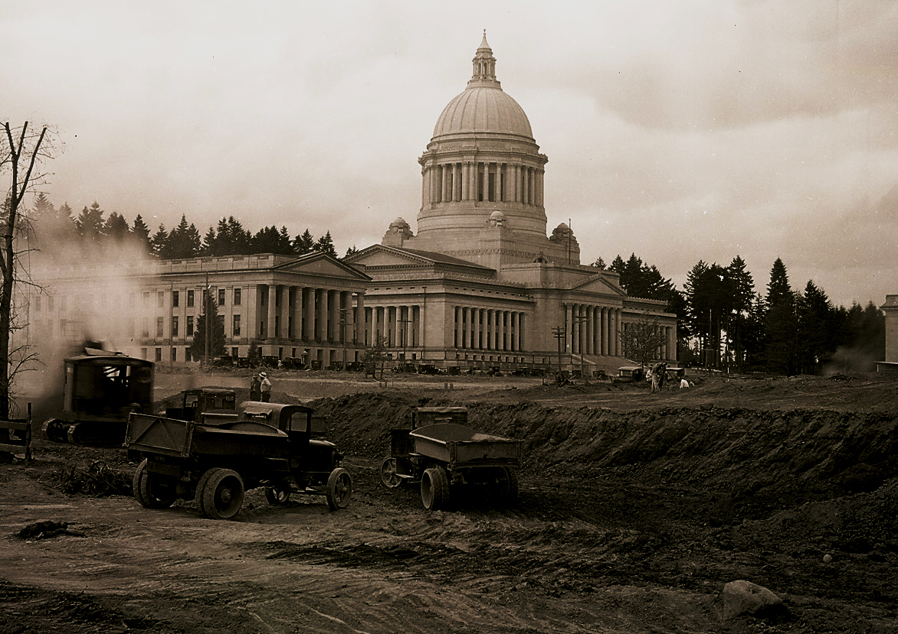
Washington State Historical Records Advisory Board
The Washington State Historical Records Advisory Board is the central advisory body for historical records planning in Washington. Established in 1976, it promotes practices that ensure preservation of, and access to, the state’s public and private historical records.

Slide 3
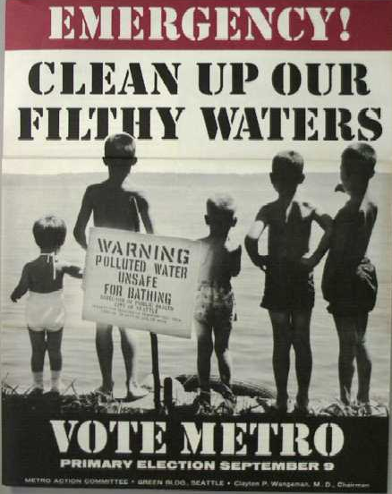
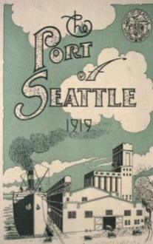
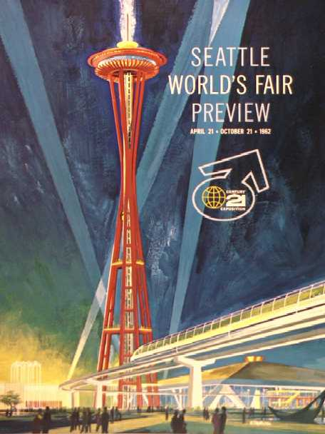
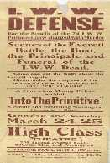
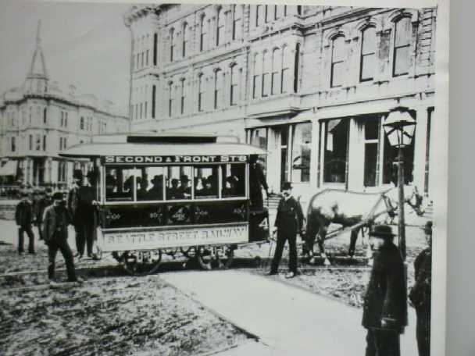
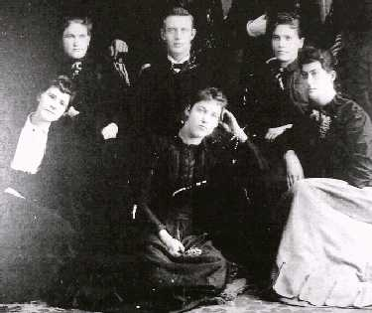
A Public Trust
The Archives of Washington State are administered by the Secretary of State and the State Archivist as a public trust.
Notes:
They preserve primary information about state and local government agencies and the citizens they have served through time.

Slide 4
http://www.sos.wa.gov/archives/

Slide 5
http://www.digitalarchives.wa.gov/

Slide 6
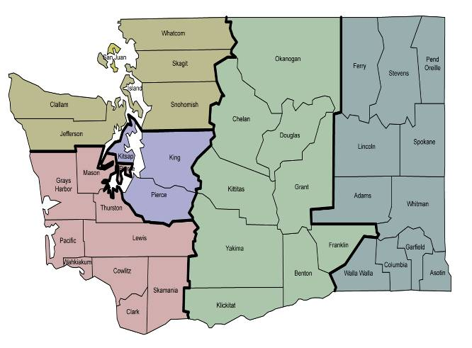
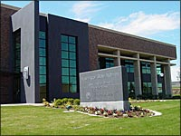
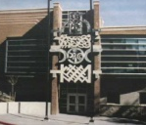
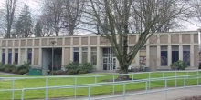
Regional Archives System http://www.sos.wa.gov/archives/

Slide 7
http://www.sos.wa.gov/library

Slide 8
http://www.sos.wa.gov/library/libraries/interlibrary.aspx

Slide 9
Goals for this workshop:
Understand basic concepts and key terms
Become familiar with types of sources
Develop research strategies
Locate collections of interest
Learn how to conduct research in archives and libraries

Slide 10
History is:
an of explanation events through time, when they happened, how they happened and why they are important.
The credibility of historical analysis and interpretation depends on the quality of the research that the historian does.

Slide 11
The historian’s analysis and conclusions are
based on evidence gathered through research.
Key questions about research sources:
What are they?
Where are they?
How do I use them?

Slide 12
What are they?
What are they?
Primary Sources:
Information that is generated during an event or by participants and witnesses.
Secondary Sources:
Information created after an event to explain it to someone else.
Primary Sources:
Information that is generated during an event or by participants and witnesses.
Secondary Sources:
Information created after an event to explain it to someone else.

Slide 13
Primary Sources Include:
Personal papers such as diaries, journals speeches, interviews, letters, memos, manuscripts
Memoirs, autobiographies, and newspapers / periodicals from the time of the event
Records of organizations and government agencies
Photographs, audio and video recordings
Artifacts
Reports
Maps

Slide 14
Secondary Sources
Histories
Biographies
Encyclopedias
Periodicals (Written after event)
Newspapers (Written after event)
Theses
Dissertations

Slide 15
Where are they?
Archives
Museums
Historical Societies
Colleges and Universities
Libraries

Slide 16
Introduction to a topic. Historical context. Historical analysis and interpretation. Information on primary sources. Makes sense of primary sources.
How do I use them?
Secondary sources:
Primary sources:
Direct evidence on events and participants. Information generated by participants or observers. Personal connections to events and conditions. Evidence that supports or contradicts secondary sources. Evidence used to test and support the researcher’s analysis.

Slide 17
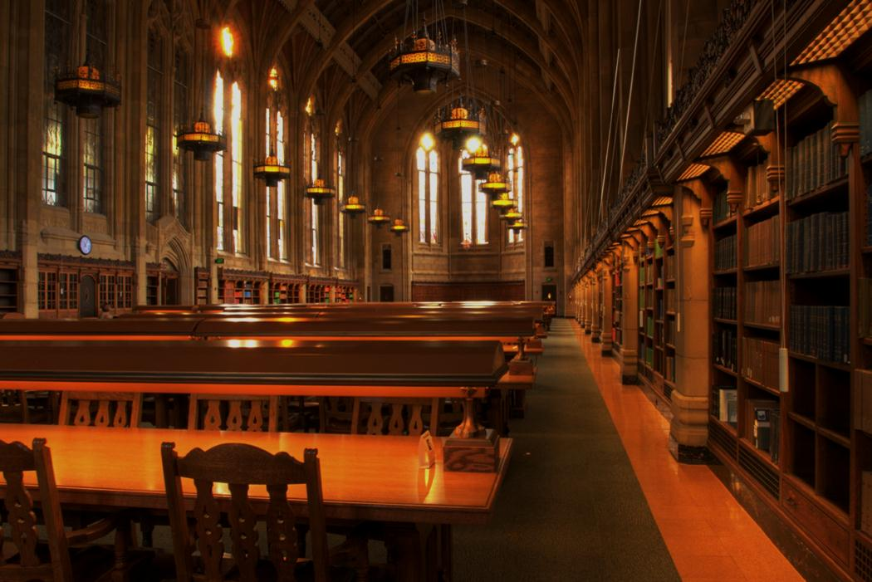
First Stop: The Library
Doing Secondary
Source Research
Sean Lanksbury
Washington State Library
PNW & Special Collections Librarian
sean.lanksbury@sos.wa.gov

Slide 18
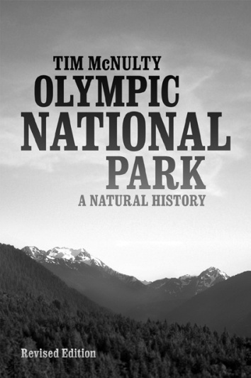
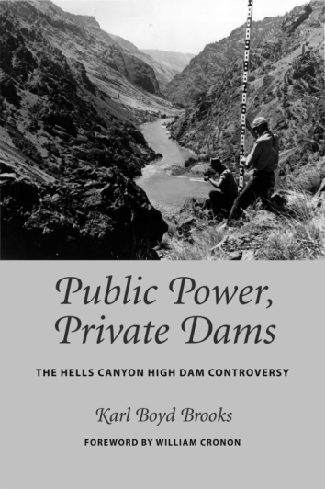
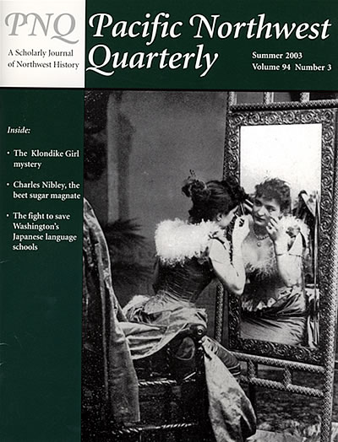
Secondary Sources
What are they?
Notes:
Histories, Biographies, Encyclopedias, Periodicals (written after an event), Newspapers (written after an event), Theses, Dissertations

Slide 19
Why start your research with secondary sources:
Notes:
Introduction to a topic, historical/broader context, historical analysis and interpretation, information about primary resources

Slide 20
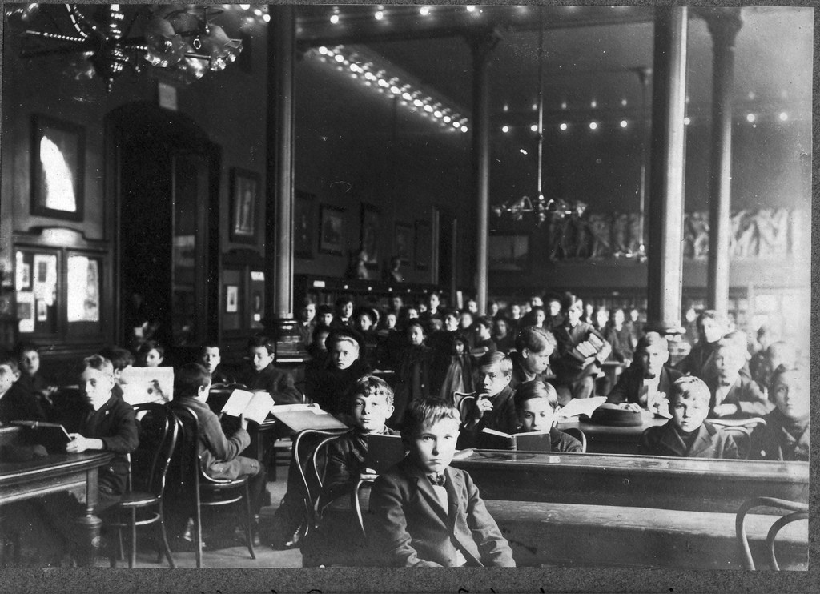
Strategies for Researchers
Notes:
Let’s talk about a few things that can help you with your research, ways to begin and some strategies on engaging the materials.

Slide 21
Active Reading Strategies:
Suggested Strategies:
STAMP
3 R’s: Read, Record, Recite
SQ3R
Notes:
Active reading strategies. There are many out there. They all have the same idea, to get you to engage with the material, previewing, reading, reviewing and thinking critically about what you have read. Let’s go over a few of these strategies

Slide 22
Active Reading Strategies for Researchers:
S – T – A – M – P
Structure
Thesis
Argument
Motives
Primaries
Adapted from “How to Read a Secondary Source”
by Patrick Rael, Bowdoin College
Notes:
S – how has the author structured the work, how do they make their case, how would you outline it
T – Identify the Thesis – or in the case of a book , how can I sum up what the author is saying in one to two sentences?
A – evaluate and analyze the argument, is the reasoning valid?
M – define context(s) and biases – why was this written, why would the author argue this?
P – use and strength of primary sources

Slide 23
Active Reading Strategies for Researchers:
3 Rs
Read: read and re-read!
Record: take notes, look-up unknown words
Recite: recite key ideas, words, and concepts

Slide 24
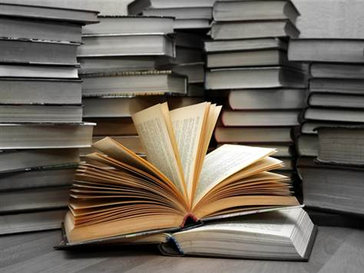
Active Reading Strategies for Researchers:
SQ3R
Notes:
Survey – skim headings, topic sentences, and end summaries
Question – what do already know about the topic? Turn titles and headings into questions
3R – READ - engage the material as you read, RECALL - (mentally visualize, or physically sketch into your own works key ideas, topics, concepts without looking at the material, REVIEW – check how well you recalled the material, tell the material to someone else

Slide 25
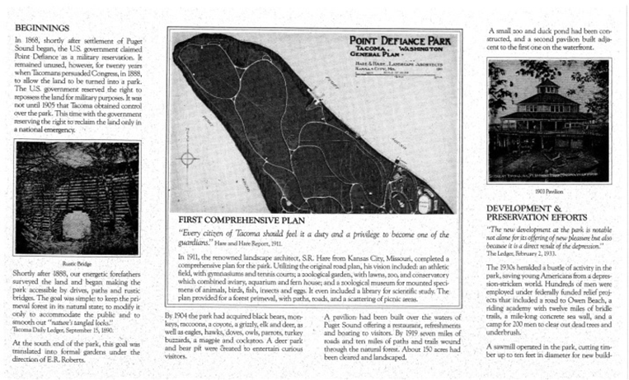
Active Reading Strategies in Action!
What is it?
What does it tell me?
What else do I need to find out?
Notes:
“The Forest in the City” Pamphlet 1990
What is the author’s thesis? The argument? How does the author structure the argument? Why might the author have written this work?
How does it connect to other resources? How are primary sources used to support the argument?

Slide 26
Where are they?
How to locate secondary sources:
Notes:
Library Catalogs, books, newspapers, periodicals, online resources, commercial databases, uncataloged resources

Slide 27
Finding Secondary Sources
Strategies for Researchers
Maximize your secondary sources
Diversify your secondary sources
Use library & online resources and ask a librarian for assistance
Notes:
It is always best to consult a few secondary sources on your topic, it is even better if you can choose different types, books, journals, theses, dissertations, local histories

Slide 28
Library Catalogs
Washington State Library http://www.sos.wa.gov/library/catalog.aspx
Seattle Public Library http://www.spl.org
University of Washington Libraries http://www.lib.washington.edu/
Reader’s Guide to Periodical Literature After 1983: http://www.hwwilson.com/Databases/Readersg.htm 1890-1982: http://www.hwwilson.com/Databases/rdgretro.cfm

Slide 29
WorldCat
http://www.worldcat.org/advancedsearch
Notes:
Catalog itemized the collections of more than 10,000 libraries. Created in 1971 it will let you search many libraries at once and locate it in the library closest to you. Not only books, but music, videos, research articles, digital items, some may be available for viewing or downloading

Slide 30
Bibliographies
Published Bibliographies Example:
Reporting the Pacific Northwest : an annotated bibliography of journalism history in Oregon and Washington / by Floyd J. McKay (Portland, Or. : Oregon Historical Society Press)

Slide 31
Online Resources
Search Engines (use Advanced Search options)
Google scholar, maps, images
Wikipedia

Slide 32
What should I know when I am done
with my secondary source research?
The Story
Historical Context
Historical Significance
Where to find primary sources
Notes:
Who What When Where How Why
Historical Context – before, during, and after
Historical Significance – why should we care, how does this affect us today

Slide 33
Sean Lanksbury
PNW & Special Collections Librarian
sean.lanksbury@sos.wa.gov
Washington State Library
6880 Capitol Blvd SE,
Tumwater, WA 98501
(360) 704-5200
https://www.sos.wa.gov/library/
Notes:
Sean Lanksbury
Washington State Library
PNW & Special Collections Librarian
sean.lanksbury@sos.wa.gov

Slide 34
Break!

Slide 35
Primary Sources
What are they?
Firsthand accounts
Personal Connections
Evidence
Original fundamental and authoritative documents

Slide 36
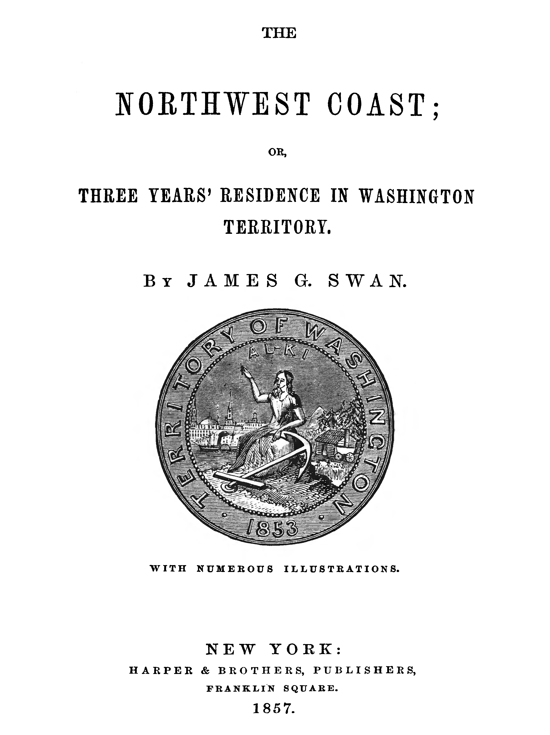
Books, Magazines, Newspapers
What????
If they are contemporary to the event

Slide 37
Where to Find
Washington State Library
University of Washington
Timberland Regional Library
Seattle Public Library
Tacoma Public Library
Washington State University Libraries, Northwest History Database

Slide 38
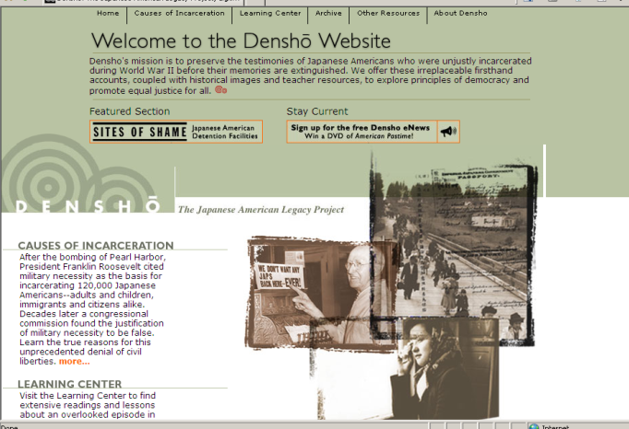
Oral Histories

Slide 39
Oral histories

Slide 40
http://www.digitalarchives.wa.gov/

Slide 41
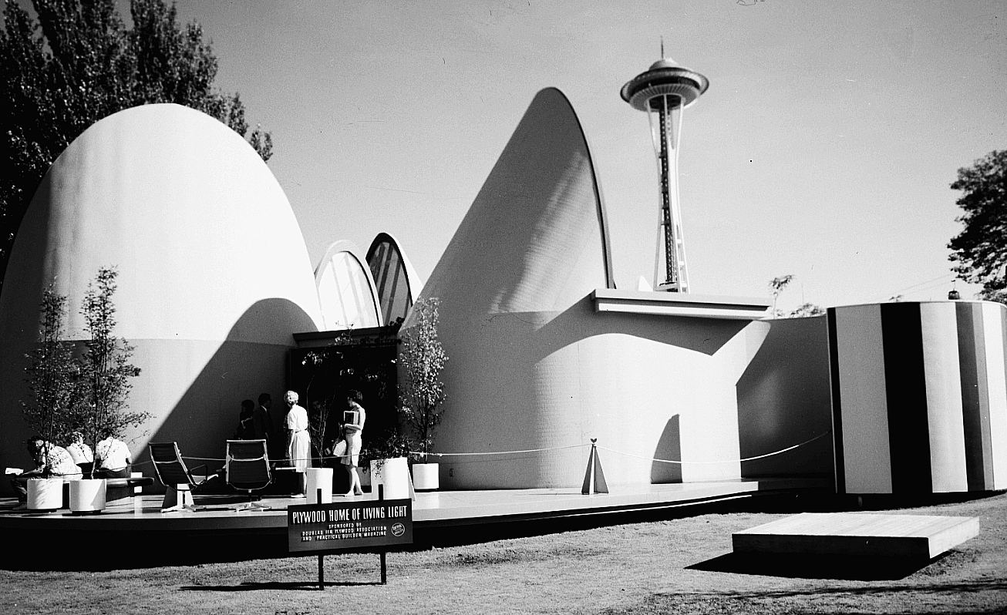
Artifacts: Buildings,
Tombstones, Clothing

Slide 42
Where are they?
Primary archives are found in archives
What does the word archives mean?
The historical files/records in a collection
The building or repository
The organization, program or agency

Slide 43
Types of Archives
Government Archives
Institutional Archives
Corporate Archives
Special Collections and Manuscript Repositories

Slide 44
How to get started
Focus your research goals and search for an archival repository that holds the collections you need.

Slide 45
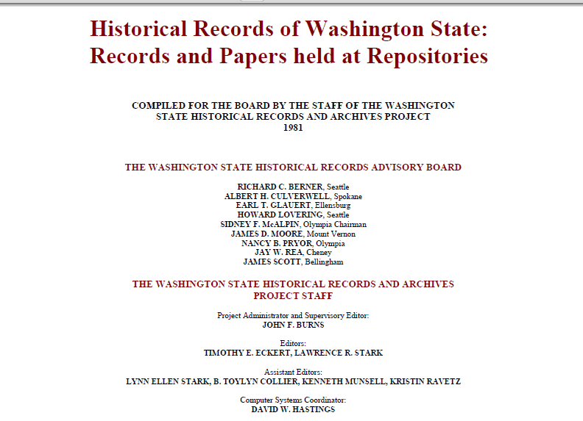
Washington State Survey
https://www.sos.wa.gov/_assets/archives/wasrab.pdf

Slide 46
Online Guides to Archival Collections
History Day

Slide 47
How do I find what I really need?
Ask an archivist!
Primary source research begins with conversations
between the researcher and archivists.

Slide 48
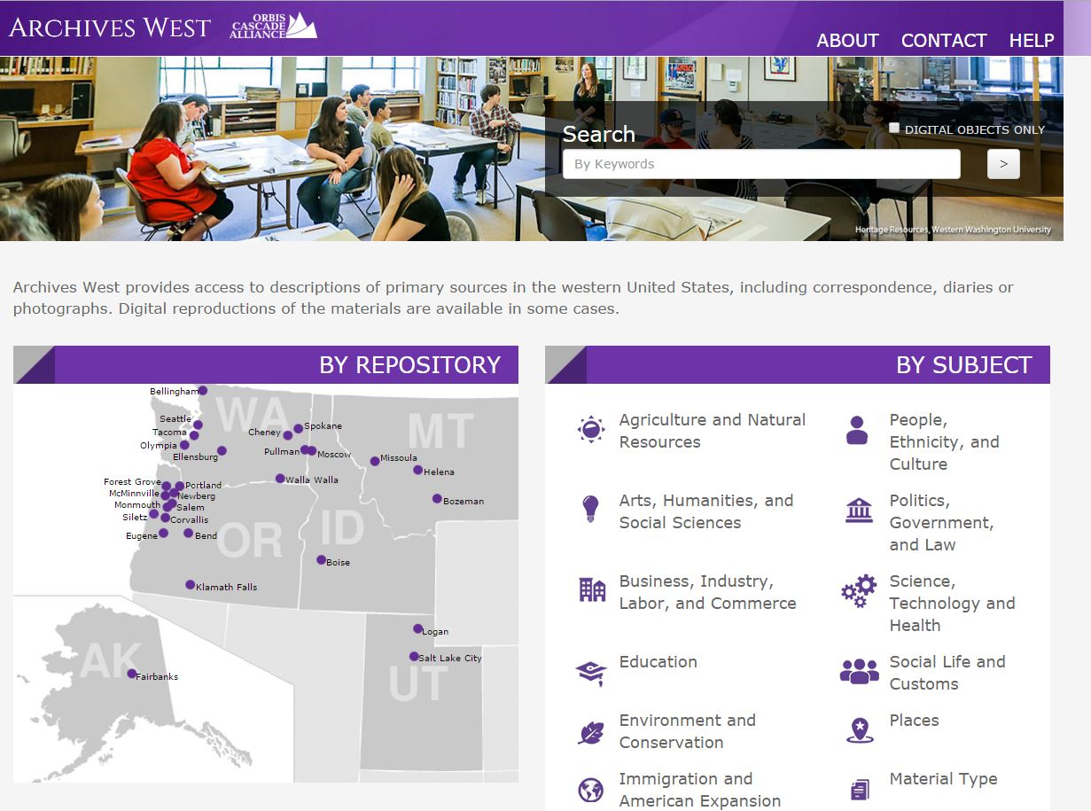
Finding Aids

Slide 49
Using Primary Sources
Ask the questions
What, Who, When, Where, How, Why

Slide 50
What?
What does it tell me?
Was it meant to inform or persuade?
What is the creator’s point of view?
How does my point of view affect the way I look at the information the source provides?

Slide 51
What?
Does it support the interpretation provided by my secondary sources?
How does it compare with the information provided by other sources?
Is it reliable?
Is it credible?
Notes:
Mason County Assessor – Timber Cruise – 27-23N-3W

Slide 52
Using a Primary Source
Survey
Question
Read and RE-READ
Record
Recite
Recall
Review

Slide 55
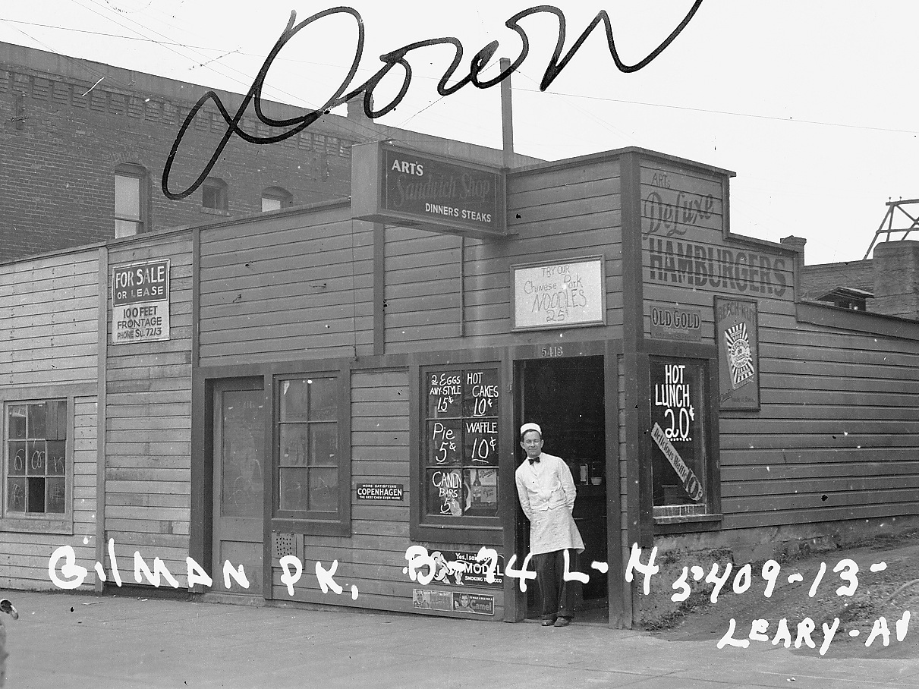
Notes:
Corporations and Trademarks

Slide 56
Map – Seattle Worlds Fair
Notes:
Apple County Tours LLC

Slide 58
Cite your Sources
Primary source citations should include:
Type of document
Name of creator
Date
Collection or record group
Office of record or subgroup
Volume and page
Repository

Slide 59
Research Etiquette
Contact the Repository ahead of time
Comply with all rules posted
Never remove research materials
Many records are fragile
Use pencils

Slide 60
Break!

Slide 61
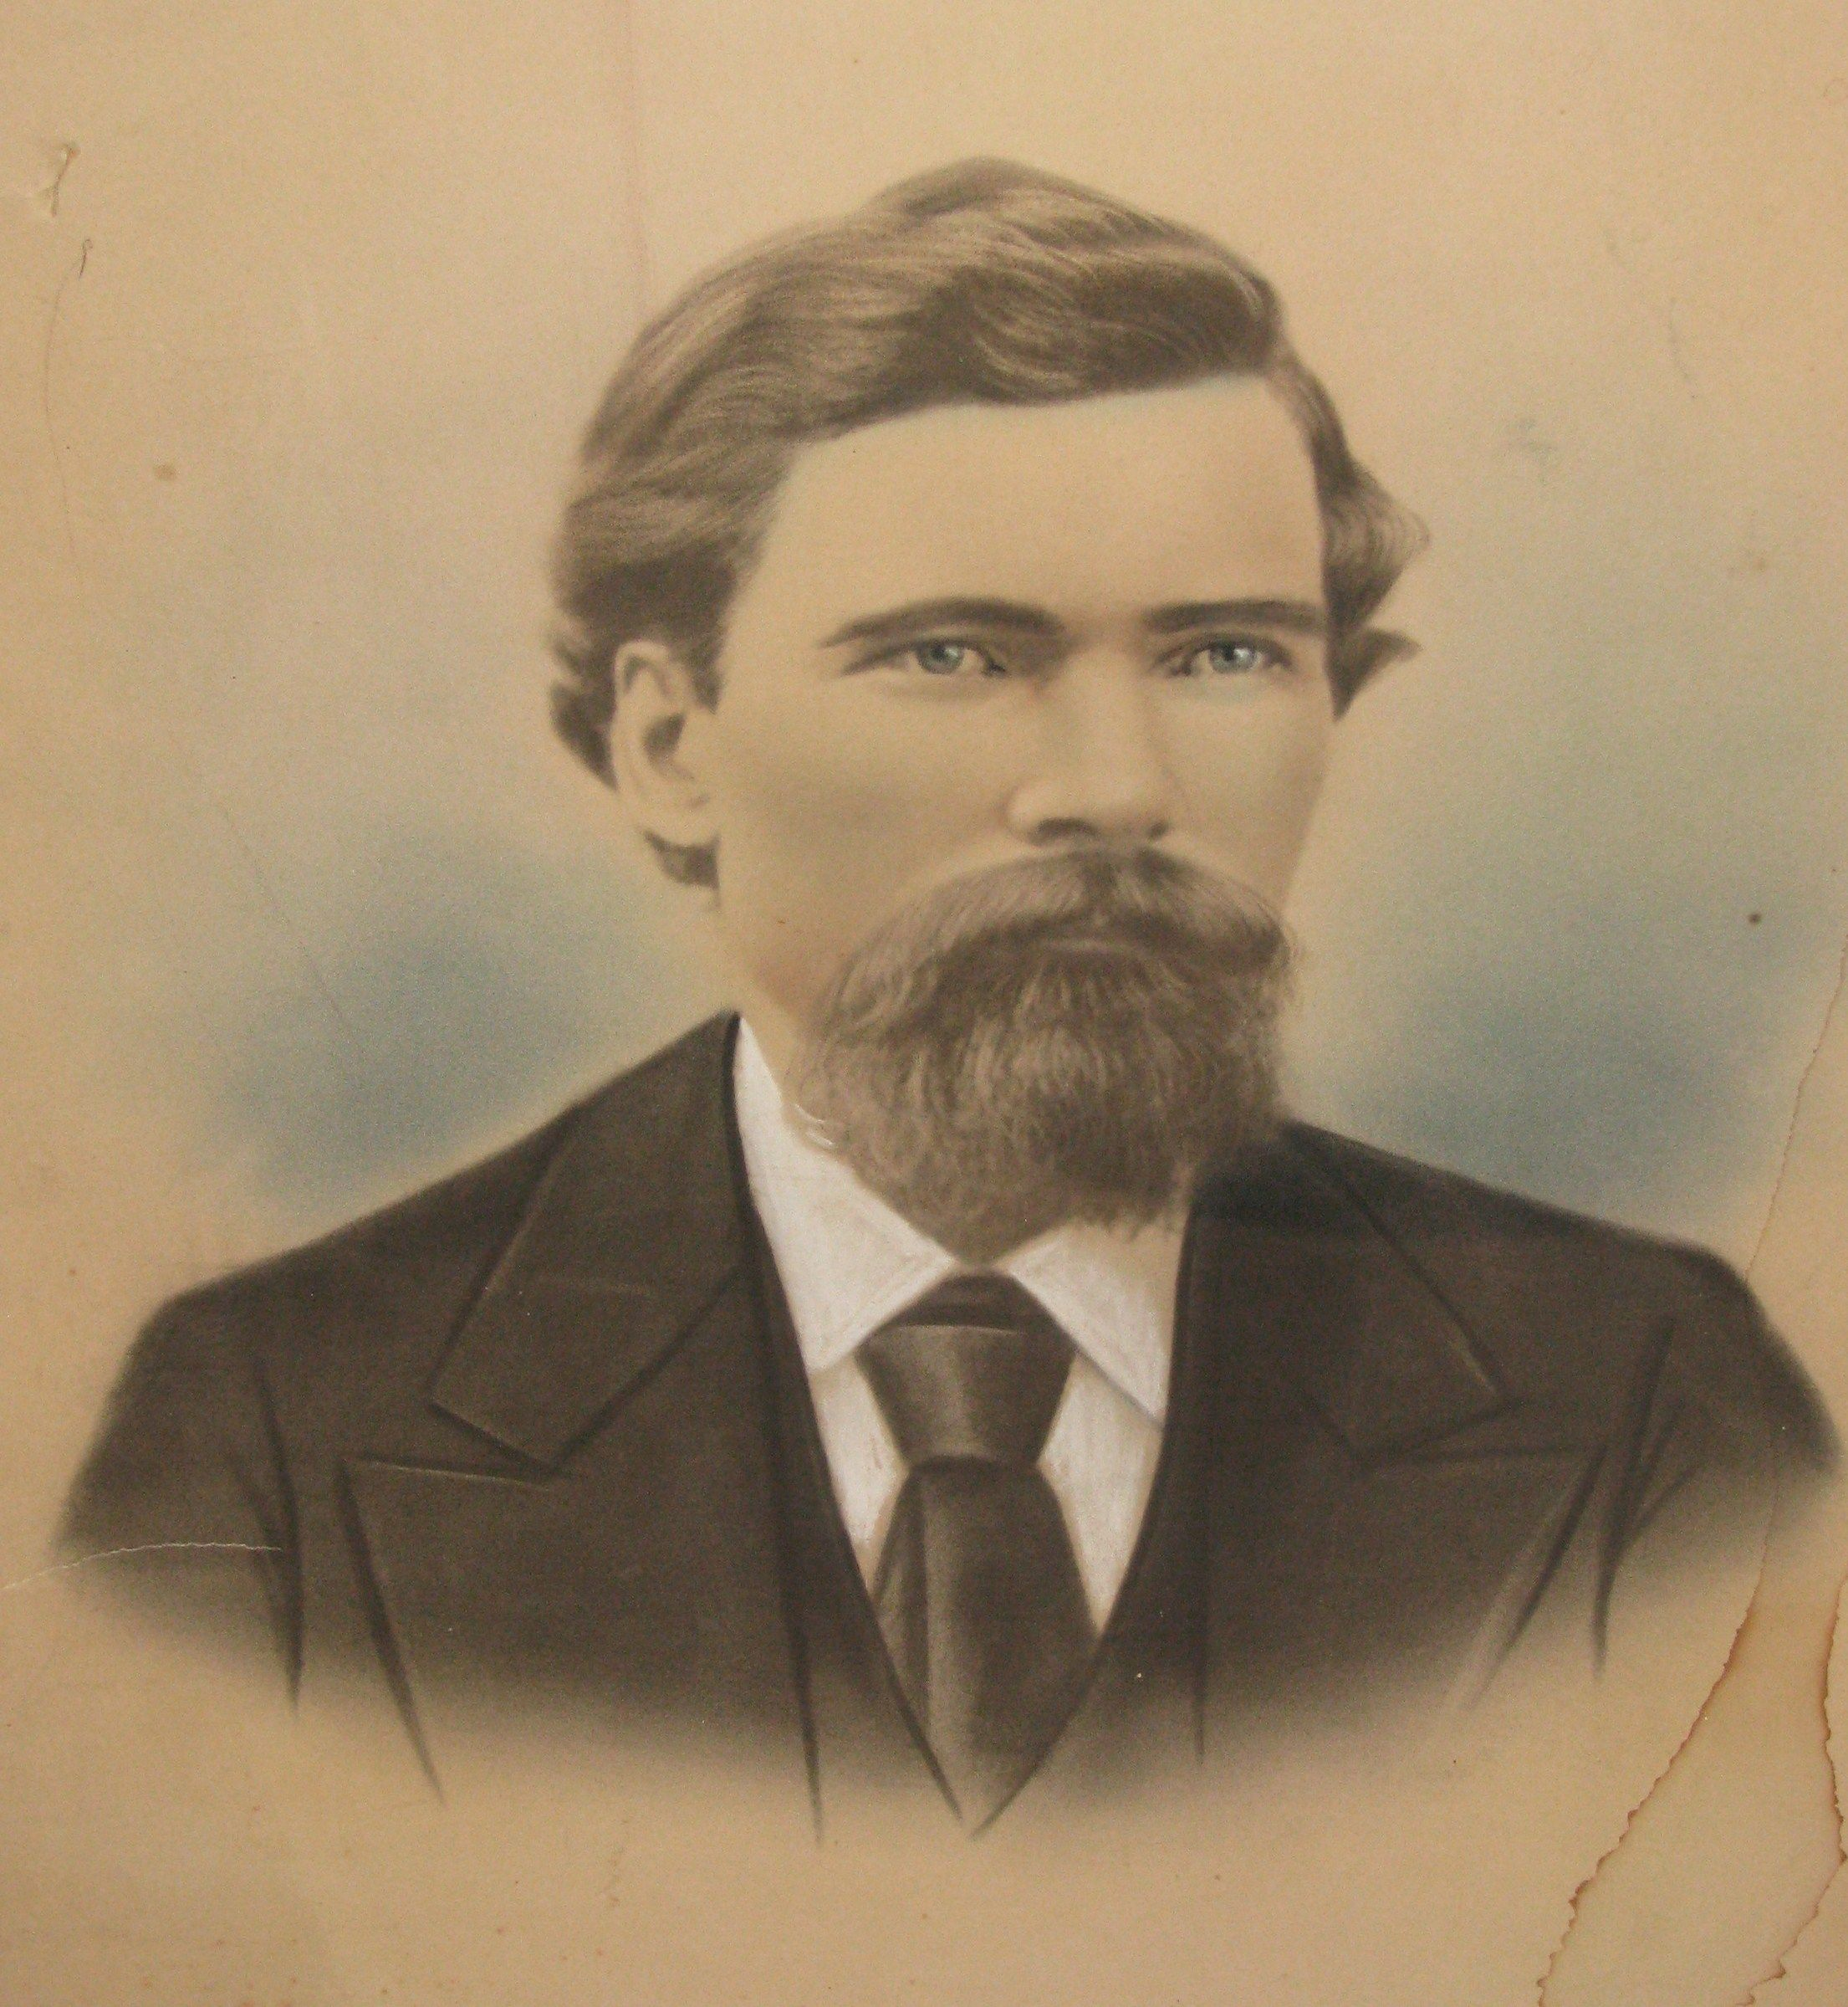
Notes:
In the spring of 1888, Patrick Murphy, a farmer from New Brunswick, Canada, settled in the Satsop River Valley near Montesano.

Slide 62
Notes:
Soon After his arrival, Patrick bought roughly 80 acres of rich loam soil on the banks of the Chehalis River. Over the next twenty-four years, Patrick would buy several more acres of property in the area, and…

Slide 63
Notes:
and build a house on what is today Brady Loop Road, four miles east of Montesano. At the time of his death in April of 1912, Patrick would own approximately 258.5 acres. According to his obituary, he died an “aged and greatly respected rancher”, and left all of his property, including “30 cows, 12 yearling heifers, 12 calves, 1 bull, 3 hogs, 15 pigs, 2 dozen chickens, and $150 dollars’ worth of household goods” to his wife Mary Murphy.

Slide 64
THE MURPHY’S OF MONTESANO
A Case Study
Maggie Cogswell
SWBranchArchives@sos.wa.gov
(360) 753-1684
Notes:
Back in July of 2015, Roxanne Lowe, great grand-daughter of Patrick Murphy responded to an ad I put out in the June 2015 newsletter and was hoping I could help her find out more about her families property in Grays Harbor County, where she and her mother still live. More specifically, Roxanne wanted to know how much land her grandfather acquired during his life, how it was broken up after his death, and why did the first house burn down? For this case study, I’m going to be using the experience I had researching Patrick Murphy to explain in detail my process for answering some of Roxanne’s questions.

Slide 65
RESEARCH GOALS
Trace ownership
Map out property
Learn about family
Notes:
In order to answer Roxanne's questions, my goals, in summary, were to trace ownership of the land from Patrick all the way to Roxanne’s mother Patricia; map out the property using deeds and tax records to get a visual on the land and Patrick's holdings; and finally, to use genealogical resources to find out about why the house burned down, and also to learn about the family that lived there.

Slide 66
GETTING ORGANIZED
Gather what you know
Start digging
Online Resources
Archival Resources
Map it out
Fill in the gaps
Notes:
When doing property research, or research of any kind really, it’s always best to start with what you know. In my preliminary correspondence with Roxanne, I learned that Patrick Murphy was a major landowner and farmer in Chehalis County (now Grays Harbor County).

Slide 67
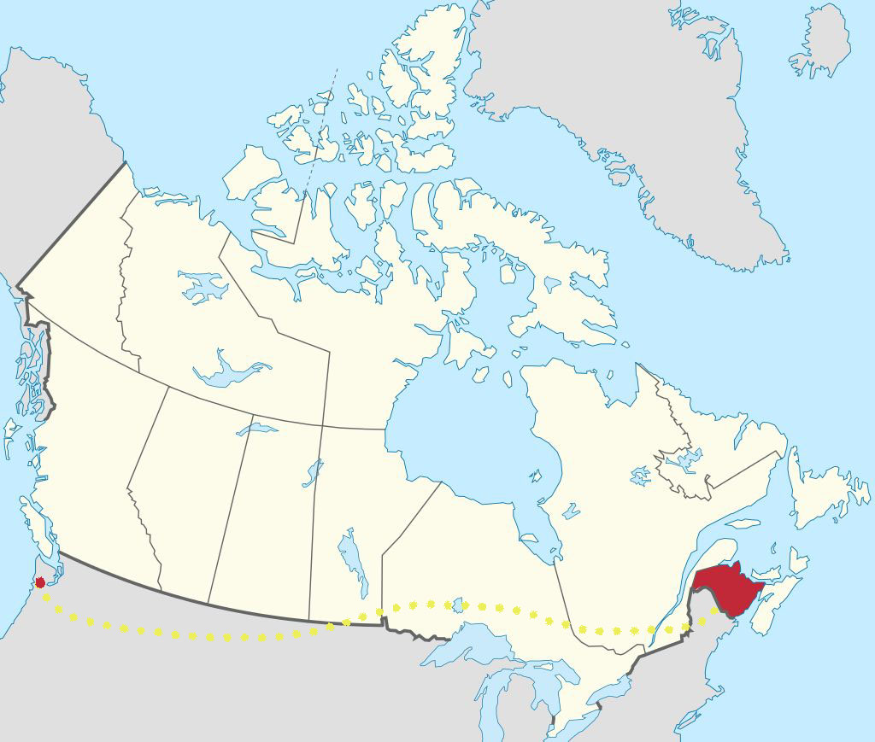
Notes:
He was born in New Brunswick, Canada, and moved to Chehalis County in the spring of 1888 with his wife Mary Murphy. Together they settled on a piece of property along the banks of the Chehalis River, and lived in a house that burnt down after Patrick’s death in 1912. A second home was built by the family soon after. This home is still standing today, but is no longer owned by the family. A portion of the original property that is still owned by the family, is occupied by Roxanne’s mother, Patricia, granddaughter of Patrick Murphy, and daughter of Daniel and Josephine Murphy.

Slide 68
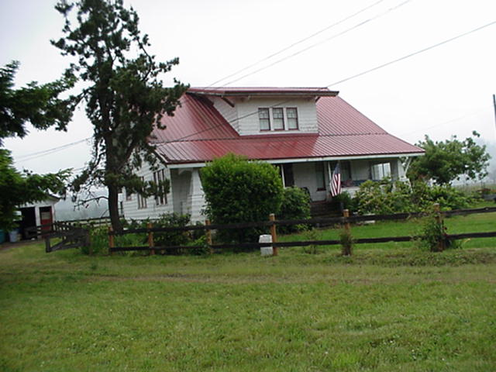
Notes:
Photograph of second house from the Grays Harbor County assessors website

Slide 69
GETTING ORGANIZED
Gather what you know
Start digging
Online Resources
Archival Resources
Map it out
Fill in the gaps
Notes:
After speaking with Roxanne, I started digging for information about the property and the murphy family online and here in the archives. When I felt as thought I had exhausted my immediate resources, I made a trip to Montesano to do some digging at the county assessors office. When I finished gathering as much documentation as I could find, I used maps and surveys to visually map out the Murphy property. And lastly I filled in the gaps of information by going back online to see if there was anything more that I could learn about the murphy family that might help me paint a broader picture of who they were, and how they lived on the land.

Slide 70
TRACING OWNERSHIP
Online Resources
Assessors Website
Bureau of Land Management
Washington State Digital Archives
Genealogical Websites
Online Newspapers
Archived Resources
Washington State Archives – Southwest Branch
County Assessors Office
Notes:
In this section we are going to be covering a lot of ground! So have you’re note pads ready. First I’m going to be talking about the online resources that I used to learn about the property and the murphy family, and then I’m going to highlight the records I used from our collections here at the archives and at the Grays Harbor County assessors office.

Slide 71
Notes:
The best place to find current information on a home is from the County Assessors website. Like many Assessor websites in Washington, the Grays Harbor County website has a parcel search feature that can provide a variety of information on existing properties, including current owner, structures, including the year they were built, an abbreviated property description and a photograph.
In my correspondence with Roxanne, she gave me two current addresses for homes that were on the original parcels owned by her great grand-father Patrick Murphy. One of the homes, located on Monte-Brady Rd was inherited by Roxanne’s mother Patricia Ferbrache. The other property is currently owned by the Gonsalves Family. This property includes the second house that was built by the Murphy family after the first house burnt down in 1920.

Slide 72
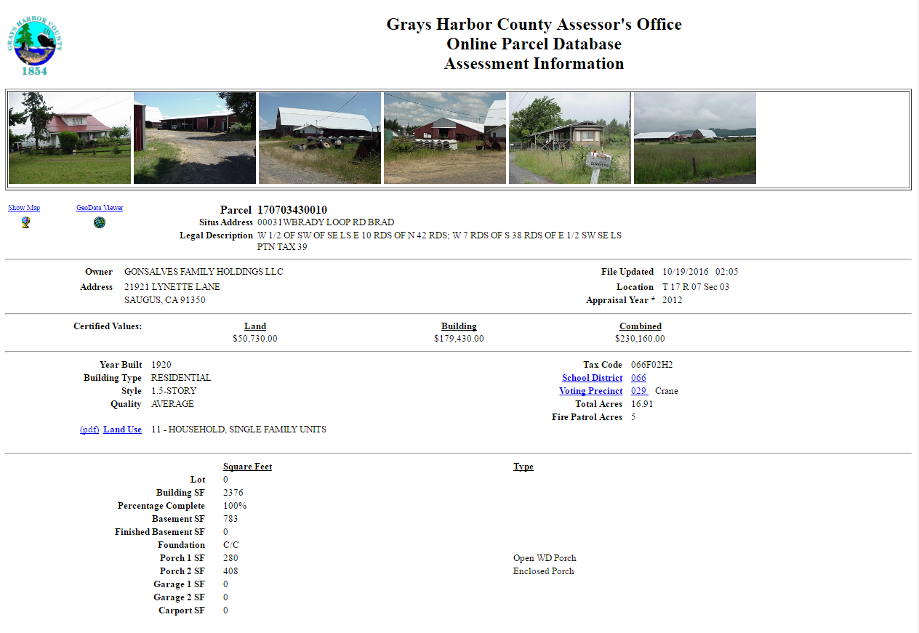
Notes:
Assessor page for 31 Brady Loop Rd in Montesano.

Slide 73
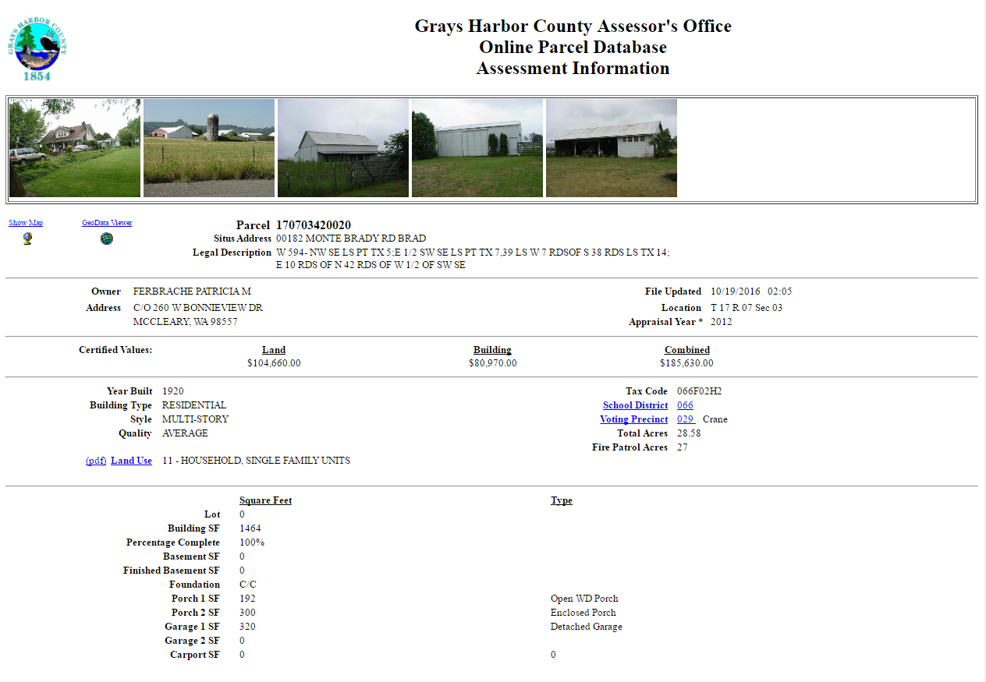
Notes:
Assessor page for 182 Monte Brady Rd

Slide 74
Notes:
The Bureau of Land Management(BLM), General Land Office (GLO) Records Automation web site provides live access to Federal land conveyance records for the Public Land States, including image access to more than five million Federal land title records issued between 1820 and the present. I went to this website initially, because I wanted to see if Patrick's holdings were obtained by the federal government. If he was issued a land patent to homestead in GH county by the federal government, a record of his patent would have showed up here. When I searched his name, nothing came up. This told me that Patrick must have bought his land from someone who was already living, and owned land in the area.
This meant that if I wanted to find out who he purchased his land from, I would need to go through the General Indexes from Grays Harbor County.

Slide 75
Notes:
With the property descriptions I obtained from the assessors website I went onto our website, the Washington State Digital Archives, to see if I could find any early maps or surveys of the area. I was hoping to find one with his name listed on it, but I did not. Even still, the survey that I did find from 1883 came in handy later in my research when I needed to map out the families property.

Slide 76
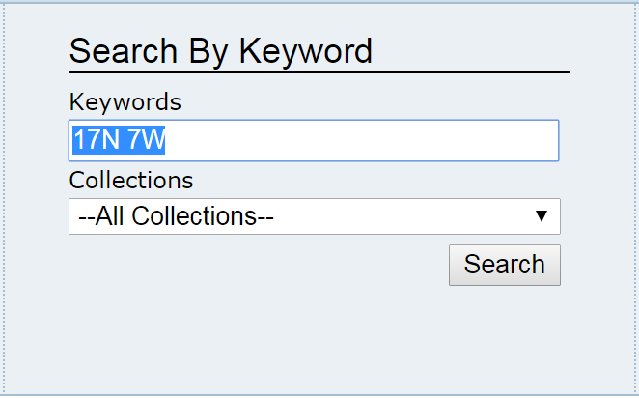
Notes:
You can search for survey maps on the DA by typing in the township and range into the keywords search field on the main page like so…

Slide 77
Notes:
When you hit search, a list of record series matching your search terms will come up. The record what we’re interested, and that I was looking for, can be found under the title “Natural Resources, Department of, Survey Plats of Washington, 1852-1980”

Slide 78
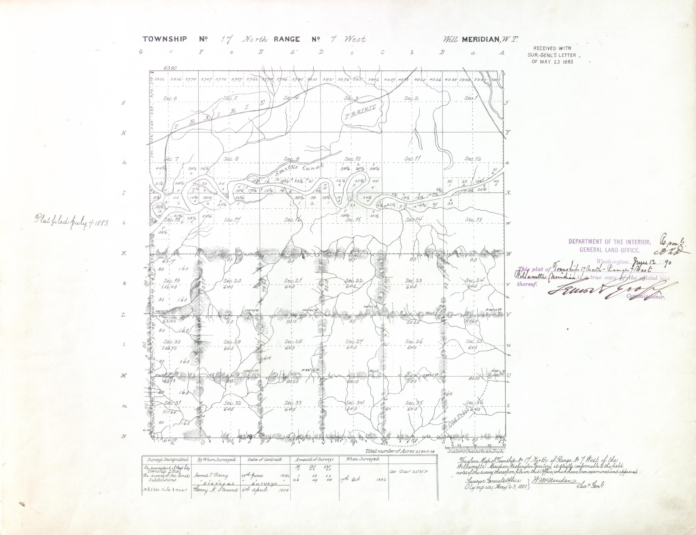
Notes:
This collection of maps was donated to the archives by the Washington State Department of Natural Resources. These survey/plat maps were created by the Surveyor General of Oregon from 1852 to 1854, the Surveyor General of Washington from 1854 to 1925, the General Land Office from 1925 to 1944, and the Bureau of Land Management from 1946 to 1980, and like many survey maps these drawings indicate various types of natural and man-made features, and If an individual was homesteading in the area at the time the survey was being conducted, surveyors would often include the boundaries of the homestead in their drawings.

Slide 79
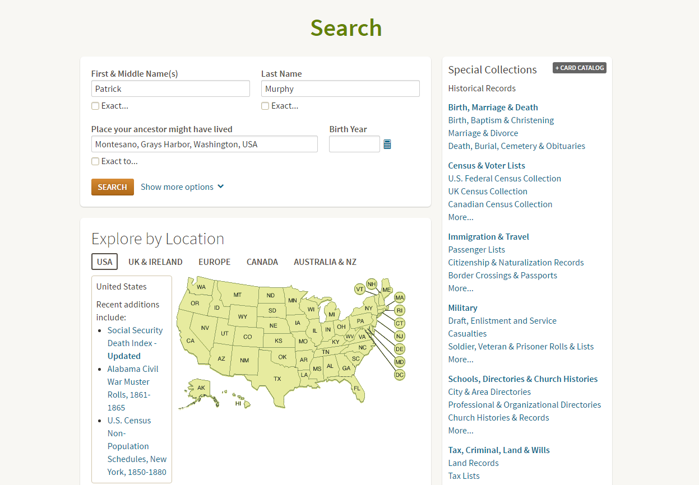
Notes:
Next, I wanted to see what I could find online about Patrick Murphy himself, so I went online to ancestry.com and familysearch.org. When I typed in “Patrick Murphy” and “Montesano” into the search boxes on ancestry I did get several hits for records. Including links to a probate and will, as well as some city directories.

Slide 80
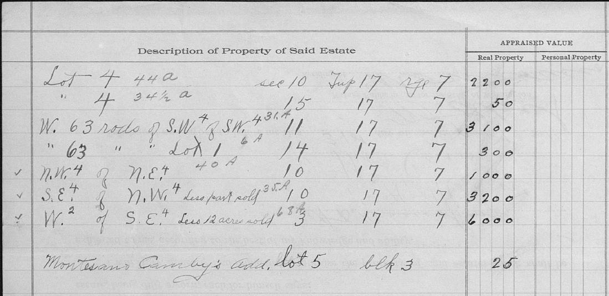
Notes:
The probate record was an especially great find because it included a complete list of Patrick’s real property at the time of his death. This list provided me with property descriptions that I could then take to the general indexes to trace the ownership of his land after his death.

Slide 81
Notes:
I performed a similar search on familysearch.org, and came up with a death certificate and census record from 1900. Both records came in handy later in my research when I was tracing ownership of the land after Patrick's death because they listed the names of all of his children, who would later buy portions of the land from their mother Mary.

Slide 82
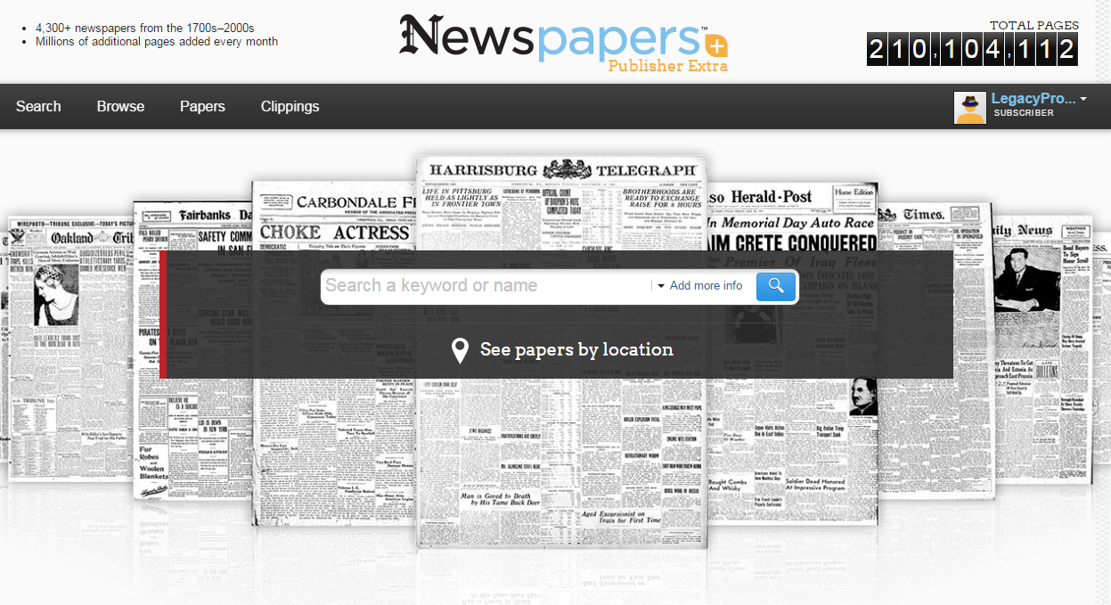
Newspapers.com
Notes:
Next I used Newspapers.com…

Slide 83
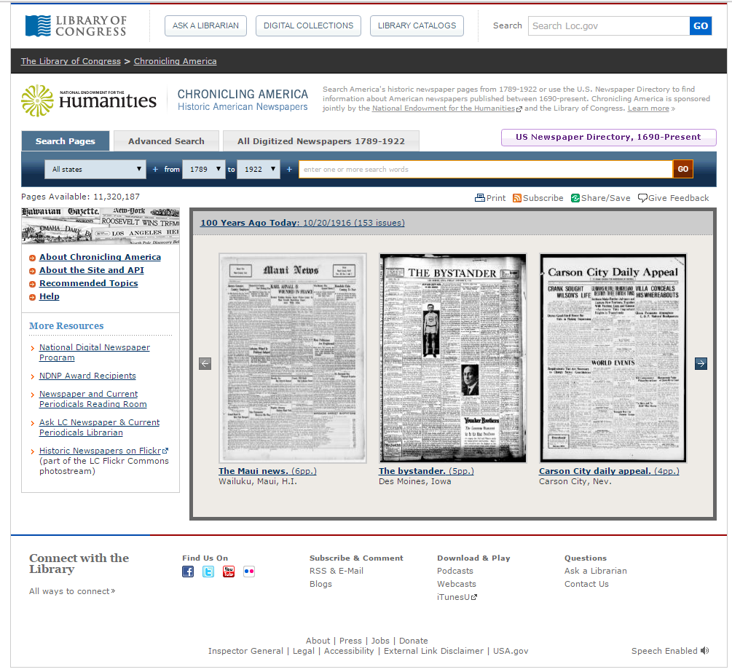
Notes:
And ChroniclingAmerica.loc.gov to find articles about Patrick Murphy and the Murphy family. Both websites had collections of newspapers from the Aberdeen Herald that provided me with Patricks obituary…

Slide 84
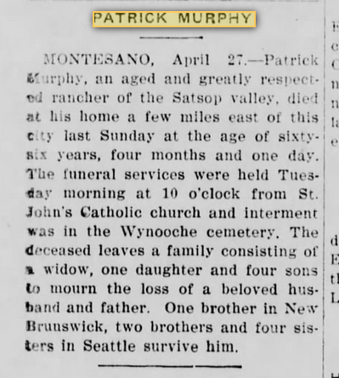
Notes:
And several other articles, including two about an injury that Patrick sustained to his leg, and three about the Murphy Brothers and their prize winning dairy cows.

Slide 85
Archived Resources
County Auditor Office
General Indexes
State Archives
Deeds
Maps and Surveys
Log and Cattle Brands
Other
Tax Assessor Rolls
Assessor Field Books
Notes:
When I was finished with my online search, and felt as though I had exhausted all possible avenues in that area, I travelled west from Olympia, to Montesano, to look through the general indexes at the county auditor’s office. In a small corner of the office I spent several hours tracing the ownership of the Murphy family property from Patrick, to his wife, and eventually to three of their sons, Daniel, John P. and Thomas F. Following multiple lines of property, I learned that Patrick’s original holdings were partly divided, and partly shared by his sons and their wives, and eventually occupied by their children. Over the years, portions of the property were added to and subtracted from by sale or loss.

Slide 86
Notes:
If you’re not familiar with General Indexes, they are a direct and reverse indexes to filings in the auditor's office. These indexes may include references to the following transactions: deeds, mortgages, patents, lis pendens, leases, bills of sale, conditional sales, chattel mortgages, mining claims, power of attorney and articles of incorporation.
When I went through the indexes for this particular project I was really only looking for deed transactions, but in the process a stumbled across a cemetery plot purchase made by Patrick in the Wynoochee Cemetery where he is now buried.
When using the General Indexes, the most important information to write down are the names of the grantor and grantee, also known as the buyer and the seller, the date the document was recorded, the nature of the instrument, whether that’s a deed or a mortgage or a mining claim, the volume and page number where the document is recorded and the property description if there is one.

Slide 87
Property Descriptions
Notes:
When I got back to the archives from Montesano I pulled all of the deed volumes that I had found in the indexes and started tracing the ownership of the family property. If you own a home you should be familiar with deed records, if not, it is a record issued for the conveyance of title to real property, showing names of grantor and grantee, date of filing, instrument number, location and legal description of property. If the buyers paid in cash, and did not obtain a mortgage for the property, it will sometimes show how much was paid.
Legal descriptions, if you’re not familiar, are a way to define or accurately pinpoint where a particular piece of property is located. Some legal descriptions are very simple and involve a lot and a block and a subdivision or plat name. But others, especially when you’re dealing with rural properties like the ones I was researching here in GH are more complex…For example, in this particular deed the legal description starts out… Commencing at the Northwest corner of the southwest quarter of the southwest quarter of section eleven, in township seventeen north of range seven west of the Willamette meridian.”

Slide 88
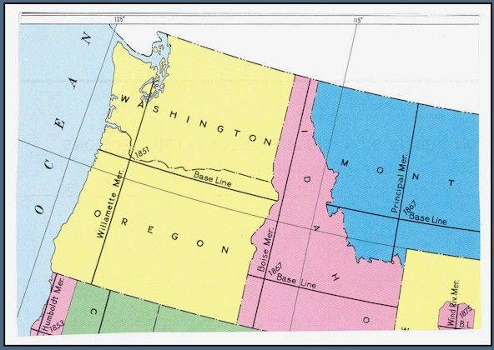
Notes:
The Willamette Meridian was the principal meridian from which land surveying in the Pacific Northwest west of the Cascades began. It ran north to Puget Sound and south to the California border, and the baseline was established running east to the Idaho border and west to the Pacific Ocean. From these surveyed lines, the lands of the Northwest were divided into townships six miles square beginning at the Willamette Base Line numbering north or south and given a range beginning at The Willamette Meridian numbering east and west. Each full township is divided into 36 sections of land 1 mile square which are numbered starting at the northeast corner of each.

Slide 89
Notes:
When searching for property by township and range we call this metes and bounds.
Metes and bounds is a surveying system where land is divided into sections, and each section is 640 acres. The legal description pinpoints the location of the subject property within its particular Township, Range and Section. There are 36 sections in each township and range. If you’re interested in learning more about the Public Land Survey System go to…

Slide 90
Notes:
So if we take the property descriptions from the deeds, and outline them on a survey map, we can clearly see where the boundaries of our properties are located.

Slide 91
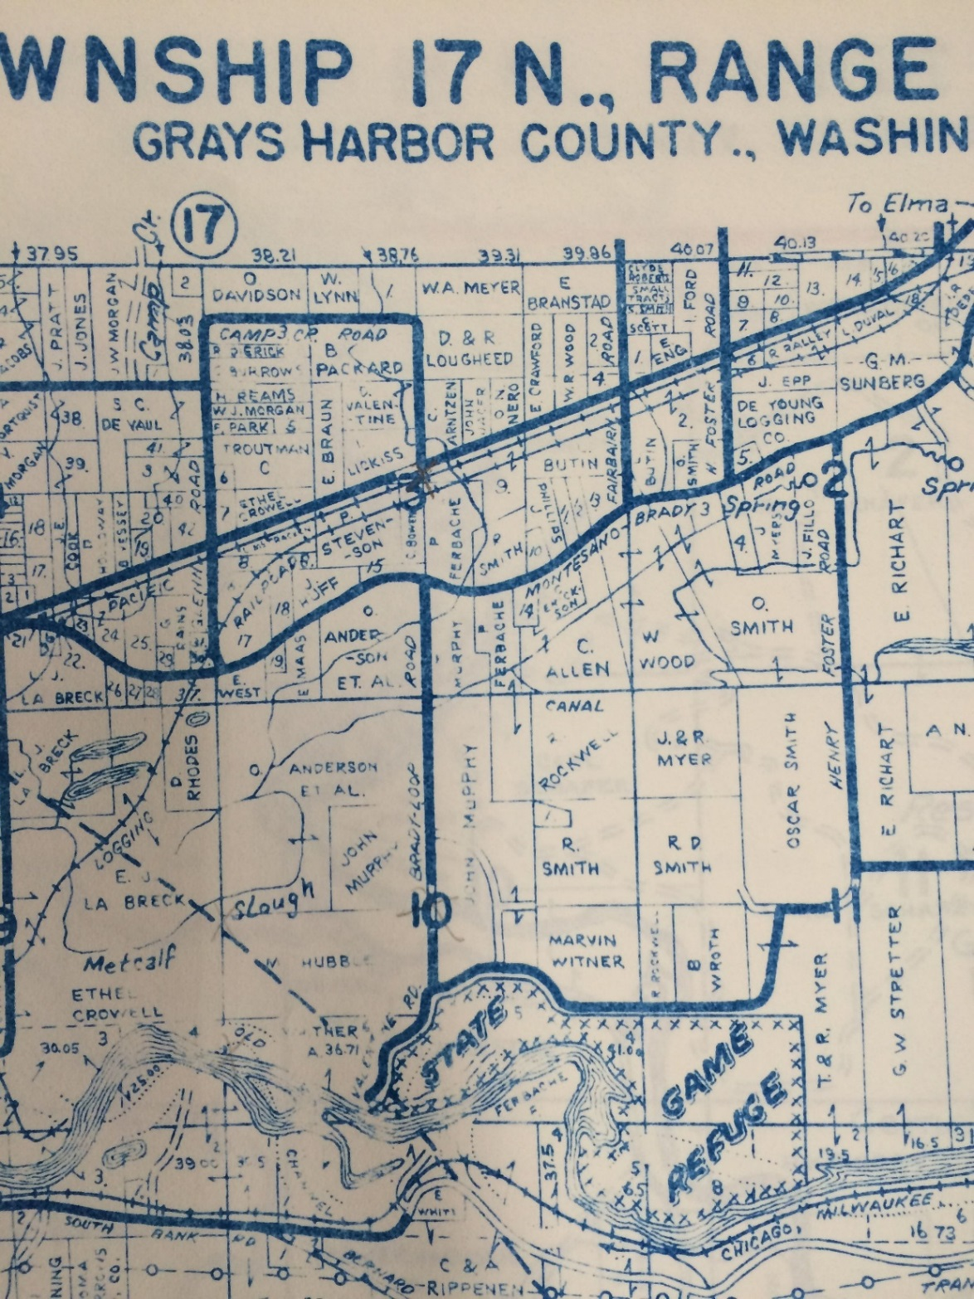
Metsker Maps
Notes:
A more modern map that we can also use for property research are metsker maps. Metsker Maps are especially great for research in rural areas because they often name individual owners within their parcel on the map. If we zoom in on the map above…

Slide 92
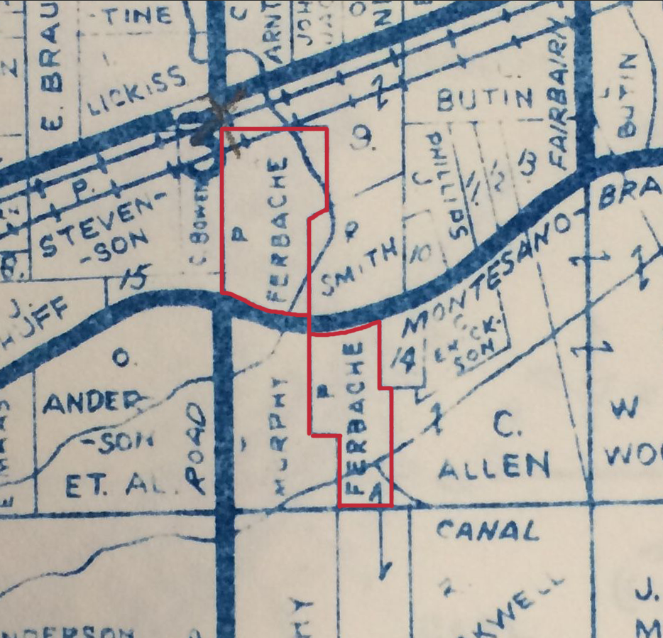
Notes:
…we can clearly see which portions of land Roxannes mother held in 1962.
Here at the archives we have Metsker Maps for Grays Harbor County from 1935, 1952 and 1962. Using these maps, I was able to see what portions of land were owned by individuals in the Murphy family all the way up to Roxanne’s mother, Patricia.

Slide 93
Timber Cruises
Notes:
The last map I’d like to show you today are the timber cruise survey maps. From my correspondence with Roxanne, I knew where the original house was located, but if you are not so lucky to have this kind of information, Timber Cruises can be a great resource. Timber Cruises were originally created to map out and estimate the amount of standing timber that a forest contains. The maps that the timber cruiser made, often include locations of structures that were there at the time, including houses and barns. In the timber cruise collection from Grays Harbor County, I was able to identify the Murphy Family home.

Slide 94
Tax Assessor Rolls
Notes:
To find out what year a home was built, assessment and tax rolls are the best option. Using the tax rolls it is possible to identify when a home was built by looking for “improvements” on a lot. Unfortunately for me, I was not able to find out when the Murphy home was built. Like many series in our collection here at the archives, there is a gap in information about the time period in which the Murphy home may have been built. But maybe you will have more luck than I did!

Slide 95
Notes:
Having traced the ownership of the property and mapped it out, I now needed to fill in the gaps of information that deeds and maps cannot give you. To find out more about the people who lived and worked the land, I went to online resources, newspapers, and documents in our own collection to learn more.

Slide 96
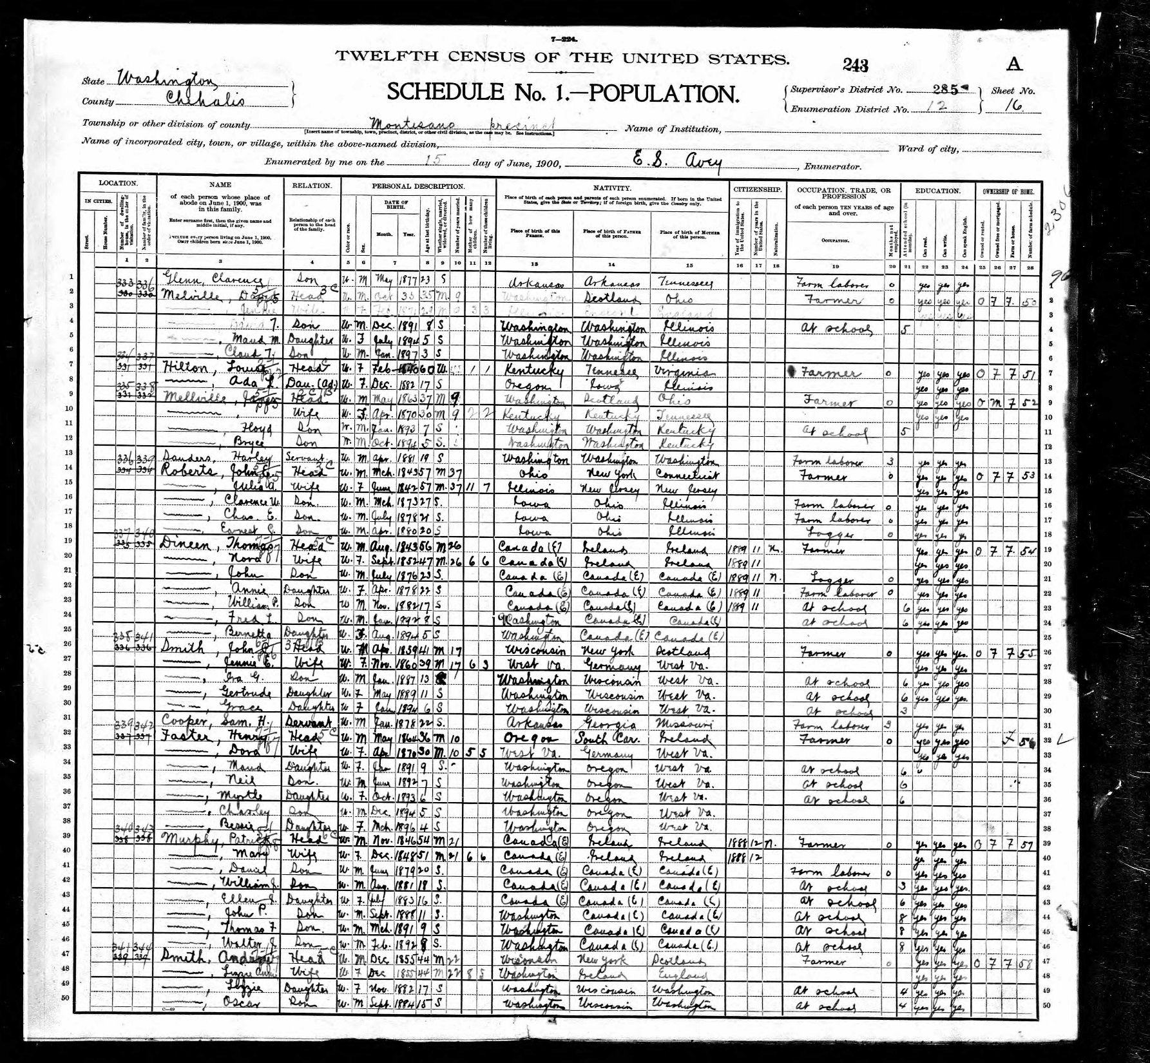
Notes:
Using online genealogical sites like Ancestry.com and FamilySearch.org, I was able to find information about the Murphy family in the city directories and census records. Through these records I was able to build Patrick’s family tree, and discovered that he was, a dairy farmer, and so too were his sons.

Slide 97
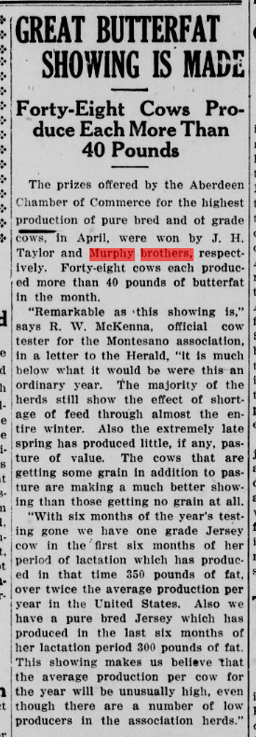
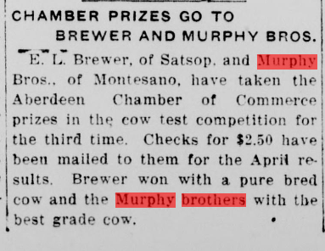
Notes:
In newspapers I found online, I learned about how the Murphy Brothers of Montesano had several prize winning cows, which in 1915 were “netting a bit more than $19 a month from sales of butter fat at 34 cents a pound!”

Slide 98
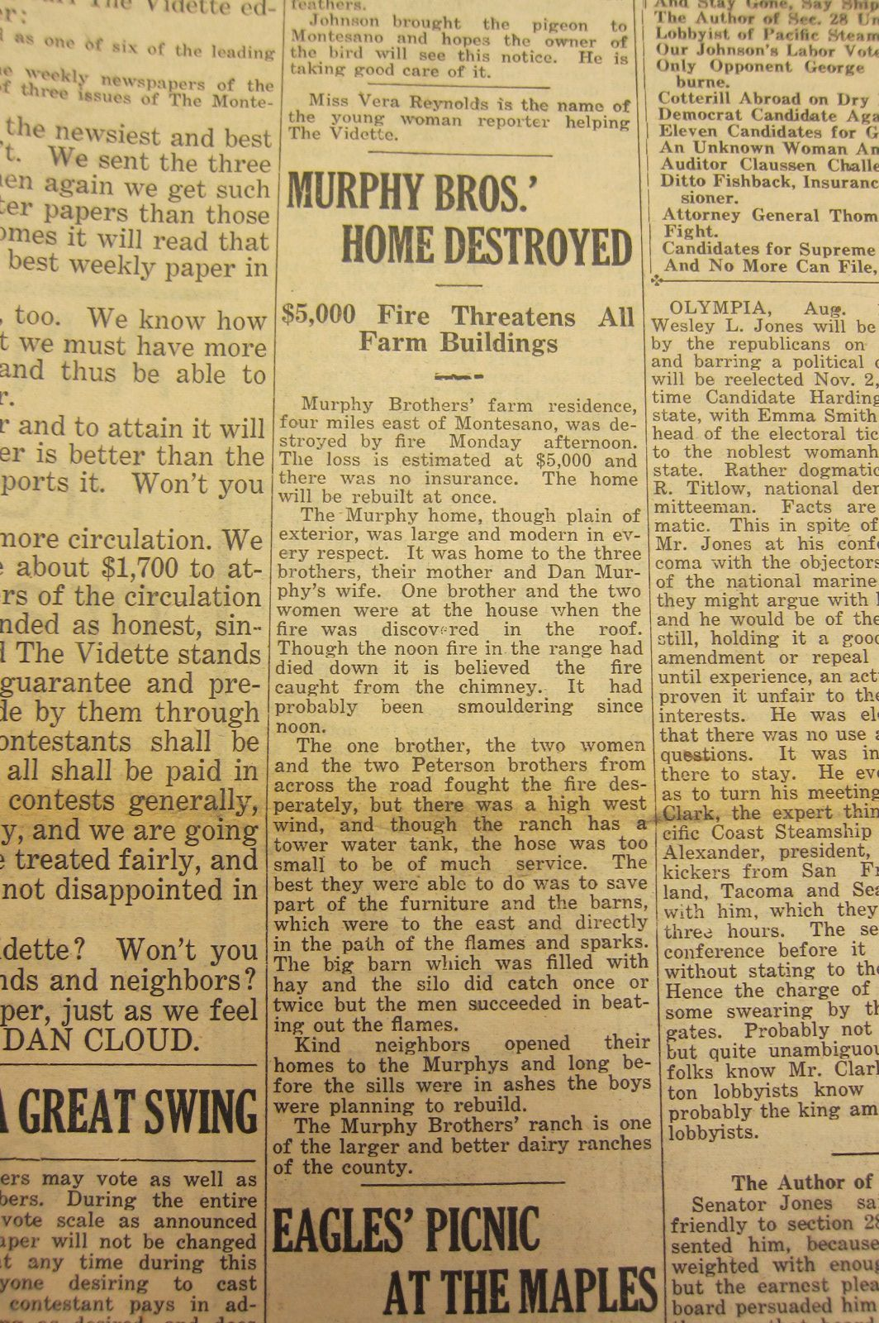
Notes:
With help from Roxanne, we also found an article in the Montesano Vidette from August 1920 about when the first house burnt down. In the summer of 1920, the home was destroyed by a fire that started from the chimney. According to the article “one brother…two women and the two Peterson brothers from across the road fought the fire desperately, but there was high west wind, and though the ranch has a tower water tank, the hose was too small to be of much service.” Despite this setback, the Murphy family rebuilt their family home on what is today Brady Loop Rd.

Slide 99
Notes:
Using records here at the archives, online and at local county offices I was able to trace the ownership of the Murphy families land and learn a little bit about the family in the process.

